Slide 1
Welcome to your registered manager network update
Ali Porteous

Slide 2

The state of the adult social care sector and workforce in England 2026: Launch event
Wednesday 14 October 2026 | 09:30 - 11:30 | Online
Join us as we mark the launch of our flagship report providing a comprehensive analysis of the adult social care workforce in England and the characteristics of the people working in it.
This will include a look at key sector trends including information about the registered manager workforce.
Register for the event: skillsforcare.org.uk/StateOfLaunchEvent
Notes:
Direct event link: https://www.skillsforcare.org.uk/news-and-events/Events/October/The-state-of-the-adult-social-care-sector-and-workforce-in-England-2026-Launch-event.aspx
Overview
Join us as we mark the launch of our flagship ‘The state of the adult social care sector and workforce in England 2026' report.
The report provides rich and valuable insights on the size and structure of the adult social care workforce, and key sector trends including recruitment and retention, workforce demographics, pay, training and qualifications, and future workforce forecasts.
At the launch event, we’ll share a comprehensive analysis of the adult social care workforce in England and the characteristics of the people working in it.
The report includes specific data about the total number of registered managers, and other data including the registered manager vacancy rate, demographic and training data.

Slide 3
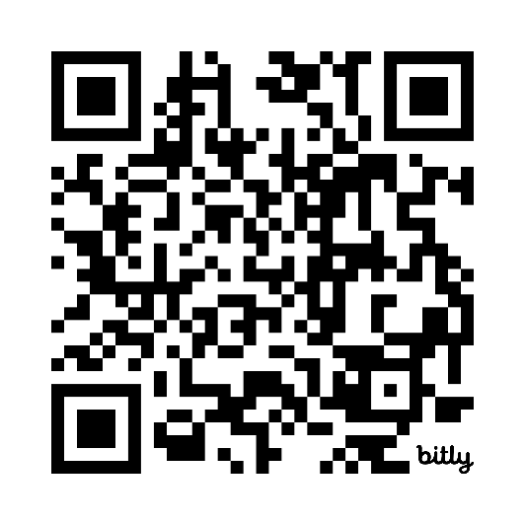
Adult Social Care Workforce Survey 2026
Tell it like it is.
You're balancing quality, workforce pressures, compliance, recruitment, retention and much more.
The Adult Social Care Workforce Survey is your opportunity to tell it like it is.
The survey covers the issues that affect working life in adult social care, including pay and financial security, wellbeing and workplace experiences, training and development, career opportunities and future plans.
Your experience matters.
Please allow time for, and encourage, your team to complete the survey to make sure their voices are heard too. Download our resource pack to help you.
Take the survey
www.ipsos.com/ASCWorkforceSurvey

Slide 4

The Adult Social Care Workforce Data Set
ASC-WDS is a free data collection service, commissioned and funded by the Department of Health and Social Care. It is the leading source of intelligence for the adult social care workforce. It helps you to manage your team and provides crucial information to decision makers.
Notes:
The Adult Social Care Workforce Data Set (ASC-WDS) is a data collection service, commissioned and funded by the Department of Health and Social Care. It is the leading source of intelligence for the adult social care workforce.
We know that the adult social care sector is complex and fragmented and made up of thousands of different care providers. And, we know that the people who work in the sector are absolutely vital in terms of providing high quality care and support. So, understanding that workforce is so important for planning and decision making across the sector- and that’s what we’re trying to do with ASC-WDS- to build that understanding.
It helps providers to manage their teams, can save you thousands of pounds, and also provides crucial information to key decision makers such as Government, DHSC, CQC and local authorities.

Slide 5
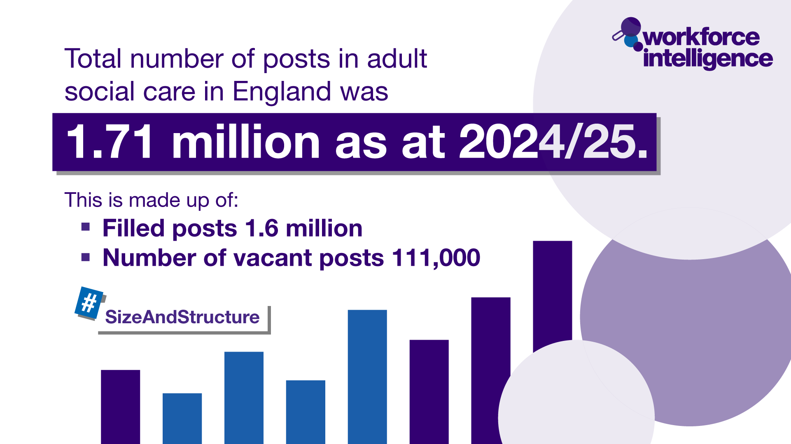

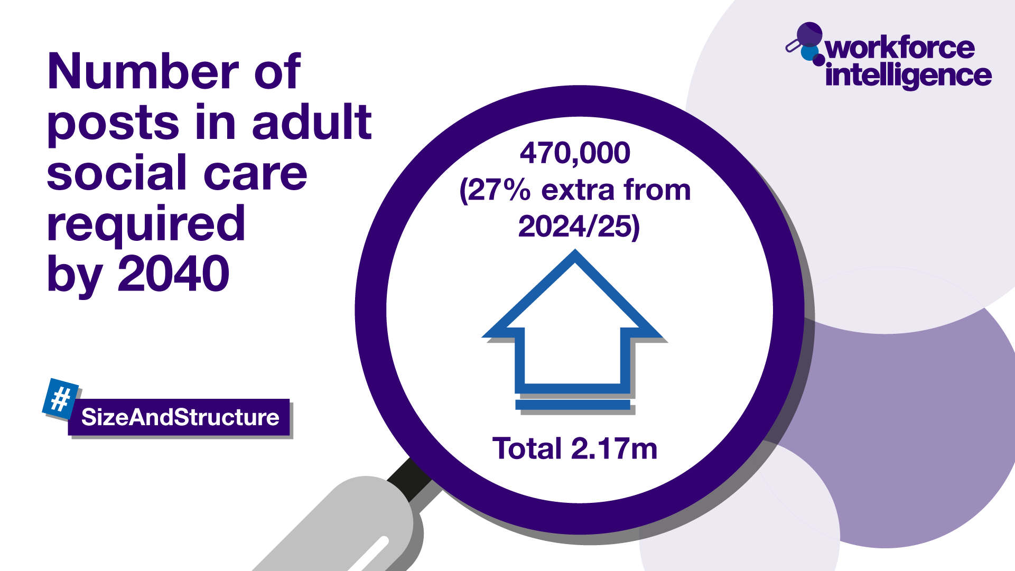










The Adult Social Care Workforce Data Set
Our crucial intelligence is used by:
Who we are regulated by:
Notes:
ASC-WDS means that all care providers can make their voice heard. Around 21,000 providers already have an account and are providing us with crucial information, including almost two thirds of all Outstanding rated providers.
The data from those providers tells us…
There are one point seven one million posts in ASC
That one point four seven million people work in ASC in England
In 2024/2025 the ASC vacancy rate was 7%. Returning to levels seen prior to COVID-19
It also tells us that we’ll need 470,000 more jobs by 2040 to keep up with an aging population
The data we collect is the leading source of intelligence for the adult social care workforce. It provides crucial information to decision makers such as government, the Department of Health and Social Care, the Care Quality Commission, ICSs and local authorities. We are regulated now by the Office for Statistical Regulation as a leading source of workforce intellgience data.
So by contributing to ASC-WDS, you can help us build a detailed picture of the sector and highlight the areas that most need support.

Slide 6

How can you use the ASC-WDS data?
You can use the anonymised ASC-WDS data to gain insight on:
the local labour market
future demand for care services in your areas
trends and patterns in workforce issues such as turnover and pay rates.
Data can be used to inform workforce planning and can be integrated into existing platforms.
Notes:
Key stakeholders use the data to gain insight on the local labour market, future demand for care services in their areas, and trends and patterns in workforce issues such as turnover and pay rates. The data can be used to inform workforce planning and the support you offer to the sector. For a fee, it can also be integrated into your existing platforms- For example, we integrated the data with the London ADASS Market Insight Tool, which brings together several sources of data across London to inform their commissioners.

Slide 7
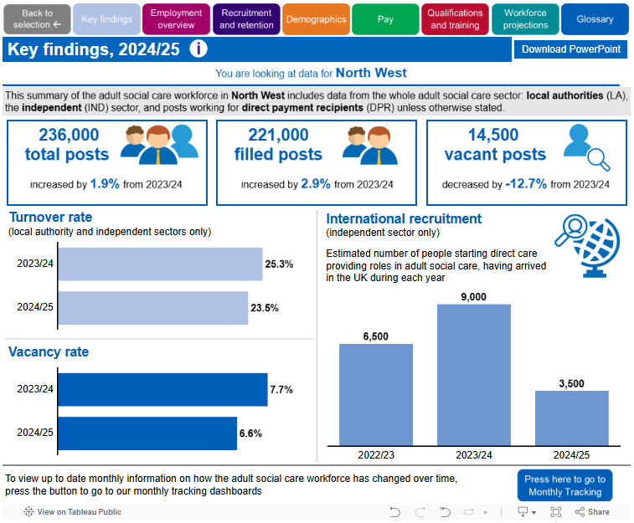
Data example
Notes:
Please feel free to replace with a screenshot from your local area, you may want to draw attention to some of the key stats in your area: https://www.skillsforcare.org.uk/adult-social-care-workforce-data/Workforce-intelligence/publications/local-information/My-local-authority-area.aspx
Here’s an example of some of the workforce data that you can find on the Skills for Care website. It is presented in ways which are easy to interpret.
You can view information on a national level, regionally, or by local authority or ICS area.

Slide 8
The state of the adult social care sector and workforce 2024/25
Key findings from this year’s report
International recruitment helps social care workforce grow – but domestic recruitment and retention struggles persist:
The workforce grew to 1.6 million filled posts and vacancies fell to 111,000 a 16,000 (12.4%) decrease from 2023/24. Totalling 1.71 million posts in ASC.
7% vacancy rate – returning to levels seen pre-covid.
23.1% turnover rate in 2024/25 compared to 24.2% turnover rate in 2023/24.
Number of men in the sector reached record high at 22%.
50,000 international recruits, a drop from 105,000 in the previous year
Workers with British nationality decreased by 30,000
We will need another 470,000 posts by 2040 – in line with the aging population
Adult social care contributes £77.8 billion gross value added (GVA) to the economy
Notes:
International recruitment helps social care workforce grow – but domestic recruitment and retention struggles persist. The data shows:
The workforce grew (to 1.71 million filled posts) and vacancies fell (to 131,000) for the second year in a row.
The sector’s vacancy rate of 8.3% was still around 3 times that of the wider economy
24.2% of people working in care left their jobs in 2023/24. For independent and local authority employers the turnover rate fell to below 1 in 4 for the first time since 2014/15, down from 29.1% the previous year.
The number of men in the sector reached record high at 21%. It is the first time that men have represented more than a fifth of the workforce since records began – the proportion had been static at 18% from 2012/13 until 2022/23, when it rose for the first time, to 19%.
However, these positive statistics are mainly due to the record level of international recruitment in 2023/24 and the sector is still struggling with domestic recruitment and retention.
In 2023/24 there were 105,000 international recruits starting direct care providing roles in the independent sector and the number of people in the workforce with a British nationality decreased by 30,000. Over the two years since March 2022, 185,000 international recruits joined and the number of British workers fell by 70,000. It is clear from the data that this is not a case of international recruits taking jobs from British people, as the number of vacancies across the sector remains high.
The turnover rate for internationally-recruited care workers was 30%, the turnover rate for domestic recruits into Care Worker roles was 41.1%.
29% of international recruits were male, but men only accounted for 15% of newly-recruited British care workers.
So IR has had a positive effect on the sector- but we can’t expect that to stay. Our latest tracking data suggested an estimated 8,000 new international recruits started between April and June 2024, compared with an average of 26,000 per quarter the year before. Changes in immigration policy are set to have an effect on the supply of the workforce for us.
In addition to filling vacancies, the sector will need another 540,000 posts by 2040 if the workforce is to grow in proportion to the number of people aged over 65
Despite all our challenges, we’re a vital piece of the puzzle and the adult social care sector was estimated to contribute £68.1 billion gross value added (GVA) to the economy in England - which is up 13.2% from 2022/23.

Slide 9





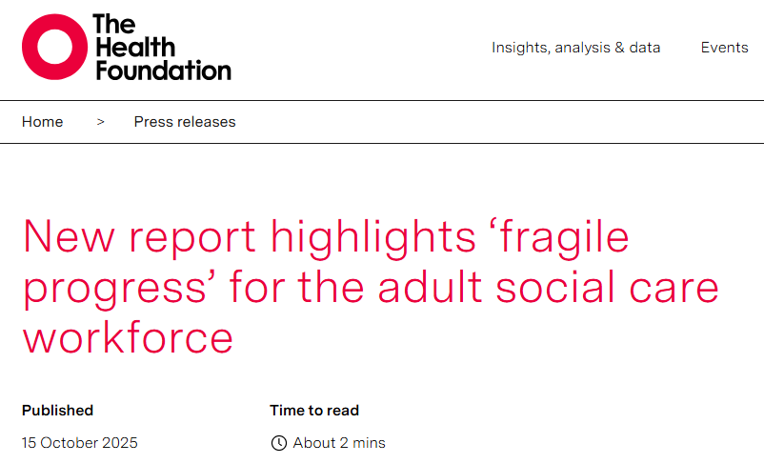
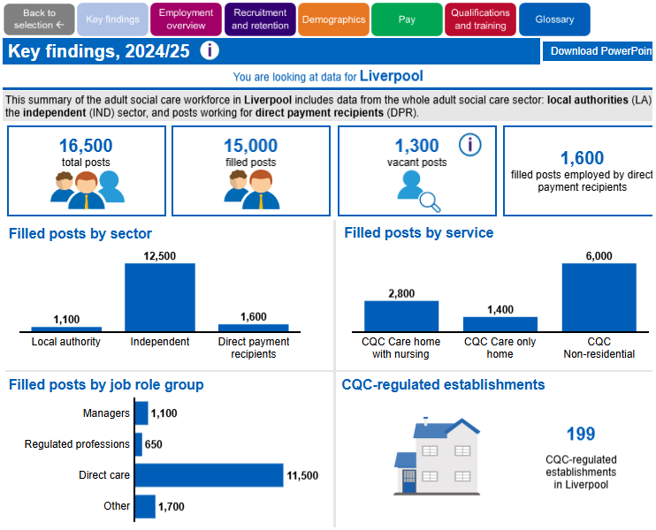

Informing policy and planning
Notes:
The information providers give us is used to provide intelligence and evidence to key decision makers in the sector, here’s a few examples of what that actually means…
We’ve provided data to government to inform their thinking on things like:
In June 2025 we added Care Workforce Pathway questions to ASC-WDS. DHSC commissioned Skills for Care to help them better understand the uptake and usage of the care workforce pathway. So, by adding in your own data, you’ll be helping them to make informed decisions about how to support adult social care career pathways in the future.
We’ve just (Feb 2024) finished testing some new questions about International Recruitment, which was a request from DHSC so they are able to find our more granular detail about who is using Health and Social care visas (that they don’t get from the home office)- the job roles that these people are doing, what types/sizes of organisations etc. This data was recently published in the size and structure of adult social care in england 2025 report.
In 2023, we worked with NHS TD to add digital jobs/skills/training options into ASC-WDS so they will be able to monitor the impact of their work to improve digital use in the sector.
In Summer 2022 DHSC asked us to add some new questions to the service (Qs are about recruitment, advertising and staff benefits etc). They'll use the responses to measure the impact of the social care reform initiatives that they’re working on from the latest White Paper. So it’s going to be crucial going forward to measure the success of what they’re proposing to do to help face the challenges in the sector at the moment.
The Migration Advisory Committee’s review of the impact of ending freedom of movement, data provided by Skills for Care was integral in highlighting the important role that non-British workers play in our social care sector
Our analysts have recently done some work on international recruitment for the secretary of state – to help them understand the link between the high international recruitment inflows and the vacancy rate in the sector
Insight into the experiences of lower-paid ethnic minority workers )Equality and Human Rights commission inquiry)
Highlighting recruitment and retention challenges (Health and social care select committee review)
the impact of changes to the National Living Wage
the number of flu and COVID-19 vaccines needed in the sector.
We'll be publishing our annual State Of Adult Social Care report in October – there'll be a launch event and the data usually features in the media. It's important headline data which informs policy and planning for the following year.

Slide 10
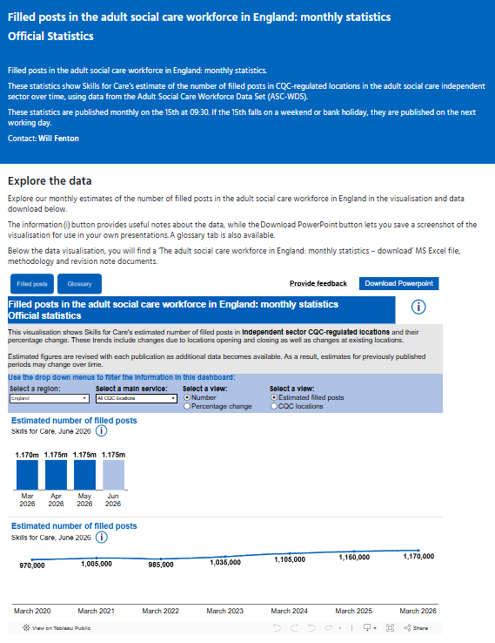
ASC-WDS data is now an official statistic
Filled posts in the adult social care workforce in England: Monthly statistics – Official Statistic
It is a Skills for Care official monthly workforce statistic, published using ASC-WDS independent sector data.
Enhancing how workforce intelligence is provided to the sector.
Move from annual to monthly reporting, replacing estimates that were published months after the reporting period.
More timely workforce insights on filled posts in the CQC-regulated independent sector.
Supports better decision-making by providing the Government, policymakers, employers and sector partners with up-to-date workforce trends.

Slide 11
The Adult Social Care Learning and Development Programme
Learning and Development Support Scheme (LDSS) and Oliver McGowan Mandatory Training (Oliver’s Training) funding available
Funded by the Department of Health and Social Care and administered by NHS Business Services Authority (NHSBSA).
Call to action: With over 150 eligible training courses and qualifications available to claim LDSS funding for, which can support retention and succession planning, don’t delay in submitting your claims.
To claim funding, you first need an up-to-date Adult Social Care Workforce Data Set (ASC-WDS) account. Find out more about ASC-WDS.
Find out more about the funding available, including guidance documents and grant determination letters.
Notes:
AMENDED: W/C 21 September
https://www.gov.uk/government/collections/adult-social-care-learning-and-development-support-scheme
The funds included in the Adult Social Care Learning and Development Programme are:
Learning and Development Support Scheme (LDSS)
Oliver McGowan Mandatory Training on Learning Disability (Oliver’s Training)
Assessed and Supported Year in Employment (ASYE)
User-led organisation (ULO) funding for ULOs representing individual employers and personal assistants
ASC-WDS
https://www.skillsforcare.org.uk/Adult-Social-Care-Workforce-Data/Adult-Social-Care-Workforce-Data-Set/Benefits-of-ASC-WDS.aspx
ASC-WDS virtual tour registration link
https://www.skillsforcare.org.uk/news-and-events/Events/Ongoing/Take-a-virtual-tour-of-the-Adult-Social-Care-Workforce-Data-Set.aspx

Slide 12
Level 2 Adult Social Care Certificate (L2ASCC) qualification
An accredited qualification designed to:
  provide a baseline standard to care,
  reduce the need for repeat training and give recognition to our care workforce,
  Ofqual-regulated, requiring workplace assessment, completed in 6-8 months (or less)
  provide the key knowledge and skills required for the ‘New to Care’ role in the Care Workforce Pathway.
Available for funding through the LDSS (up to £1,540 per qualification).
Employers can find quality approved learning providers through the Quality Assured Care Learning Service. L2ASCC is the only qualification at level 2 approved by Skills for Care.
Mandated within the revised Level 2 Adult Care Worker Apprenticeship Standard, therefore providing an alternative funded route (via Apprenticeship Levy).
Call to action: prioritise enrolling staff who don’t hold a relevant qualification on to the L2ASCC qualification, to enable them to gain recognised skills and support progression in their role.
NEW WEBINAR: Learn more about the L2ASCC qualification on 19 November 2026
Find out more about the L2ASCC qualification (including factsheets and FAQs).
Notes:
AMENDED: w/c 21 September
NEW WEBINAR details added - https://www.skillsforcare.org.uk/news-and-events/Events/November/Understanding-the-Level-2-Adult-Social-Care-Certificate-qualification.aspx
L2ASCC qual
DID YOU KNOW THAT SINCE THE LDSS LAUNCHED IN SEPTEMBER 2024, OVER 5,000 CLAIMS FOR THE L2ASCC QUALIFICATION HAVE BEEN ACCEPTED?
Factsheets and FAQs for care providers, care workers and training providers (published March 2026) www.skillsforcare.org.uk/CareCertificateQual
(Main updates: Reference to £1,540 LDSS funding maximum reimbursement (previously £1,500) and references the Foundation Apprenticeship and how this links to L2 learning).
Why choose the L2ASCC?
Eligible employers can claim LDSS funding for up to £1,540 per qualification. (Ensure your ASC-WDS account is up-to-date to meet eligibility requirements)
Designed to ensure staff have the most up to date knowledge and baseline skills.
Help staff feel valued and recognised as part of professional workforce.
https://www.skillsforcare.org.uk/Developing-your-workforce/Level-2-Adult-Social-Care-Certificate-qualification.aspx
More detailed slides/notes/quotes available in L2ACC-In a nutshell slides available on following link:
L2ASCC qual and CC standards- In a Nutshell slides.pptx
https://skillsforcare.sharepoint.com/:p:/r/sites/engagementdirectorate/Shared%20Documents/Engagement%20Directorate%20public/Area%20team%20repository/In%20a%20nutshell/L2ASCC%20Qualification%20and%20Care%20Certificate%20Standards/L2ASCC%20qualification%20and%20Care%20Certificate%20standards_care%20providers%20-%20In%20a%20Nutshell%20slides.pptx?d=wfdad67b6265446eca772dd9cebc96566&csf=1&web=1&e=H6T2PS
Currently 54% of direct care workers do not have a level 2 or above qualification. The introduction of the L2ASCC qualification will provide people in care roles the most up-to-date knowledge and baseline skills required to support people well and succeed in their roles.
For those who have been in the sector for several years and deserve acknowledgement for the skilled care they provide, the qualification will also provide a route for them to gain a recognised qualification. Investing in training and support for staff will act as an incentive for staff recruitment, retention and development within the workforce.
It’s based on the 15 standards from the original Care Certificate to reflect best practice but with a greater depth of learning and portability.
Aimed at new starters and those without existing qualifications. It’s expected to take a new learner around 6-8 months to complete.
This could be reduced for more experienced learners through any reliable and sufficient recognition of prior learning. Care Certificate standards and induction training may be counted as prior learning. The training provider should clearly set out how prior learning can be used in the assessment process before enrolment.
Care Cert Standards 2025 still exist and are available here.
https://www.skillsforcare.org.uk/Developing-your-workforce/Care-Certificate/Care-Certificate-standards.aspx

Slide 13
Quality Assured Care Learning Service (QACLS)
Supporting you to select high‑quality, trusted training
What QACLS provides
Reviews individual training providers and adult social care courses and qualifications against national quality standards.
Supports employers to identify high‑quality, accessible learning that meets workforce and care needs.
Quality assures eligible training courses and qualifications on the Learning and Development Support Scheme (LDSS), and quality assures approved providers delivering Oliver McGowan Mandatory Training.
Over time, quality‑assured learning will be the only route for LDSS funding.
What this means for registered managers
Supports evidence of compliance with CQC expectations on staff training and competence.
Improves workforce capability, consistency and outcomes for people who draw on care.
Actions
Prioritise selecting quality-assured training providers, courses and accredited qualifications when planning staff development, using the QACLS list.
Monitor the impact of training on practice, care quality and inspection outcomes.
Notes:
NEW: 5 MAY
The Quality Assured Care Learning Service (QACLS) is a DHSC funded service delivered by Skills for Care.
There are two spreadsheets available on the QACLS webpage, which are updated fortnightly.
Quality assured training providers, courses and qualifications – linked to LDSS funding
Quality assured Oliver McGowan Mandatory Training providers
https://www.skillsforcare.org.uk/Developing-your-workforce/Quality-assured-training-and-courses.aspx
Please email QAservices@skillsforcare.org.uk.

Slide 14


The Training Hub
Affordable, high-quality adult social care training that meets regulations, supports teams, builds skills, and strengthens service quality.
Developed by Skills for Care, with over 25 years’ experience in improving adult social care
All courses aligned with current and emerging standards
Prices from £9 - Every penny of profit reinvested back into improving social care
Gain access to bite-sized eLearning courses covering:
Statutory and mandatory: including IPC, MCA and care planning
Enhanced care: including dementia and end of life care
Leadership and management: including HR skills for managers and Business skills in practice
Introductory modules for managers – 11 modules available
(eligible for funding via LDSS)
www.skillsforcare.org.uk/thetraininghub
Notes:
AMENDED: W/C 10 Aug
The Training Hub has been created in response to what care leaders say they need most: credible, up‑to‑date training that reflects current and emerging standards, is easy to use, is fairly-priced, and genuinely supports staff to feel confident and competent in their roles.
Skills for Care has worked closely with care providers to understand what they need from their training provider. This has included focus groups and one-to-one consultations taking place at each stage to ensure all elements of the training offer truly meet the requirements of people working in social care.
All courses are developed by Skills for Care, drawing on our deep and longstanding expertise in workforce development and quality improvement.
The training will be delivered via an award-winning learning management platform that has been expertly designed to suit different types of learners.
As part of our mission to support and develop the social care workforce, every penny of profit from The Training Hub will be reinvested into supporting our vital sector work.
Statutory and mandatory - covering essential topics applicable across all roles​
Difficult conversations
Falls prevention awareness
Frailty awareness
Introduction to equality, diversity and inclusion
Introduction to infection prevention and control
Mental Capacity Act awareness
Mental health awareness
Principles of care planning
Principles of person-centred care
Principles of record keeping
Enhanced care - covering a range of topics particularly suited to frontline and enhanced care roles​
Dementia (tier 1) introduction
Introduction to end of life care
Leadership and management – covering skills and knowledge to support role progression
Coaching
Mentoring
Coming soon… Health and safety – covering key health and safety requirements
MIS – Introductory modules for managers 11 modules also available
www.skillsforcare.org.uk/thetraininghub

Slide 15

Discover the ASC-WDS
The Adult Social Care Workforce Data Set (ASC-WDS) is a free data collection service, commissioned and funded by the DHSC.
It is the leading source of intelligence for the adult social care workforce. It helps you to manage your team and provides crucial information to decision makers
Benefits to providers
Funding for training staff
Safe and free storage of staff records
Manage training records
Benchmark your workplace
Access the ASC-WDS Benefits Bundle
Your data makes an impact and contributes to the
voice of the sector
Share your ASC-WDS with CQC or Local Authority
Create an account today
Notes:
AMENDED: W/C 27 JULY
https://asc-wds.skillsforcare.org.uk/registration/create-account
VIDEO: https://www.skillsforcare.org.uk/Adult-Social-Care-Workforce-Data/Adult-Social-Care-Workforce-Data-Set/Benefits-of-ASC-WDS.aspx
We’ve created this short video to help you understand the benefits of using ASC-WDS and how the data within the system can be used by the Government and other stakeholders to make informed decisions about the care sector.

Slide 16
How the Care Workforce Pathway is structured
Direct Role categories | Supporting Role categories |  | Contents of each category | Supporting resources
New to care Care or support worker Activity co-ordinator Enhanced care worker Care technologist Personal assistant Supervisor or leader Practice leader Deputy manager Registered manager Nominated individual | Corporate management Learning and development practitioner Quality assurance lead Administration Catering Domestic Maintenance |  | Universal role values Behaviours Knowledge and skills Suggested learning and development Personas | How to guide Sample board report Role categories Role mapping in practice Stories from those using it Progression routes
The Care Workforce Pathway
Notes:
NEW W/C 10 Aug
This is what the Pathway looks like in practice. All the roles for the Pathway sit on the GOV.UK website.
It sets out clear role categories across adult social care from people who are new to care, right through to leadership roles like registered managers.
It’s important to note that these are role categories, not individual job titles. If you’re roles have different names, that’s totally fine. What’s important is to know where your roles sit on the Pathway.
What the Pathway shows is a career journey. It helps people see where they are now, what the next step could be, and it supports them to understand how to get there.
It also creates a shared way of describing roles across organisations so we’re more consistent in how we talk about expectations and progression.
It’s still growing with more roles being developed to reflect the wider workforce.
https://www.skillsforcare.org.uk/Developing-your-workforce/Care-workforce-pathway/The-Care-Workforce-Pathway.aspx
https://www.skillsforcare.org.uk/Developing-your-workforce/Care-workforce-pathway/Getting-started.aspx
https://www.skillsforcare.org.uk/resources/documents/Developing-your-workforce/Care-Workforce-Pathway/Care-Workforce-Pathway-role-category-characteristics.pdf
https://www.skillsforcare.org.uk/Developing-your-workforce/Care-workforce-pathway/Adopting-the-Care-Workforce-Pathway.aspx
https://www.skillsforcare.org.uk/resources/documents/Developing-your-workforce/Care-Workforce-Pathway/Career-and-development/Care-Workforce-Pathway-progression-opportunities.pdf

Slide 17
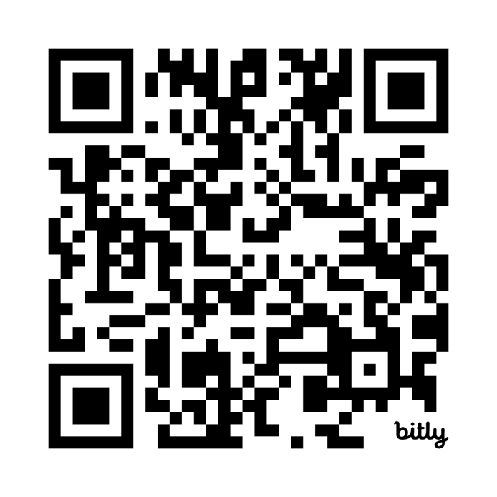
Care Workforce Pathway support programme for care providers
The registration process is quick and simple:
Complete the application at : Support programme for care providers
Read through the commitment statement
Wait to hear on next steps
After sign-up – when registration is confirmed, you will have access to:
Full resource library, including content ringfenced to the support programme
Programme schedule
Workshops, networks, and working groups
Notes:
NEW: W/C 13 JULY
This slide shows the current application process for the CWP support programme.
When we talk about CWP, it can sometimes feel overwhelming. Many organisations know where they want to get to but taking that first step can be the hardest part.
That's exactly where the Care Workforce Pathway Support Programme comes in. This isn't about asking you to transform everything overnight or commit to a large-scale project. Instead, it's about providing practical support that helps you identify what is achievable for your organisation right now and then take those first small, manageable steps.
The programme has been designed to meet organisations where they are. Whether you're just starting to explore the Care Workforce Pathway, or you've already begun thinking about implementation, there is support available to help build confidence, share good practice, and turn ideas into action.
What I would encourage you to think about is: What could one small step look like for your organisation? It might be starting a conversation with managers, reviewing a role against the pathway, or identifying a workforce challenge that the pathway could help address. Small actions often create momentum, and momentum leads to meaningful change.
The benefit of engaging with the programme is that you don't have to do this alone. You'll have access to guidance, resources, examples from others, and support that can help make the process feel more achievable and less daunting.
There are 3 initial workshops, these are followed by peer support discussion groups, and all the resources and tools are available for you to use.
Applications are now open to join the support programme starting in January 2027. If you are interested in putting your organisation forward, please follow the link to read more and apply.
https://www.skillsforcare.org.uk/Developing-your-workforce/Care-workforce-pathway/Support-programme-for-care-providers.aspx

Slide 18
Delegated healthcare activities (DHA)
New deep dive
Are you confident that you and your staff recognise when you/they are being asked to carry out a DHA?
How are care workers in your organisation recognised and rewarded for taking on DHA?
Notes:
NEW W/C 7 September
Intro/context for respondents
A delegated healthcare activity, usually of a clinical nature, is an activity that a regulated healthcare professional delegates to a care worker or personal assistant. Delegated Healthcare Activities are tailored to people’s individual health outcomes for a better experience of care with greater choice and control. It’s not new; this has been happening for many years. There is no statutory requirement for social care providers to provide delegated healthcare activities. Skills for Care's voluntary guiding principles support person-centred, safe and effective delegation and decision-making.
This deep dive will run from 1 – 30 September
https://www.skillsforcare.org.uk/Support-for-leaders-and-managers/Managing-a-service/Delegated-healthcare-activities/The-guiding-principles.aspx
Questions
System/ICB Contacts
Is DHA part of the neighbourhood planning in your area, if so, what are the plans including who is involved (i.e Integrated commissioners)?
What support is there for ASC providers adopting DHA in your area? E.g. Clinical oversight, shared governance, agreed funding flows etc
What are the top 3 things that you feel are required to implement DHA successfully within your area?
Care Providers
Are you confident that you and your staff recognise when you/they are being asked to carry out a DHA?
How are care workers in your organisation recognised and rewarded for taking on DHA?
Please initiate conversations with your networks and contacts in the sector and share any insight into the deep dive SI channel on Teams.

Slide 19
Latest info
Key sector developments and information related to your role

Slide 20
New preceptorship workshops – are you a registered manager who employs nurses?
Our upcoming online preceptorship workshops can help strengthen support for newly registered nurses and nursing associates in your service
Whether you’re looking to develop your experienced nurses and nursing associates in becoming preceptors who will support new registrants OR looking to embed preceptorship leadership by identifying a lead for preceptorship within your organisation, these workshops provide practical tools, guidance and shared learning.
Preceptor role workshops: 10 February 2027 | Find out more and register today
Preceptorship lead workshops: 8 October | 3 February | Find out more and register today
Spaces are limited – find out more and register today!
Notes:
AMENDED: W/C 1 JUNE
Our upcoming online preceptorship workshops can help strengthen support for newly registered nurses and nursing associates in your service.
Following the success of our 2025 programme, with 100% of attendees rating the workshops as valuable, this new series focuses on embedding effective preceptorship in adult social care settings.
The ‘preceptor’ role can ONLY be carried out by a nurse or a nursing associate as they are essentially providing peer support to their newer to practice colleagues.
For the preceptorship lead role, it is really ideal if this role could also be performed by a nurse but if there are difficulties in identifying a nursing member of staff who could lead on preceptorship for their organisation then it is OK for the RM to perform this function.
We are asking preceptorship leads to also attend a preceptor workshop so that they are able to understand what their preceptors (experienced nursing staff) will be doing to support preceptees (those new to role).

Slide 21

Behaviour change competencies framework​
Developed by Skills for Care working with RSPH and people from across adult social care, this framework helps you recognise, support and evidence the behaviour change skills already being used in day-to-day practice.​
Strengthen person-centred practice: support people to make changes that improve health, independence, dignity and quality of life.​
Support your workforce: give staff a shared language, clearer expectations and confidence to build behaviour change into everyday conversations.​
Evidence good practice for CQC: use the framework to show how your service supports staff with the right skills, knowledge, supervision and development to deliver effective care.​
No extra burden: designed to build on existing good practice, not introduce new requirements.
Download now
Notes:
NEW: W/C 29 JUNE
https://www.skillsforcare.org.uk/Support-for-leaders-and-managers/Managing-a-service/Prevention-in-social-care/Behaviour-change-competencies-framework.aspx
This framework goes live on Monday 29 June

Slide 22


Practical approach toolkits for ASC leaders
Our practical approach toolkits support leaders and managers to tackle today's most pressing workforce challenges
Bringing together what’s working across adult social care, they provide clear, actionable guidance that can be adapted to local contexts.
Each toolkit shares real examples, practical steps and recommendations, helping you understand not just what works, but how to put it into practice. Topics include recruitment and retention, workforce planning, skills development, integrated care and provider engagement.
Whether you’re leading a service, shaping local plans or working at system level, these flexible toolkits are designed to work across different settings, needs and ambitions.
Practical approach toolkits
Have you adapted, adopted or used any part of a toolkit? Please give us your feedback!
Notes:
AMENDED: W/C 27 JULY
https://www.skillsforcare.org.uk/Support-for-leaders-and-managers/Practical-approach-toolkits/Practical-approaches-toolkits.aspx
Explore practical toolkits designed to support leaders and commissioners in adult social care. Access guidance, tools and resources to help implement effective approaches and improve outcomes.
We're keen to understand how the Practical Approaches Toolkits are being used in practice. Whether you've implemented a toolkit in full, adapted sections to meet local needs, or simply explored the content, your feedback will help us assess what's working well and identify opportunities for improvement. Please share your experiences, examples of how you've used the resources, and any suggestions you have to help shape future toolkit development.
NOTE TO LM: Actively capture any feedback from employers who have adapted, adopted, or used all or part of a Practical Approaches Toolkit. Please share any comments, examples, case studies, benefits realised, or suggestions for improvement with Rob Hargreaves and Helen Nokes. Where an employer is willing to provide further insight, Rob and Helen will be happy to follow up directly to gather additional feedback and help inform the ongoing development of these resources.
Neighbourhood-based block-pay
How a pioneering new approach to homecare delivered high-quality care and retained staff.
Empowering self-managing teams
Explore how a self-management model boosts recruitment, retention, wellbeing and quality in homecare.
Ensuring providers have a voice at the table
Discover ways providers can influence Local Skills Improvement Plans.
Building engagement with adult social care providers
Learn how to tailor skills development to employer needs, whilst securing their longer-term engagement.
Wellbeing champions
Explore how a co-ordinated, peer-led wellbeing model can reduce stress while supporting a more resilient and engaged workforce.
Leveraging provider engagement in local skills
Discover how meaningful events can align providers and partners on local skills priorities
Retaining the next generation
Age-responsive support and apprenticeships that motivate young care workers to stay.
Using data to strengthen workforce planning
Learn how a single platform is bringing together health, care, population and workforce data to support strategic planning.
Collaborating for careers in care
A partnership-led, centralised approach to connecting care employers with education, recruitment and training.
Centralising recruitment
Explore how centralised support fast-tracked recruitment opportunities and refined onboarding and development.

Slide 23

Delegated healthcare activities
Find guidance and real-life case studies to support you as a manager and the service you lead with delegated healthcare activities.
Explore case studies to learn how you can apply these approaches in management roles.
Use the new short guide for providers and organisations to understand the key steps for safely carrying out delegated healthcare activities in adult social care.
Explore the guiding principles for safe, person-centred delegation, effective governance and best practice.
Notes:
AMENDED: Aug 2026
The delegated healthcare activities guiding principles for health and social care were co-developed by Skills for Care, the Department of Health and Social Care and partners, including the Care Quality Commission (CQC). They were first published in May 2023. Following an independent evaluation, they were updated in November 2024 to reflect learning from their implementation.
Case studies
Explore our real-life case studies to see how other across the regions are carrying out delegated healthcare activities. These resources highlight how delegated healthcare activities can work differently across regions and settings but with the same goal of improving outcomes for those who draw on care and support.
New delegated healthcare activities guides
Our new guides are designed to be used alongside organisational policies and professional guidance to support good conversations, shared decision making and the effective implementation of delegated healthcare activities within adult social care. They’ve been developed with a wide range of sector partners, including an individual employer with lived experience of delegated healthcare.
There is a guide specifically for providers and organisations.
National learning exchange: Upcoming sessions
Our national learning exchange for delegated healthcare activities is an opportunity to ask questions and share experiences around delegated healthcare activities with others.
Myth busting delegated healthcare activities: Insurance - getting it right together
Wednesday 16 September 2026 | 14:30 - 15:30 | Online
Join this myth busting session where we look at insurance for delegated healthcare activities.
https://www.skillsforcare.org.uk/news-and-events/Events/September/DHA-Learning-exchange-Myth-busting-insurance.aspx

Slide 24
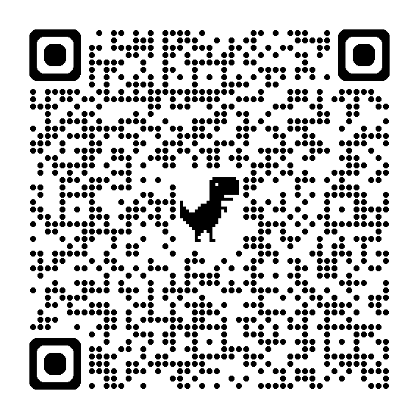
Employment Rights Act (2025) | Updates
Fair Pay Agreement (FPA) in adult social care
Government’s response to the FPA public consultation is now available.
Read more in the Negotiating Bodies and FPAs factsheet and in the Department of Health and Social Care's (DHSC) blog.
FPA, zero hours and similar contracts are two of the ERA measures that were detailed in our recorded national ERA webinar on 7 July 2026, where we were joined by DHSC, DBT, DWP, the Fair Work Agency and Acas. Other measures included Statutory Sick Pay, trade union access and the creation of the Fair Work Agency.
Statutory Sick Pay
Read more about the changes in the SSP factsheet. There is also helpful guidance as to how different employment types affect SSP eligibility
NEW: FAQs for employees with variable hours and different contracts
Notes:
AMENDED: W/C 17 AUGUST
FPA and webinar info
Read more in the Negotiating Bodies and FPAs factsheet and in the Department of Health and Social Care's (DHSC) blog.
Government’s response to the FPA public consultation is now available here.
https://www.gov.uk/government/consultations/fair-pay-agreement-process-in-adult-social-care
Skills for Care delivered a national webinar with the Department of Health and Social Care, the Department for Business and Trade, the Department for Work and Pensions, the Fair Work Agency and Acas on 7 July 2026 on how new employment rights will impact adult social care. This webinar was recorded is available on Skills for Care’s ERA webpage.
https://www.skillsforcare.org.uk/Support-for-leaders-and-managers/Employment-Rights-Act-2025/Employment-Rights-Act-2025.aspx
Statutory Sick Pay
Read more about the changes in the SSP factsheet. There is also helpful guidance as to how different employment types affect SSP eligibility and frequently asked questions for employees with variable hours and different contracts.
https://assets.publishing.service.gov.uk/media/695fb36d47867b8e14f764fb/statutory-sick-pay-factsheet.pdf
https://www.gov.uk/guidance/statutory-sick-pay-how-different-employment-types-affect-what-you-pay#agency-workers
https://www.skillsforcare.org.uk/resources/documents/Support-for-leaders-and-managers/Employment-Rights-Act-2025/SSP-FAQs.pdf
Registered managers should be aware of upcoming changes to Statutory Sick Pay (SSP) and how these may affect their workforce, particularly where they employ staff on variable hours, zero-hours, agency, or other non-standard contracts. Read more about the changes in the SSP factsheet. There is also guidance on how different employment types affect SSP eligibility, along with frequently asked questions covering employees with variable hours and different contract arrangements.

Slide 25
Upcoming events, seminars and programmes

Slide 26

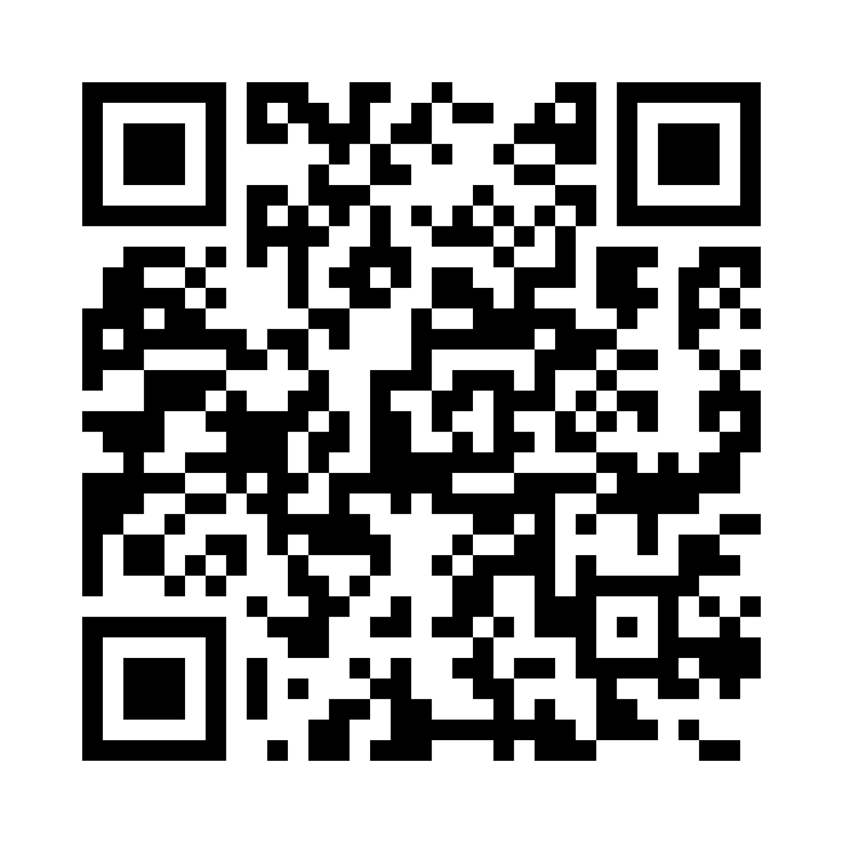
Improving your CQC rating seminar
Monday 12 October | 10:00 – 13:00 | Online
If your service has been rated Requires Improvement or Inadequate, this refreshed three-hour seminar will help you turn things around.
What to expect:
Understand why your service received its rating
Build a clear, structured recovery plan
Learn how to evidence measurable improvement
Embed a positive culture of change across your team
Prepare with confidence for your next assessment
Cost £125 + VAT
10% discount for ASC-WDS account holders
Leave with a clear plan, practical tools, and the confidence to lead meaningful improvement across your service.
Book now
Notes:
NEW: W/C 7 SEPT
https:/www.skillsforcare.org.uk/news-and-events/Events/Ongoing/Improving-your-cqc-rating-seminar.aspx
Other dates available to book:
Monday 12 October | 10:00 - 13:00
Tuesday 8 December | 10:00 - 13:00

Slide 27
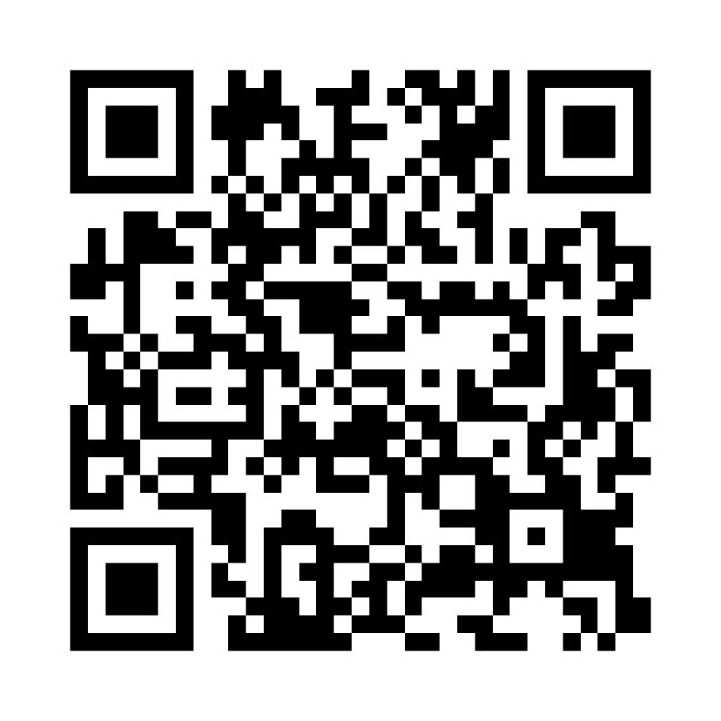
Being prepared for CQC assessment
Thursday 15 October | 10:00 - 15:30 | Online
This popular one-day interactive seminar is for services that want to understand practical ways to be ready for their CQC assessment.
What you’ll learn:
What the CQC is really assessing under the Assessment Framework
How to evidence quality, safety, and leadership effectively
Ways to involve your team and people you support in the process
How to build strong, assessment-ready evidence
The latest insights into current CQC priorities
Cost £250 + VAT
10% discount for ASC-WDS account holders
Perfect for registered managers, team leaders, quality and compliance leads who want to move from uncertain to assessment-ready.
Book now
Notes:
AMENDED: W/C 24 AUG
https://www.skillsforcare.org.uk/news-and-events/Events/Ongoing/Being-prepared-for-CQC-assessment-seminar.aspx
Summer offer: Register for any September seminar and receive an extra 5% off. ASC-WDS account holders can combine this offer with their existing 10% discount, for a total saving of up to 15%. Use code 5%OFF at checkout.
An interactive seminar for services who want to understand the practical ways to be ready for their CQC assessment.
Learning outcomes
Learn about the CQC Assessment Framework including the new areas of assessment focus
Understand successful approaches to being ready and learn to map out how your service can prepare your staff for CQC assessment
Understand what you will be expected to evidence and how to demonstrate your service meets or exceeds what the CQC expect
Other dates available to book
Thursday 15 October
Tuesday 17 November
Tuesday 15 December

Slide 28
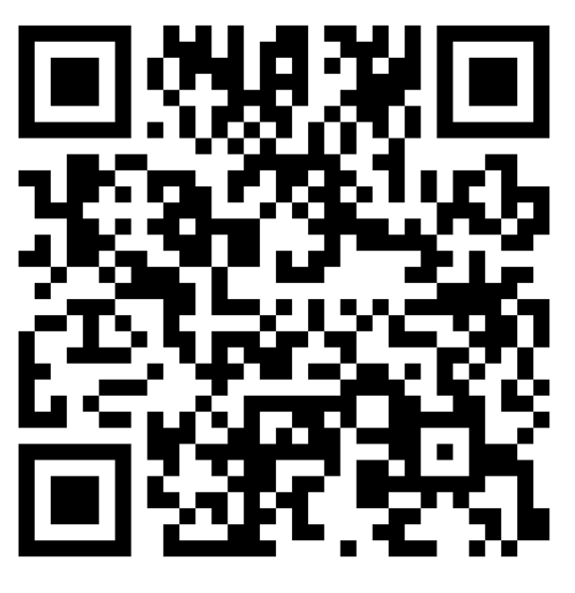
How to evidence safe and effective staffing for CQC compliance seminar
Wednesday 28 October | 10:00 – 13:00 | Online
A practical session providing the tools to turn everyday workforce planning into clear, compelling evidence for the CQC
What you’ll gain:
Understand what the CQC really looks like for in safe and effective staffing
Use the data you already have and identify what’s missing
Link staffing decisions to measurable outcomes
Confidently present your workforce planning at assessment
Cost £125 + VAT
10% discount for ASC-WDS account holders
Perfect for registered managers, team leaders, quality and compliance leads.
Turn workforce planning into assessment-ready evidence
Book now
Notes:
NEW: W/C 21 SEPTEMBER
https://www.skillsforcare.org.uk/news-and-events/Events/Ongoing/How-to-evidence-safe-and-effective-staffing-for-CQC-compliance.aspx
10% discount available for ASC-WDS account holders
A practical session providing the tools to turn everyday workforce planning into clear, compelling evidence for the CQC.

Slide 29
DM10 programme – Developing deputy managers
A practical five-month leadership development programme designed specifically for deputy managers in adult social care.
DM10 gives deputy managers the opportunity to step back from the day-to-day, invest in their leadership and return to practice with new ideas, greater confidence and practical tools they can use immediately.
What you’ll gain
Build confidence in your leadership role
Understand yourself and your leadership style
Develop your team and workplace culture
Lead change and continuous improvement
Learn from and connect with other deputy managers
Put learning into practice in your own service
Find out more www.skillsforcare.org.uk/DM10
Commissioning DM10 for your organisation
If you’re looking to develop multiple deputy managers within your organisation, you may benefit from commissioning an in-house version of DM10 - up to 16 people at a cost of £1,250 (+VAT) per person
Notes:
NEW: W/C 7 SEPTEMBER
https://www.skillsforcare.org.uk/Support-for-leaders-and-managers/Developing-leaders-and-managers/DM10.aspx
DM10 is exclusively for deputy managers working in social care, at any stage of their career.
It’s for deputy managers who want to:
strengthen their leadership skills
build confidence and resilience
understand themselves and their leadership style
develop their teams and workplace culture
lead change more effectively
improve the quality of their management practice
prepare for the next stage of their leadership journey.

Slide 30

Moving Up
Programme starts: Wednesday 11 November | 09:15 - 16:00 | Online
The Moving Up programme is back, offering a valuable opportunity to support aspiring and new leaders. Aimed at those from Black and Asian backgrounds, to grow in confidence and capability across adult social care.
This programme combines self-led learning with online workshops, helping participants develop their leadership style, build their personal brand, strengthen networks, and overcome barriers to progression. It also provides a supportive peer environment to share experiences and broaden perspectives.
With a strong track record over 12 years, Moving Up is an excellent way to invest in your workforce and future leadership pipeline. £750 + VAT (LDSS funding available).
Limited places available | Book your place now
Notes:
NEW: W/C: 21 SEPTEMBER
https://www.skillsforcare.org.uk/Support-for-leaders-and-managers/Developing-leaders-and-managers/Moving-Up.aspx
Learning outcomes
Boost your confidence and self-belief to help you grow and progress in your career.
Develop and understand your personal brand: learn how people perceive you and how to raise your profile within your organisation.
Assess your leadership style and understand its impact on the people around you.
Enhance your leadership skills to become a more effective and influential leader including looking at your strengths and weaknesses to focus mprovements.
Gain an understanding of the power of networking and how to use it to your advantage.
Overcome challenges and barriers to growth using specific techniques.
Increase your awareness of how protected characteristics and culture influence practice in the workplace.
Share experiences and learn from peers to expand your perspective and grow your leadership capabilities.
Delivery
Combining learning modules with three live online sessions - via the Skills for Care virtual learning environment. It equips you with the tools to better understand and focus on your organisation, helping you to shape and influence your career progression with confidence and clarity.
Cost
£750 +VAT.
Adult social care providers can claim money towards the cost of the programme via the new Adult Social Care Learning and Development Support Scheme (LDSS).

Slide 31
Further support and resources
For registered managers and frontline managers

Slide 32

The care exchange
Our podcast series which celebrates managers in social care is celebrating over 31,000 downloads!
Listen to real conversations with social care managers from across the sector
Our podcasts are hosted by locality manager Pia Rathje-Burton and guest co-hosts. Hear real-life insights into being a manager in social care including best practices, experiences and top tips which will inspire your own approach to being a registered manager.
Series 6 is coming this autumn!
Get ready for more honest conversations, fresh perspectives and practical insights from the people shaping and leading adult social care.
We’re bringing you new voices, real experiences and conversations about the challenges and opportunities facing managers today.
www.skillsforcare.org.uk/careexchange
Notes:
AMENDED: W/C 1 JUNE
https://www.skillsforcare.org.uk/careexchange
https://www.skillsforcare.org.uk/Support-for-leaders-and-managers/Support-for-registered-managers/The-care-exchange/The-care-exchange-Series-5.aspx

Slide 33
Celebrating over 50,000 webinar views!
We’re excited to share that our registered manager webinars have been viewed over 50,000 times!
Explore over 35 recorded webinars covering a wide range of topics - they are delivered to a live audience and recorded for further viewing. The webinars are between 30-60 minutes long and are supported with resources and additional information.
Our new recorded webinars include:
Strengthening recruitment and retention: Insights, recommendations and practical actions | Watch now
Navigating the CQC regulations: Building confidence in what you will need to evidence | Watch now
Dementia care: Enabling people to live well | Watch now
Notes:
AMENDED: W/C 29 JUNE
https://www.skillsforcare.org.uk/Rmwebinars
Strengthening recruitment and retention: https://www.skillsforcare.org.uk/Support-for-leaders-and-managers/Support-for-registered-managers/Registered-manager-webinars/Recruitment-and-retention.aspx#Strengtheningrecruitmentandretention
Navigating the CQC regulations: https://www.skillsforcare.org.uk/Support-for-leaders-and-managers/Support-for-registered-managers/Registered-manager-webinars/Managing-a-service.aspx#NavigatingtheCQCregulationsBuildingconfidenceinwhatyouwillneedtoevidence
Dementia care: https://www.skillsforcare.org.uk/Support-for-leaders-and-managers/Support-for-registered-managers/Registered-manager-webinars/Care-topics.aspx#DementiacareEnablingpeopletolivewell

Slide 34

Registered manager membership
Skills for Care is the award-winning membership organisation for registered managers.
Through membership, we support managers to develop best practice and knowledge, keep up-to-date with sector developments and share ideas with peers.
Membership benefits include:
copy of our ‘Social care manager’s handbook’
monthly newsletter including practical information and guidance
access to Good and Outstanding care guide: Single Assessment Framework version
exclusive annual resource when you renew your membership
the chance to train to become a mentor or receive mentoring.
access to special offers from learning providers on Quality Assured Care Learning Service - assured courses and qualifications
Become a member for £35 per year.
Find out more about our award-winning registered manager membership
Notes:
https://www.skillsforcare.org.uk/membership
Become a member for £35 per year

Slide 35
Registered manager membership - Mentoring
A free, one-day virtual workshop for registered manager members
Registered manager membership mentoring workshop
Thursday 19 November | 10:00 – 16:00 | Register now
Build the skills and confidence to mentor colleagues within your organisation or support other registered managers through mentoring.
You’ll gain:
Understand mentoring – how it supports leadership and management, and how it differs from coaching
Explore the mentoring journey – from starting to ending a mentoring relationship
Build core mentoring skills – including effective questioning techniques
Use practical tools & approaches – to structure and strengthen your mentoring sessions
Take away practical skills you can use immediately in your organisation.
Notes:
NEW: W/C 7 SEPTEMBER
https://assets-gbr.mkt.dynamics.com/d43a2d77-48d9-411c-97cc-461eaaf4b5bf/digitalassets/standaloneforms/a963a045-efa6-f111-aaad-7c1e5204e3bd?readableEventId=Registered_Manager_Members_Mentoring_Workshop1897522084

Slide 36

Exclusive membership annual resource | Effective supervision
This revised and updated workbook edition is designed to support you in planning and delivering effective supervision
All members renewing their membership from 1 April 2026 to 31 March 2027 will receive a printed copy of ‘Effective supervision: A practical guide for adult social care managers and supervisors’.
The guide explores how supervision can strengthen working relationships; it highlights the key attributes of a successful supervisor and provides guidance on developing effective supervisors within your team.
The workbook includes practical activities, checklists, reflection points, and templates to help you apply your learning in real-world settings.
Check your renewal date – don’t forget to renew your membership when the time comes!

Slide 37

Good and outstanding care guide – Single Assessment Framework edition
Our Good and Outstanding care guide has been co-produced with The Outstanding Society and covers the CQC Assessment model.
Aimed at frontline managers and those supporting regulated services, it helps regulated providers to prepare evidence to meet the CQC’s 34 Quality Statements.
An electronic version of this latest edition is available to all our registered manager members as part of their membership.
Become a member for £35 a year

Slide 38
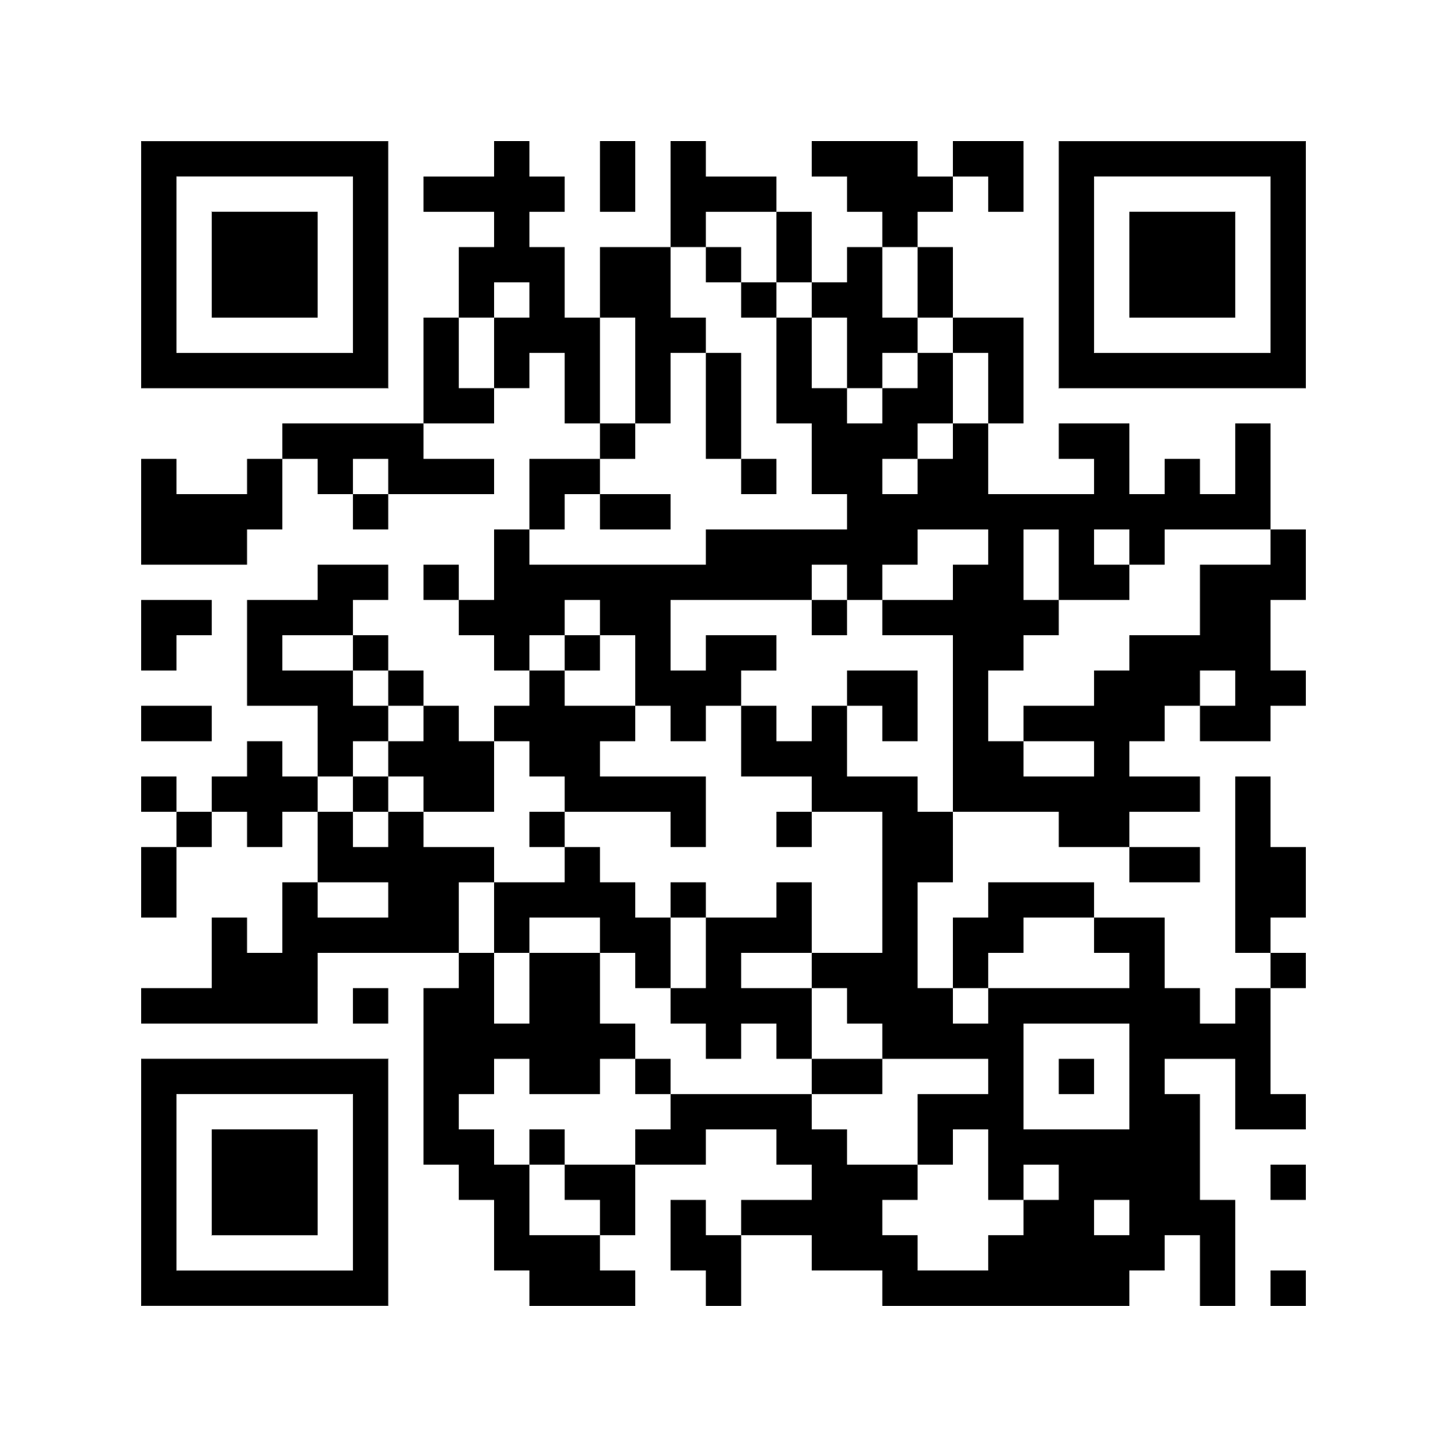

Social care managers Facebook group
Staying connected with each other and sharing advice, experiences and guidance is vital.
Our Facebook group is open to all registered managers and front-line managers in similar roles.
Join this growing group of managers who are using it every day to:
network with peers and connect one another’s services
discuss issues affecting them and their service, and share advice and experience with other managers
provide support and ideas to like-minded colleagues across England.
Find out more and join the group
Notes:
https://www.skillsforcare.org.uk/Support-for-leaders-and-managers/Support-for-registered-managers/Social-care-managers-Facebook-group.aspx
Join this group of managers to stay connected with each other and share advice, experiences and guidance

Slide 39
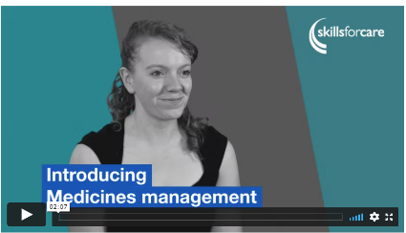
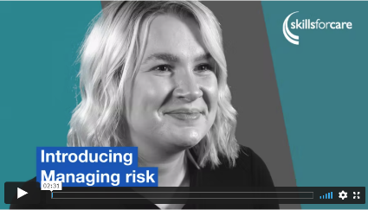
Support for the CQC Assessment Framework – Inspection toolkit
Recommendations, practical examples, advice and resources to support your CQC assessments
Ensure your service is prepared by exploring recommendations, practical examples and resources covering the 34 Quality Statements in our inspection toolkit.
Notes:
Inspection toolkit
https://www.skillsforcare.org.uk/Support-for-leaders-and-managers/Good-and-outstanding-care/Inspection-toolkit.aspx

Slide 40

Developing new managers and deputies – a guide to effective succession planning
This guide provides practical steps to identify, develop, and retain future leaders in adult social care.
The development of future managers is more important than ever, and this guide provides insight into practical ways to succession plan across different sizes and types of adult social care services.
The guide includes practical tools such as checklists, interview templates, and scenario-based assessments to help adult social care providers develop effective succession planning strategies.
Download the guide now
Notes:
https://www.skillsforcare.org.uk/membership
https://www.skillsforcare.org.uk/resources/documents/Support-for-leaders-and-managers/Developing-leaders-and-managers/Developing-leaders-and-managers-guide/Developing-new-managers-and-deputies-guide.pdf
With 10,000 registered managers due to retire in the next 15 years, succession planning is key to ensuring that your service continues to provide well-led, consistent quality care, both today and in the future.
This will be available to buy on the bookshop shortly and will amend the slide when this is live

Slide 41
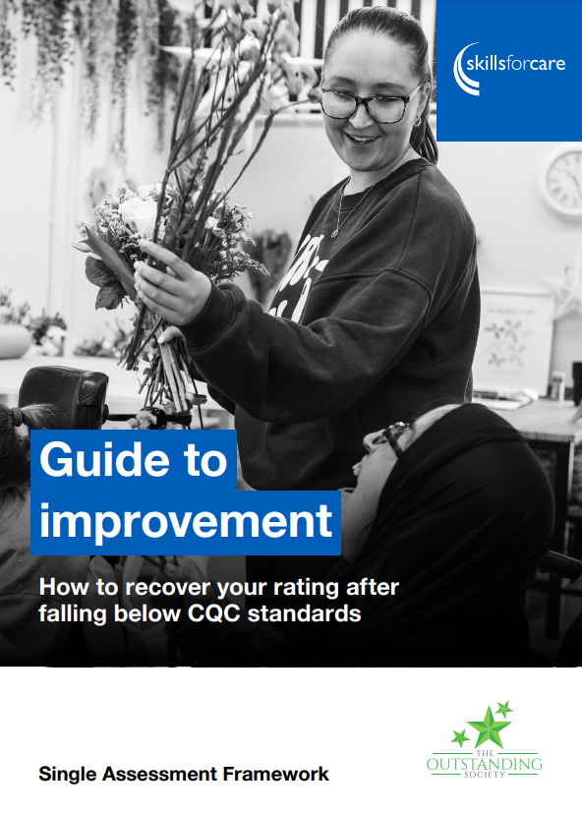
Guide to improvement
Co-developed by Skills for Care and The Outstanding Society.
Shaped around the CQC Single Assessment Framework, the guide looks at what has caused adult social care services to be rated Requires improvement or Inadequate since 2023.
The guide is designed to help frontline managers and others at the service to embed sustainable solutions informed by services who have recovered their rating.
Discover how to engage your teams and identify practical solutions that will work for your service and understand the building blocks to improvement.
The guide is free and can be downloaded now
Notes:
https://www.skillsforcare.org.uk/resources/documents/Support-for-leaders-and-managers/good-and-outstanding-care/Improve-your-CQC-rating/Guide-to-improvement.pdf
Guide highlights
Understanding the building blocks to improvement, helping your service to overcome common barriers, embed a learning culture, and the system and processes needed to strengthen quality
How to engage your teams, service users, and stakeholders in identify practical solutions that will work for your service
What’s are the recurring issues causing services to fall below CQC expectations on each Quality Statement, how might this breach CQC regulations, and how to tackle these issues

Slide 42
Aspiring and deputy manager network
Whether you’re a deputy manager, team leader or aspiring to take the next step into leadership, this national network is here to help you grow
Join peers from across England in a welcoming, supportive space where you can share experiences, explore challenges, exchange ideas and build the confidence to lead.
Reflective leadership and supervision | Tuesday 29 September | 10:30 – 12:30
Explore how reflective leadership can strengthen supervision, build resilience for you and your team, and support wellbeing in the workplace. Book now
Notes:
AMENDED W/C 17 AUGUST
National network meeting for aspiring and deputy managers
Join peers from across England in a welcoming, supportive space where you can share experiences, explore challenges, exchange ideas and build the confidence to lead. Each interactive virtual session is facilitated by a Skills for Care Locality Manager and includes practical tools, leadership insights and the opportunity to learn from others facing similar experiences.
Reflective leadership and supervision | Tuesday 29 September | 10:30 – 12:30
Explore how reflective leadership can strengthen supervision, build resilience for you and your team, and support wellbeing in the workplace.
You will:
gain practical tools to become a confident and effective leader
discover ways to build resilient, motivated teams and support staff wellbeing
learn how reflective practice, supervision and coaching can improve your leadership
connect with peers from across England to share ideas, challenges and good practice.
https://assets-gbr.mkt.dynamics.com/d43a2d77-48d9-411c-97cc-461eaaf4b5bf/digitalassets/standaloneforms/58fccc75-8886-f111-ab0f-7c1e5204e7bc?readableEventId=Aspiring_managers_and_Deputies_Network3129417451
Next network meeting:
Compassionate leadership and coaching | Wednesday 3 March 2027 | 10:30 – 12:30
Discover how compassionate leadership and coaching can help you create a positive workplace culture while nurturing and developing your team.
Bookings not yet open

Slide 43
Nominated individuals / CEO networks
Nominated individuals, CEOs and other senior leaders play a critical role in the provision of high-quality, person-centred care.
NI / CEO networks: provide a space for meaningful strategic collaboration with other senior leaders, managers and stakeholders to discuss the implications of national, regional and local strategies and opportunities for providers and their workforce. Find out more
Nominated individuals' handbook: looks at key aspects of the NI role and shares top tips so you can continue to provide high-quality, person-centred care to the people you support. Download your free copy
Notes:
AMENDED: W/C 27 JULY
Dates updated
UPCOMING DATES
Eastern NI
27 October 2026
9 February 2027
Midlands NI
13 October 2026
27 January 2027
Northern NI/CEO
16 September 2026
LSE & SW NI
18 November
February
LSE CEO
1 October 2026
25 February 2027
https://www.skillsforcare.org.uk/NI-CEOnetworks
https://www.skillsforcare.org.uk/resources/documents/Support-for-leaders-and-managers/Nominated-Individuals/Nominated-individual-handbook-a-practical-guide.pdf

Slide 44
RM12 – a leadership programme for registered managers
Strengthen your leadership team with RM12 - a six-month, practical development programme
RM12 helps leaders build confidence and strengthen skills. Each month participants join expert-led sessions exploring key leadership principles with a focus on real-world application.
Core topics include supervision and goal-setting, communication and conflict resolution, equity in leadership, and leading change.
Commissioning RM12 for your organisation
Invest in confident, capable managers who make a real difference – up to 16 people, six-month programme at a cost of £1,625 (+VAT) per person
Find out more www.skillsforcare.org.uk/RM12
Notes:
NEW: 10 Nov
www.skillsforcare.org.uk/RM12
Why commission an in-house RM12 programme?
Immediate impact: gain practical tools and approaches that improve service quality.
Modern leadership: adopt a fresh, forward thinking approach to inspire, empower, and influence with confidence.
Small changes, big results: discover how small, strategic changes can transform your team culture and outcomes.
Reflective practice: develop self-awareness and resilience through guided reflection and peer learning.
Reduced staff turnover: effective leadership builds a stronger, more stable workforce.
Although the total cost of the six-month programme is £26,000 + VAT for up to 16 people, that equates to: £1,625 per person (+VAT) or £135 (+VAT) cost per RM12 session. Participants will be offered the opportunity to participate in sessions covering the following topics:
- Supervision and goal setting
▪ Building presence and confidence
▪ Giving and receiving constructive feedback
▪ Effective communication and conflict resolution
▪ Decision-making and boundaries
▪ Self-compassion and vulnerability
▪ Equity in leadership
▪ Effective team-based working
▪ Fostering innovation and continuous improvement
▪ Workforce planning and understanding your area
▪ Managing change
▪ Celebration and evaluation

Slide 45
Other resources
To support you in your role and to support your services

Slide 46

Leadership Qualities Framework (LQF)
Shows what great leadership looks like at every level
Care worker
First-time manager/new to commissioning
Operational manager or leader/operational commissioning
Strategic manager or lead/strategic commissioning
Includes the Management and Leadership Code for Health and Social Care – developed with NHS England
Supporting self-assessment tools
www.skillsforcare.org.uk/lqf
Notes:
NEW: 9 Mar
https://www.skillsforcare.org.uk/LQF

Slide 47
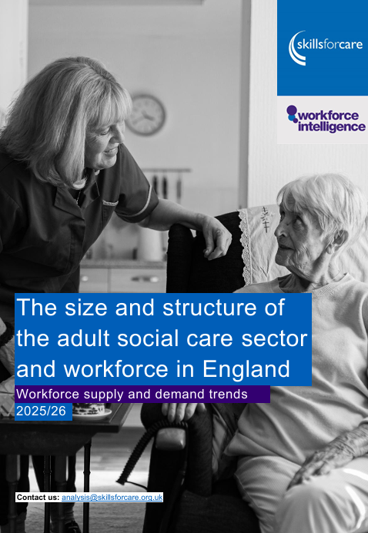
Size and structure of the adult social care sector and workforce in England report
The adult social care workforce in England grew for the fourth consecutive year in 2025/26
Other key findings
The total number of adult social care posts was 1.69m in 2025/26 (an increase of 0.6% from 2024/25).
There were 22,000 more filled posts than the previous year - an increase of 1.4%
The vacancy rate fell to 6.2%, which is the lowest it's been since 2015/16
View the report and data visualisation
Notes:
NEW: W/C 29 JUNE
https://www.skillsforcare.org.uk/sizeandstructure
Our annual ‘Size and structure of the adult social care sector and workforce in England’ report is now available. It shows that the adult social care workforce in England grew for the fourth consecutive year in 2025/26
The number of vacant posts decreased by 11,500 (-10.5%) to 96,000 vacant posts over the same period.
In 2025/26 an estimated 30,000 people arrived in the UK and started direct care providing roles in the independent sector. This was a decrease from 50,000 in 2024/25 and 105,000 in 2023/24.

Slide 48


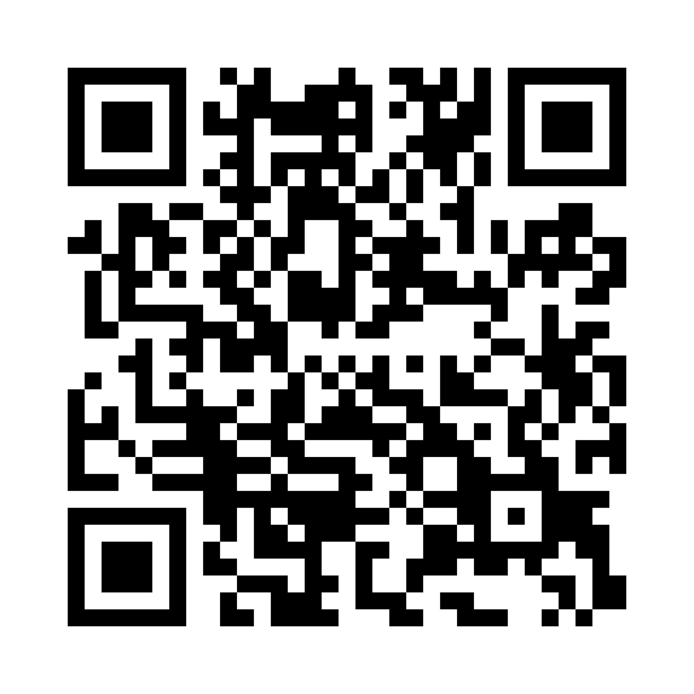
Supporting people living with dementia
Designed for anyone supporting people living with dementia including family carers, health and social care professionals and community workers
Our aim is to make dementia information more accessible, person-centred and practical.
We have developed resources to support the following areas:
Prevention
Before and after diagnosis
Support for people providing care and support
Family Carers
End of life
www.skillsforcare.org.uk/Dementia
Notes:
AMENDED: 9 MAR
Recorded webinar Dementia care: Enabling people to live well - Learn how to support people living with dementia to remain active and engaged, while improving overall quality of life.
https://www.skillsforcare.org.uk/Support-for-leaders-and-managers/Support-for-registered-managers/Registered-manager-webinars/Care-topics.aspx#DementiacareEnablingpeopletolivewell
https://www.skillsforcare.org.uk/Developing-your-workforce/Care-topics/Dementia/Dementia.aspx
Discover a range of resources, tools and videos to help support non-dementia specialist roles to provide effective and compassionate dementia care
Building connection and dementia communication videos
Top tips for a healthy lifestyle
Step-by-step guide to before and after diagnosis
Useful contact details
Distressed behaviours pocket guide
Benefits checklist
Carer’s rights factsheet
Emotional health workbook
End of life conversations guide
Understanding spirituality reflective booklet
Please take a few minutes to complete our short feedback survey:
Dementia Resources Feedback Form – Fill in form

Slide 49
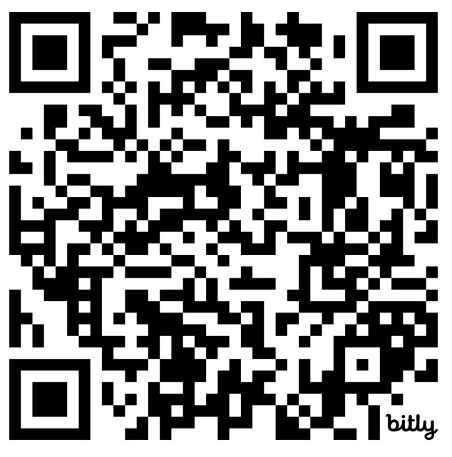
Nurse prescribing in adult social care
What is it, why it matters and how to get started
Wednesday 14 October | 14:00 - 15:00 | Online
Join our webinar to explore nurse prescribing in adult social care, sharing regulatory, educational and practical insights, plus learning from organisations developing nurse prescribing.
Following this session, attendees will be able to:
Describe the role of nurse prescribing in adult social care.
Explain the potential benefits of nurse prescribing.
Identify routes into nurse prescribing education and training.
Understand key considerations for implementing nurse prescribing.
Recognise the support, supervision and partnership arrangements to support successful implementation.
Reflect on examples of nurse prescribing practice and learnings from others.
Find out more

Slide 50
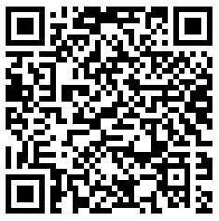
Nursing forums and networks
Join our forums and networks to connect, collaborate and lead social care nursing developments
You’ll explore workforce innovation, education and career development, and celebrate diverse voices within an inclusive, supportive professional community.
Upcoming forums and networks:
Nursing Workforce Forum
Tuesday 10 November
Tuesday 19 January
Tuesday 2 March
Time: 14:00 – 15:30
Location: Online
Nursing Education Forum
Wednesday 11 November
Wednesday 20 January
Wednesday 3 March
Time: 14:00 – 15:30
Location: Online
Global Majority
Nursing Network
Wednesday 4
November
Time: 10:00 – 11:30
Location: Online

Slide 51
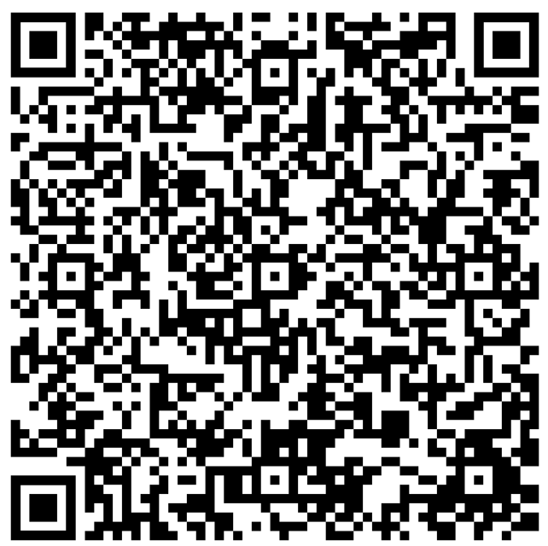
Do you host nursing placements?
It’s time to gain national recognition for your leadership in supporting nursing education
If you’re providing student nurse placements that align with the Strategy to enable social care placements for student nurses and nursing associates, you could be eligible for the Skills for Care Gold Commendation.
Achieving Gold demonstrates your commitment to:
Delivering outstanding learning experiences for student nurses.
Meeting all the recommendations within the national placement strategy.
Showcasing innovation and good practice in social care nursing education.
Supporting the future nursing workforce through high-quality placements.
Why apply?
Gain national recognition for your commitment to excellence.
Share your good practice and inspire other providers across the sector.
Find out more.
Notes:
NEW: W/C 27 JULY
https://www.skillsforcare.org.uk/resources/documents/Regulated-professions/Nursing/Student-nurse-placements/Strategy-event-July-2025/Commendation-application-process-January-2026.pdf
___________________________________________________________________________________________________
NEW RM webinar | Strategy to enable social care placements for student nurses and nursing associates
Tuesday 29 September | 14:00 – 15:00 | Online
Hear from care providers offering nursing placements for the first time and help shape the future nursing workforce in social care.
https://www.skillsforcare.org.uk/news-and-events/Events/September/Strategy-to-enable-social-care-placements-for-student-nurses-and-nursing-associates-Registered-manager-webinar.aspx

Slide 52
Updated Mental Health and Dementia Frameworks now available
Refreshed to reflect up-to-date language and guidance, they provide practical tools to design, commission and quality assure education and training.
The updated Mental Health Core Capabilities Framework and Dementia Training Standards Framework set out nationally agreed learning outcomes and capability statements, aligned to current practice.
Ideal for learning providers, employers, commissioners and registered managers, both frameworks help standardise training, strengthen competence and improve consistency across the workforce.
Explore the frameworks
Notes:
NEW: 9 Mar
https://www.skillsforcare.org.uk/Developing-your-workforce/Other-standards-and-frameworks.aspx

Slide 53
Allyship resources
Understanding allyship is the first step - putting it into practice is what creates real change.
Discover our practical tools and guidance to help you embed allyship into everyday leadership and team culture across adult social care.
Allyship is not a one-off action. It is a consistent commitment to behaviours that promote fairness, challenge inequity and strengthen belonging.
Our introductory animation and group activities are designed to help you learn to recognise and challenge bias, lead respectful conversations, respond confidently to discrimination, and foster psychological safety.
Start shaping a fairer, more supportive, and equitable workplace.
Access the resources
Notes:
NEW: 9 Mar
https://www.skillsforcare.org.uk/Support-for-leaders-and-managers/Supporting-a-diverse-workforce/Allyship/Allyship-resources.aspx

Slide 54
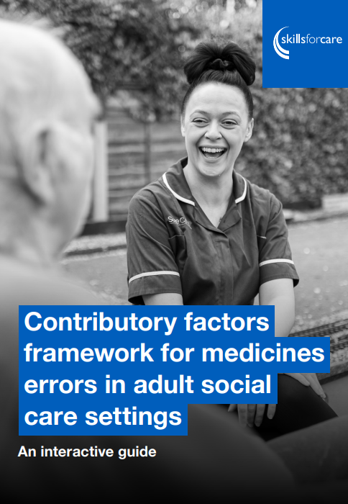
Help investigating medicines errors
Explore our new medicines management resources designed for adult social care.
These tools support training, quality assurance, and competency assessment, and provide a framework for reviewing factors contributing to medicine errors.
The ‘Contributory factors framework for medicines errors in adult social care settings’ helps services investigate errors in a structured, learning‑focused way.
The interactive framework highlights key factors to consider and supports a root‑cause‑analysis approach, encouraging staff involvement and a culture of openness. It includes case studies and a summary and action‑planning template to help prevent future errors and strengthen safe practice.
Explore the resources
Notes:
NEW: 9 MAR
https://www.skillsforcare.org.uk/Support-for-leaders-and-managers/Managing-a-service/Prevention-in-social-care/Medicines-management-resources.aspx

Slide 55

Digital skills resources
Digital skills framework: self-assessment tools
Digital Skills Self-Assessment Tool (for people working in care)
‘What Good Looks Like’ Self-Assessment Tool (for care organisations)
Level 5 Award in Understanding Digital Leadership in Adult Social Care
Aimed at registered managers, team leaders, senior care practitioners, and others in senior roles who are in a position to influence digital decisions and lead cultural change within their services.
£525 funding through LDSS is available for eligible adult social care employers.
Find out more
Notes:
NEW: 17 NOV
The Adult Social Care Digital Skills Framework is a free resource to help support the development of digital skills across the adult social care workforce.
https://www.skillsforcare.org.uk/Support-for-leaders-and-managers/Managing-a-service/Digital-technology-and-social-care/Digital-Skills-Framework.aspx
It includes seven themes which relate to effective digital working:
Theme 1: Using technology to support person-centred care
Theme 2: Technical skills for using technology
Theme 3: Communicating through technology
Theme 4: Using and managing data
Theme 5: Being safe and secure online
Theme 6: Ethical use of technology
Theme 7: Digital learning, development, and wellbeing
Each theme has two levels:
- Digital skills for all – staff at every level of digital experience should aim to develop these skills
- Go further – skills for those working in or wanting to progress into supervisory, management or leadership roles, digital champions or business support roles
The assessment tools for the digital skills framework were launched in April 2025 and support adult social care providers on their digital journey.
These assessment tools help to benchmark and baseline yourselves around digital capabilities and improvement; understand achievements and identify gaps of digital focus; it will support the development of your digital vision; and to make the case for change.
These two self-assessment tools to support you with this are: -
Digital Skills Self-Assessment Tool for Adult Social Care
https://beta.digitisingsocialcare.co.uk/digital-skills-self-assessment-tool-adult-social-care
Skills for Care worked in partnership with Oxford Brookes to deliver the content and it has been co-developed with people working across adult social care and is designed to assess their digital knowledge and skills against the seven themes of the Digital Skills Framework for Adult Social Care. It will help to identify their individual areas of learning and personal skills development as well as steer and signpost to information, training and resources to meet the learning and development needs
What Good Looks Like Self-Assessment Tool for Adult Social Care Providers
https://beta.digitisingsocialcare.co.uk/what-good-looks-wgll-self-assessment-tool-adult-social-care-providers
Skills for Care have worked in partnership with Partners for Care and Health, and the Digital Care Hub, to deliver the content for a self-assessment tool for the digital ‘What Good Looks Like (WGLL) Framework’ for adult social care organisations, and again co-developed with people working across adult social care and care providers who are at different stages of their digital transformation journey.
The tool helps care providers to assess and review their organisation against the seven success measures and standards of good practice within the ‘what good looks like’ guidance and again will signpost to further support
Level 5 Award in Understanding Digital Leadership, this is available to Deputy and Registered Managers and other staff who are interested in increasing their knowledge around Digital Leadership. As a result of completing the Digital Leadership Award, adult social care leaders and managers will have greater confidence and capability to lead the use of technology in the delivery of care, and to improve the quality of life and outcomes for people who draw on care and support.
The award will also enable leaders to drive digitisation within their organisation, lead and support their wider workforce to develop skills and confidence with technology, and lead a positive culture of learning and the continuous improvement of care services.
Focuses on three core areas:
The use of technology and data in adult social care
Implementing technology in adult social care
Leading change, learning and improvement in adult social care
Now included on the Learning & Development Support Scheme (LDSS) funded courses
https://www.skillsforcare.org.uk/Support-for-leaders-and-managers/Managing-a-service/Digital-technology-and-social-care/Level-5-Award-in-Understanding-Digital-Leadership-in-Adult-Social-Care.aspx

Slide 56

All Our Health eLearning
Discover this free eLearning module tailored for adult social care professionals, focusing on health promotion and preventive practices.
Tailored specifically for people who work in adult social care, this eLearning module has ten adult social care public health tips and an underlying theme of prevention.
Build on your existing knowledge to enhance support quality, with practical guidance on integrating public health approaches into daily care routines.
This free eLearning module is available now, developed by All Our Health.
Find out more
Notes:
NEW: 29 Sept
https://bit.ly/4peyBud
https://www.skillsforcare.org.uk/Developing-your-workforce/Care-topics/Ten-public-health-tips-elearning-module/Ten-public-health-tips-elearning-module.aspx
It offers practical guidance on how your practice relates to public health approaches and how to further integrate these approaches into your day-to-day work, building on the knowledge you already have.
Key topics include preventing illness, promoting wellbeing and mental health, and supporting healthy aging. Completing the module will enhance the quality of care for those you support and deepen your understanding of public health.

Slide 57
National induction for health and social care
Skills for Care and NHS England have created free-to-access induction materials for anyone new to a role in health and social care
The ‘National induction for health and social care’ brings together virtual learning modules and resources to equip new starters with a clear understanding of health and social care, helping to build a sense of belonging and support retention.
It introduces different subjects important to social care, such as how to deliver personalised care, why we have regulation, what roles we might come across in our work and what they do.
All content is available online to use as part of your induction or as a refresher for existing staff, alongside your organisation specific induction.
Find out more
Notes:
https://learninghub.nhs.uk/catalogue/National-induction-for-health-and-social-care

Slide 58

LGBTQ+ learning framework
This learning framework for working with LGBTQ+ people in later life aims to provide a base for identifying the insights, knowledge, understanding and skills that the social care workforce need to help them work effectively with individuals from gender and sexually diverse communities.
The framework is intended to be used by social care employers, employees, training providers, regulators, commissioners, policy makers and others to build their own knowledge and support colleagues’ understanding of how to better support LGBTQ+ people in later life.
Updated to include an additional topic which covers ‘LGBTQ+ religion and spirituality in later life’.
www.skillsforcare.org.uk/LGBTQFramework
Notes:
https://www.skillsforcare.org.uk/Support-for-leaders-and-managers/Supporting-a-diverse-workforce/LGBTQ-learning-framework.aspx

Slide 59

Training resources to help support personal relationships
Take a look at our training materials to help develop the skills and knowledge needed to support people who draw on services with personal relationships.
The trainer materials include PowerPoint slides, which are supported by a training facilitator guide, lesson plan and learner handouts and worksheets.
They complement our ‘Supporting personal relationships guide’ and are focused on enabling social care providers to offer support in a way that respects peoples’ choices and values whilst keeping them safe.
Find out more
Notes:
https://www.skillsforcare.org.uk/Developing-your-workforce/Care-topics/Supporting-personal-relationships/Supporting-personal-relationships.aspx
The programme includes a brief introduction, followed by four modules that can be delivered individually or as a complete package. The training areas are:
1. Understanding sexuality and relationships: barriers, benefits and the impact of staff values
2. Roles, regulations and the law
3. Sexual safety and autonomy
4. Practical approaches to relationships and sexuality support
The ‘Supporting personal relationships’ guide and trainer materials are supported by the Care Quality Commission and compliment their guidance around inspection in the area of relationships and sexuality in adult social care services.

Slide 60

Resources to support culturally appropriate care
These resources have been produced to help you have a clearer understanding of culturally appropriate care and what that may mean to individuals you support.
The ‘Culturally appropriate care guide’ covers a broad range of topics that will help you to learn about and be sensitive to people’s cultural identity or heritage.
Use the supporting training resources to implement the learning from the guide at your service.
www.skillsforcare.org.uk/CulturallyAppropriateCare
Notes:
www.skillsforcare.org.uk/CulturallyAppropriateCare
Notes:
The ‘Culturally appropriate care guide’ covers a broad range of topics that will help you to learn about and be sensitive to people’s cultural identity or heritage. Whether its looking to understand what is meant by exclusion and inclusion, find out how to focus on people’s life stories or improve support for people living with dementia, this guide is a great place to go for advice, insight and inspiration from real-life stories.
To support the learning within the guide, Skills for Care has also published a series of resources for use in training and development. These cover supporting individuals from ethnic minority groups and backgrounds, stereotyping, and supporting relationships and people who are lesbian, gay, bisexual, transgender, queer and others (LGBTQ+). They can be used individually, or as part of a whole package of training.

