Slide 1

South London Partner

Slide 2

What is the Data Security and Protection Toolkit?
An online self assessment of your organisation’s data security
Demonstrates compliance with data protection legislation
Reviewed annually
Gives advice and is a checklist of
good practice
digitalcarehub.co.uk/bettersecuritybettercare
hello@digitalcarehub.co.uk
6

Slide 3
Why do providers need to pay attention to this?
•
Data and cyber security is important for safe sharing of records – especially with the use of digital technology which increased during the pandemic
•
It will help you keep people’s confidential information safe
•
It will help protect your business from the risk of being fined for a data breach and from the disruption of a cyberattack
•
The DSPT will demonstrate compliance with legal and CQC requirements
•
It’s often a contractual requirement from councils and the NHS
The DSPT will be your passport to accessing the London Care Record, the Universal Care Plan, GP Connect and other digital innovations or integrations with health services, enabling you to be part of a truly joined up care network with the interests of the people you support and care for at the centre
•
digitalcarehub.co.uk/bettersecuritybettercare
hello@digitalcarehub.co.uk
7

Slide 4

The Better Security, Better Care Programme provides free support (Funded by DHSE)
for Adult Social Care to help providers complete the DSPT. It does this through 28 Local Support Partners situated across England (with LCAS in South London) to offer specialised, tailored support to the sector.

Slide 5
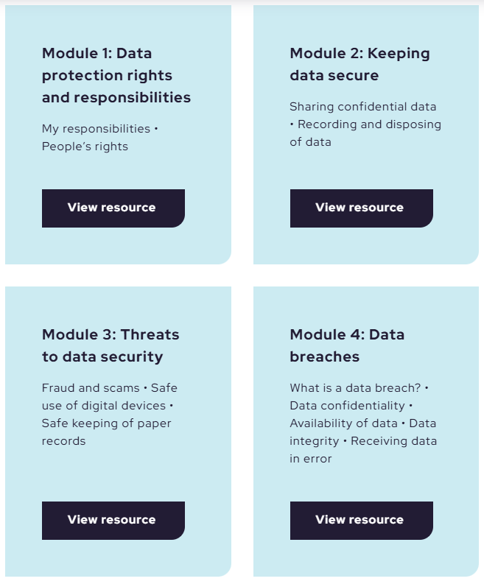
Free e-learning course for all staff working in adult social care services in England
Easily accessible
15-20 min per module
Relatable case scenario-based
learning for all staff.
Free
Compliant with question 3.2.1 on
data protection training of staff.
https://www.digitalcarehub.co.uk/digital-skills-and-training/elearning/
digitalcarehub.co.uk/bettersecuritybettercare
hello@digitalcarehub.co.uk
15
Notes:
https://www.digitalcarehub.co.uk/digital-skills-and-training/elearning/

Slide 6
Further support: template policies (Be sure to tailor to your service)
Approaching Standards: required policies
How to document your data processing, including template information asset register (IAR) and Record of Processing Activities (ROPA)
Privacy Notice Template
Data Protection Policy
Data Quality Policy – Template
Record Keeping Policy – Template (Also known as a Data or Document Retention Policy)
Data Security Policy – Template
Network Security Policy – Template
Smart Phone Policy Template – BYOD
Contracts: what contracts you must have in place
Find all template policies to download and reuse on the Digital Care Hub website here
Standards Met: Additional required policies
Training Needs Analysis
Data Security Audit Checklist
Creating and Testing a Business Continuity Plan for Data and Cyber Security
National Data Opt Out
Recommended documentation
Data Security Breach Incident Reporting Form – Template
Mobile Devices Assignment Form – Template
Smart Phone Policy Template – Organisation Provided Phones
Template Suppliers List

Slide 7
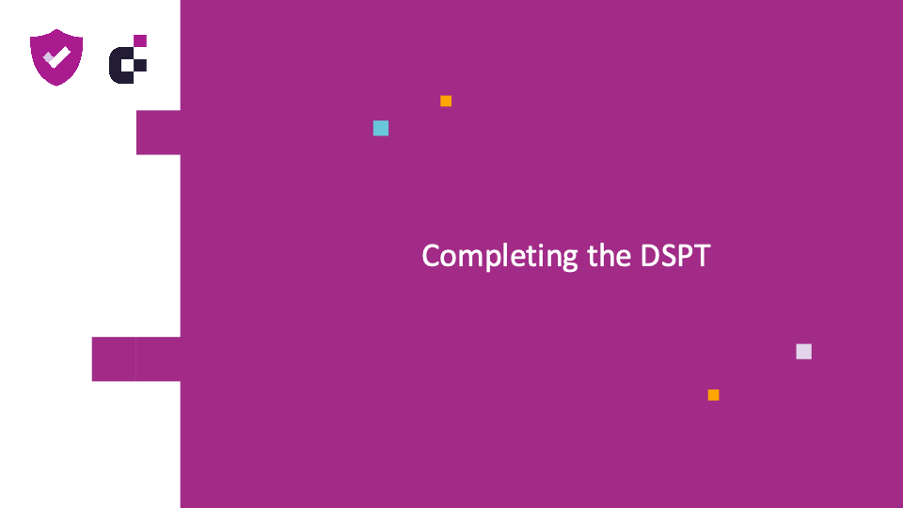
Completing the DSPT
Notes:
Learning outcome to help you understand the toolkit and plan what you need to do to complete it
Who is this for people who have not previously completed/published the toolkit.
This is a self-assessment not public questions – it is for you and your records
Your answers are NOT published – just the DSPT status that you achieve based on your self-assessment

Slide 8
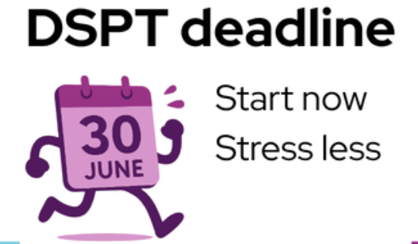

JUNE 30TH

Slide 9
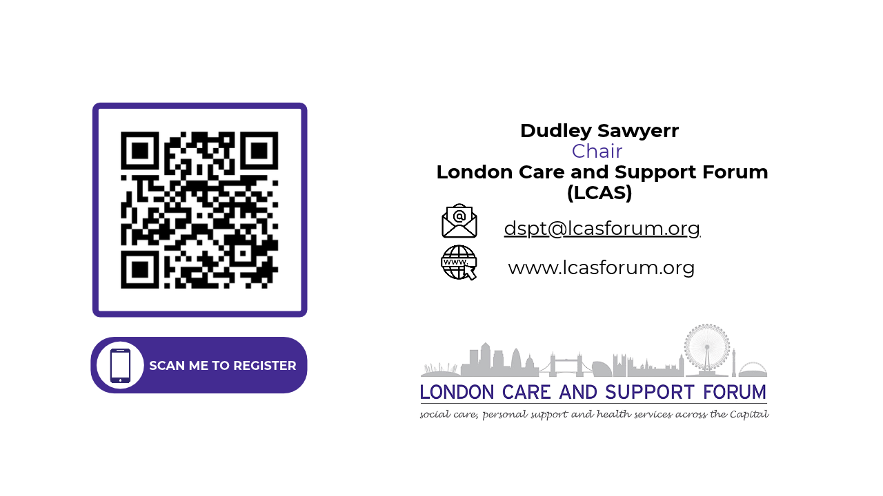
Symone@lcasforum.org

Slide 10
To book your session in email:
dspt@lcasforum.org
Or
Symone@lcasforum.org
South London Partner

