Slide 1
Welcome to your Skills for Care Update
Ali Porteous 7/11/24

Slide 2
Adult Social Care Learning and Development Support Scheme (LDSS)
The DHSC has launched the learning and development support programme for the financial year 2024-2025.
Virtual webinar: Thursday 28 November 11:30 – 12:30
Colleagues from the DHSC will share:
the eligibility criteria for being able to make claims through the scheme
how the funding can be used, including the training courses and qualifications within the scope of the scheme
details on how to access the fund to make a claim, including a demonstration of the new online claims service
Register to attend or find out more about LDSS on the DHSC web page
Please note that you need an ASC-WDS account to claim the funding
Notes:
https://www.gov.uk/government/publications/adult-social-care-learning-and-development-support-scheme
For any queries in relation to this statement please email ASCreimbursement@dhsc.gov.uk
WDF 2024-25
The WDF will be scaled down in 2024-25. It will only be possible to claim WDF for learning which is already in progress. This means that qualifications and apprenticeships which start on or before 31 March 2024 will be eligible for the WDF as long as the learner completes, and the certificate is issued by 31 March 2025.
This is to ensure that employers who have already paid for learning and development are not left out of pocket. Courses and qualifications which start on or after 1 April 2024 will not be eligible for funding through the WDF.
How to access funding to support staff training
This webinar, hosted by Skills for Care, will guide adult social care employers on accessing funding through the Adult Social Care Learning and Development Support Scheme (LDSS). Learn practical steps to claim funding for training, enhancing both staff development and organisational goals.
https://www.skillsforcare.org.uk/news-and-events/Events/November/How-to-access-funding-to-support-staff-training.aspx

Slide 3
Adult Social Care Workforce Data Set (ASC-WDS)
ASC-WDS is a free online service which helps you to manage your team and provides crucial information to decision makers
Benefits to your business
Funding for training your staff
Safe and free storage of staff records
Manage training records
Benchmark your workplace
Access the ASC-WDS Benefits Bundle
Make your voice heard!
Find out more: www.skillsforcare.org.uk/ascwds
Notes:
The Adult Social Care Workforce Data Set (ASC-WDS) is a data collection service, commissioned and funded by the Department of Health and Social Care. It is the leading source of intelligence for the adult social care workforce.
You can gain access to funding for training your staff through the Workforce Development Fund and the Learning and Development Support Scheme (LDSS). You need an ASC-WDS account to be eligible to claim funding. These funds have saved care providers thousands of pounds. One care provider with 45 staff told us they claimed over £33,000 over the years, which has meant all their staff have the opportunity to do level 2 or above qualifications!
The system provides safe and free storage of staff records and can help you to manage your training records- get expiry alerts when training is due to expire, define mandatory training for different job roles. It’s basically a free learning management system.
You can benchmark your workplace against other providers in your area, for metrics like pay or turnover. You can even filter to see only Good and Outstanding providers near you.
You’ll also get our ASC-WDS Benefits Bundle for discounts and special offers from Skills for Care and learning providers.
It only takes a few minutes to get started. Find out more on our website.

Slide 4
New Level 2 Care Certificate qualification
The Level 2 Adult Social Care qualification is an accredited qualification designed to provide a baseline standard to care, reduce the need for repeat training and give recognition to our care workforce.
It’s expected to take a new learner around 6-8 months to complete. An experienced care worker may complete this in a shorter period of time.
Eligible employers can claim funding for the Level 2 Adult Social Care Certificate on behalf of eligible care staff for up to £1500 per qualification through the Learning and Development Support Scheme (LDSS).
Find out more: www.skillsforcare.org.uk/CareCertificateQual
Notes:
https://www.skillsforcare.org.uk/CareCertificateQual
https://www.gov.uk/government/publications/adult-social-care-learning-and-development-support-scheme/learning-and-development-support-scheme-for-the-adult-social-care-workforce-a-guide-for-employers
The qualification is available now to eligible non-regulated care staff, 19+ years.
Currently 54% of direct care workers do not have a level 2 or above qualification. The introduction of the Level 2 Adult Social Care Certificate qualification will provide people in care roles the most up-to-date knowledge and baseline skills required to support people well and succeed in their roles.
For those who have been in the sector for several years and deserve acknowledgement for the skilled care they provide, the qualification will also provide a route for them to gain a recognised qualification. Investing in training and support for staff will act as an incentive for staff recruitment, retention and development within the workforce.

Slide 5
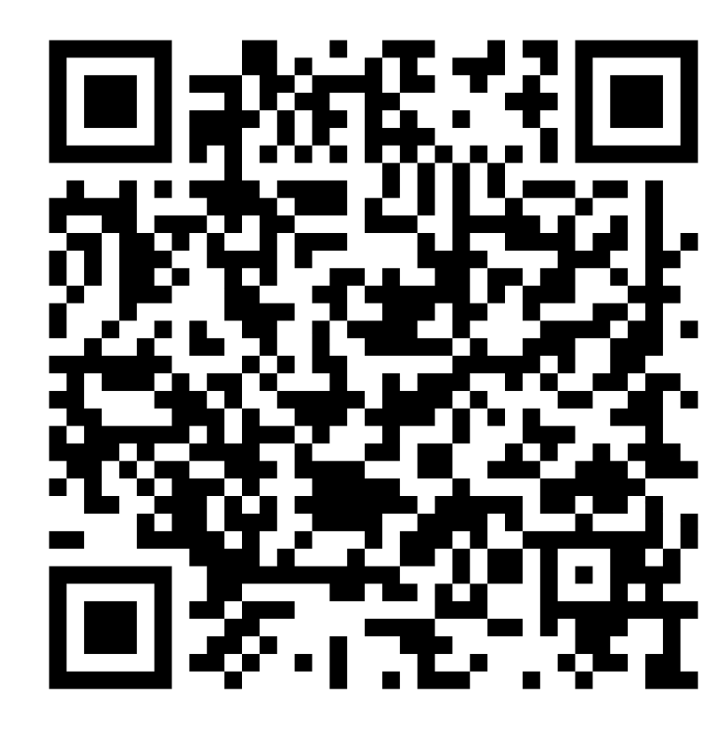
QA service - Gaps in learning provision
We are inviting you to take part in this short survey to help inform the future of the adult social care workforce training offer by telling us about training priorities and gaps in provision.
DHSC has contracted Skills for Care to develop and launch a new quality assurance (QA) service for training providers supporting the adult social care sector. The service is intended to be a route to funding through the DHSC’s Learning and Development Support Scheme (LDSS).
We will use the responses to this survey to inform DHSC of learning and development priorities, and gaps in learning provision, in the sector. This will help to shape the future of funded courses and qualifications. If you would like to find out more about the QA service for training providers, you can visit our webpage.
The survey will only take 10 minutes to complete - Access the survey
Notes:
https://online1.snapsurveys.com/interview/38a7ca6a-f9c3-408c-8fea-1e077947667c

Slide 6
Integration and Integrated Care Systems (ICSs)
Why get involved in your ICS and how?
Ensure that social care is at the heart of decision making
Promote the importance and understanding of social care
Access funding and development opportunities
Inform the development of systems and processes
Help to make the sector an attractive career option
Demonstrate to regulators you work in partnership
Have you heard of or are you involved in your ICS (at system, place or neighbourhood level)? If so, how?
www.skillsforcare.org.uk/Integration
Notes:
INTEGRATION AND ICSs
Integrated care is about people only having to tell their story once to get the high-quality care and support that means they can live the lives they want. It presents the opportunity for joint working across service providers to ensure person-centred care, where choice and control is based on what matters to the person drawing on care and support.
Joining up care leads to better outcomes for people. When local partners – the NHS, councils, care providers, voluntary sector and others – work together, they can create better services based on local need.
The Health and Social Care Act 2022 provided the legislative framework for health and care organisations to work together and deliver joined up care. Integrated Care Systems (ICSs) have been set up to make this happen. Their (ICSs) aim is to improve health and care services – with a focus on prevention, better outcomes and reducing health inequalities.
To enable ICSs to achieve their aim to improve health and care services – with a focus on prevention, better outcomes and reducing health inequalities it is important the ASC providers are aware of their purpose and have a voice.
On the Skills for Care website, we have a more comprehensive explanation about integration. For more information, visit our website for a short animation about ICSs and they are interested to find out more go to the link on our website where we have a more comprehensive explanation and a short animation about ICSs, as well as examples of where integration across sectors is already working well. You'll find examples of how leaders of social care organisations are involved with their ICS and innovative ideas for making integrated ways of working a success.
WHY GET INVOLVED?
We would like to encourage social care employers to engage with their ICS this could be through its local placed-based partnership or at neighbourhood level.
There are different ways providers can get involved – listed here are some examples how to get involved in place-based systems. This will be difference for every ICS. (NOTE TO LMs: Use your local knowledge when providing examples. And it may just be by being a member of this network and feeding in through Skills for Care).
joining the main local placed-based partnership as an individual
joining the main local placed-based partnership as a group, such as a local care association or registered manger, deputy manager or nominated individual network
joining one of the sub-groups or ‘neighbourhoods’ of the place-based partnership as an individual or network
finding out who to connect with who is already engaged with the place-based partnership in an area, seeking to be kept informed of opportunities and developments.
QUESTIONS TO ASK FOR REPORTING PURPOSES
Ask network members if they have heard of or are involved in their ICS. This could be at system, place or neighbourhood level. If people are involved ask them to explain their involvement, e.g., People Board member, subgroup, etc. (please record details on reporting tab).

Slide 7
Latest info
Key sector developments and information related to your role

Slide 8
Care Workforce Pathway
The Care Workforce Pathway will set out clearly what a career in social care means and the level of knowledge, experience and skills required to deliver high-quality, personalised, care and support
We’ve been working in partnership with DHSC to develop the first part of the pathway focusing on staff working in direct care roles which outlines an initial four role categories.
Moving forward we will continue to work in partnership with DHSC on phase 2. This will include developing further role categories and we will be engaging further with the sector for insight and feedback on what knowledge, skills and behaviours each of these require.
Find out more
Notes:
https://www.skillsforcare.org.uk/Developing-your-workforce/Care-workforce-pathway-for-adult-social-care.aspx
https://www.gov.uk/government/publications/care-workforce-pathway-for-adult-social-care
Phase 1 - 4 categories
Role category A: new to care​
Role category B: care or support worker​
Role category C: supervisor or leader​
Role category D: practice leader
Phase 2 – additional 4 categories
Deputy manager
RM
Enhanced care roles
PAs
we will be engaging further with the sector for insight and feedback on what knowledge, skills and behaviours each of these require.
We will also work with DHSC to scope further parts of the pathway, and plan for implementation and adoption.

Slide 9
Share your experience​
We’re looking for case studies, quotes or potential speakers​
DHSC initiatives: including Care Workforce Pathway, the L2 Care Certificate qualification or the Learning and Development Support Scheme​.
Help DHSC initiatives achieve maximum impact and ensure continued positive interventions.​
Impact of Skills for Care: tell us how Skills for Care’s networks, resources or support have positively impacted your service​.
Help evidence the value of Skills for Care and ensure continued support.​
Good practice examples: in workforce development, recruitment and retention, the use of digital technology, staff wellbeing support or delegated healthcare activities and prevention​.
Help others learn from your experience and enhance quality and reputation of adult social care.​
Notes:
We’re currently sourcing input from care providers across the sector to feed into a few different pieces of work. We’re flexible on what type of contributions we’re looking for- probably shaped by what the example you might have to share is. But we might want to produce some case study content or take a quote or testimonial to use in articles or blogs. We might even ask if you’d be happy to share your knowledge as a guest speaker at a network meeting or similar. We may share your examples with our funders (the Department of Health & Social Care and the NHS Transformation Directorate) or with other providers via our website, e-newsletters etc. We’ll always ask for permission to use anything in a public-facing forum. ​
​
We’d be delighted to hear from you if you can help us with any of these topic areas: ​
If you’ve used any of the recent sector reform outputs, particularly Care Workforce Pathway, the L2 Care Certificate qualification or the Learning and Development Support Scheme. Even if you haven’t used them yet but you appreciate the intentions of the project and plan to use them, we’d still love to hear from you. ​
WHY? The DHSC initiatives has been in the works for a while, and they aim to help address some of the big issues around recruitment and retention in the sector. We know that the understanding of these initiatives is varied across the sector, but for them to have the intended impact, they need to be widely adopted and recognised by the care providers. By lending your voice to the conversation about these projects, you can help the sector make the most of these opportunities and ensure government continues to provide support. ​ ​
Something that helps us demonstrate how the support and resources available from Skills for Care are making a difference in the sector. Think along the lines of: How has being part of a network shaped the work that you do? Have you used one of our guides to implement changes in your organisation? What was the impact of those changes? Increased retention? Better quality of care? Improved CQC rating? ​
WHY? Sharing how Skills for Care’s support and resources have had an impact on your business will help us build a vital evidence base that we can use with funders. We know our work has a positive impact on the sector, but these examples help us demonstrate that. Ultimately it helps us to continue to secure funding, which means we can continue to support you. ​ ​
Anything that showcases the fantastic and innovative work that’s happening in the sector, particularly good practice examples in workforce development, recruitment and retention, the use of digital technology, staff wellbeing support or delegated healthcare activities and prevention​
WHY? The reason behind this one is fairly straight forward- you can help others in the sector to learn from your experiences. We all want to ASC sector to be an attractive place to work, to be recognised as the skilled workforce we are and to ultimately deliver the right care and support so by helping others to improve, you’re not only doing good for the sector but ultimately improving the proxy reputation of your organisation as part of that sector. ​
If you’re regulated by CQC, you can also use all of these examples as evidence of activity under the “partnerships and communities” topic for “Well-led”. It says you should work with others, including peer to peer support to help share best practice. ​

Slide 10
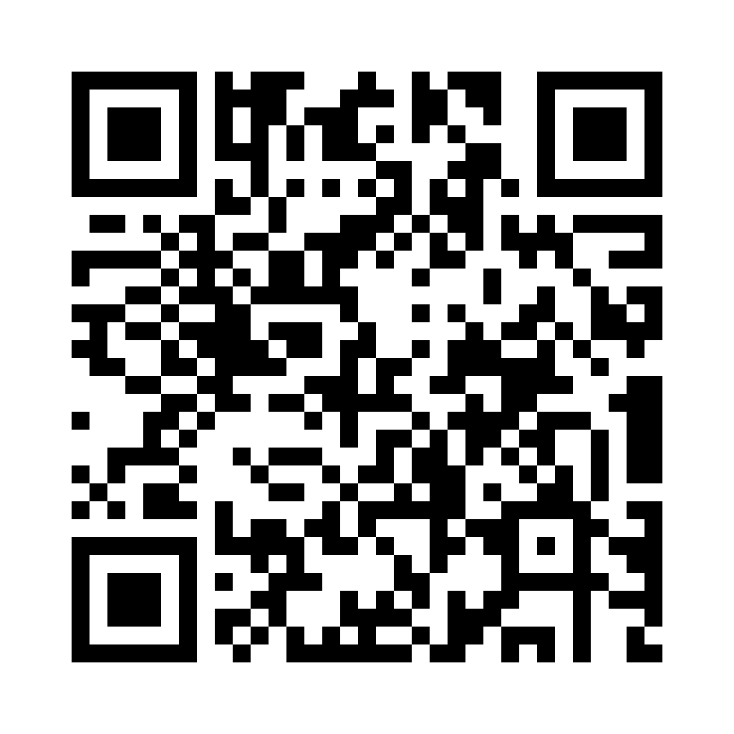
Registered manager / Deputy manager network survey 2024/25
We are inviting managers who have attended a network to take part in a short survey to help us understand more about the benefits of networks.
We want to understand and gain feedback on many things including:
why managers attend the networks
what benefits managers gain from attending
what improvements they have made to their service as a result of attending the network.
The survey will only take 10 minutes to complete - Access the survey
Notes:
https://online1.snapsurveys.com/x1x2o
We know how important the networks are to managers and we want to continue to make them as relevant and useful to you as possible by having the right support in place.
The information we gain from the survey will help us to understand more about the benefits of the networks and we will share the findings with the Department of Health and Social Care (DHSC) to demonstrate the value of the networks.

Slide 11
Evidencing CQC safe and effective staffing through workforce planning
Join our seminar designed to help registered managers meet CQC standards around safe and effective staffing through workforce planning.
The seminar will help you:
define workforce planning and its importance
utilise data to inform staffing decisions
align staffing with CQC standards
develop priorities based on workforce challenges
leave with at least 20% of the initial workforce plan developed.
Next date: Thursday 21 November 2024 | 09:30 – 15:00 | £250 +VAT
(there are also dates in January and February 2025)
Notes:
Dates also available for:
Wednesday 18 December 2024
Tuesday 14 January 2025
Key Benefits:
Enhanced compliance with CQC requirements Gain insights into aligning workforce planning practices with CQC’s expectations for safe, effective staffing and robust governance.
Improved recruitment and retention Address the underlying factors impacting recruitment and retention, resulting in a more stable and sustainable workforce.
Financial and operational efficiency By maintaining optimal staffing levels, organisations can experience significant cost savings by reducing turnover, minimising overtime costs, and enhancing service continuity.
Evidence-based decision making Equip managers with the tools to make informed staffing decisions using real-time workforce data, leading to better service quality and operational stability.
Empowered and competent workforce Establish a clear pathway for staff development and support, promoting person-centred care, reducing burnout, and fostering a positive working environment that attracts new talent.
Interactive workforce planning tool Access a customized, interactive tool to streamline workforce planning, allowing managers to track progress and adapt strategies effectively.

