Slide 1
International recruitment
Introduced by Ben Coleman

Slide 2
Workforce planning
Knowing your workforce needs
Workforce planning is the system and process used by employers to ensure they have the workforce to meet their business objectives and personal care plans.
A good workforce plan will help your organisation be more successful and make sure that you have the right people in place to meet the needs and future opportunities for your business.
The right people are those who are keen, skilled, have the right values and know what they are doing. These people will provide high quality care and support and help your business to grow.

Slide 3
Our guide - Practical approaches to operational workforce planning
Our ‘Practical approaches to operational workforce planning’ guide supports workforce planning using the analyse, plan, do, review method.
These resources have been designed to help you to pull together a clear picture of what your organisation looks like now so you can think about and plan for the future by completing some of the key tasks.

Slide 4
Workforce Planning Resources
Practical approaches to operational workforce planning
This guide for adult social care providers will help you anticipate how your workforce needs to change and develop as new business opportunities present themselves.
Workforce planning templates
Download our nine templates covering PESTLE, SWOT, analysis recording, organisational gap analysis, worforce gap analysis, risk log, workforce plan, workforce plan implementation and monitoring.
Notes:
A PESTLE analysis studies the key external factors (Political, Economic, Sociological, Technological, Legal and Environmental) that influence an organisation. It can be used in a range of different scenarios, and can guide people professionals and senior managers in strategic decision-making.
SWOT (strengths, weaknesses, opportunities, and threats) analysis is a method for identifying and analyzing internal strengths and weaknesses and external opportunities and threats that shape current and future operations and help develop strategic goals.

Slide 5
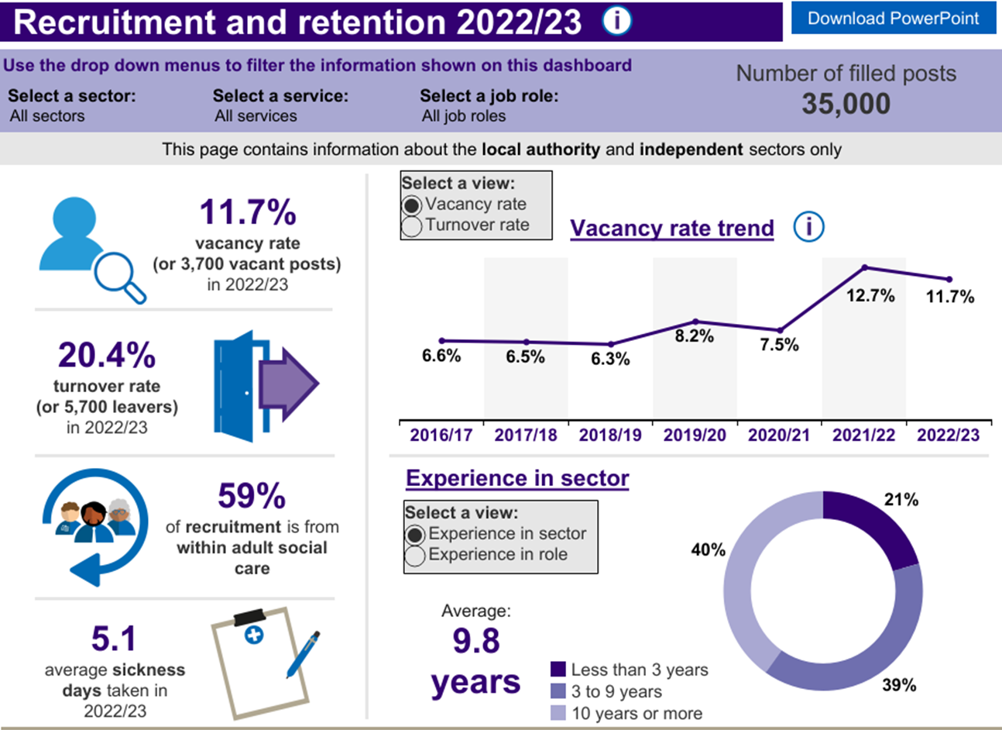
Why choose international recruitment?
Notes:
North Central London stats for Recruitment and Retention.

Slide 6
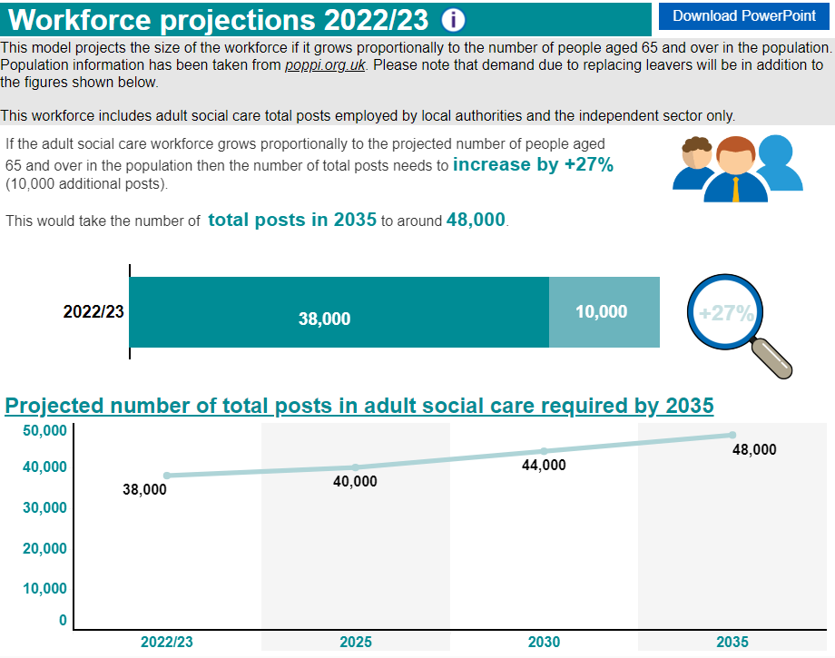
Notes:
North Central London workforce projections up to 2035 – Increase of 27%

Slide 7
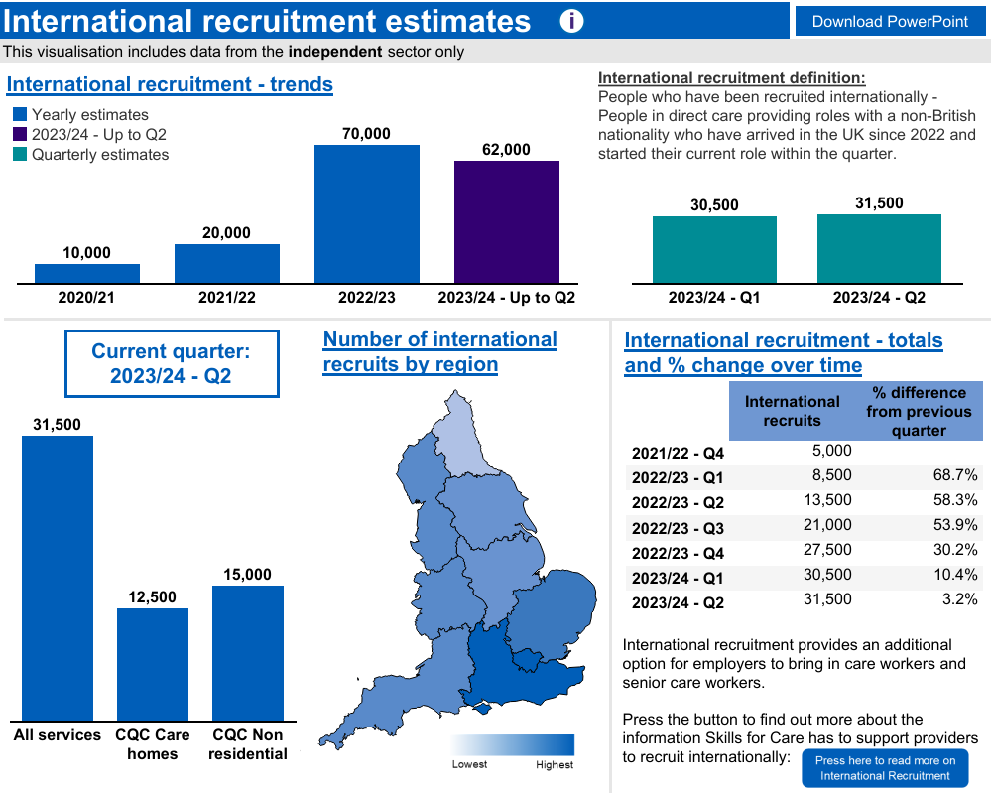
Notes:
International recruitment (skillsforcare.org.uk a lot of people have travelled here for work, different areas have used the sponsorship system in different ways, in the south east we have specific challenges when hiring international workers. With legislating changes it is likely the predicted numbers may change as we move forward. How many people arrive with one sponsor and transferer to others?

Slide 8
Look at all the ways you can recruit!
Notes:
Before you start looking for a team member from abroad look at the availability locally, are you using all the resources available, paid and unpaid to find you team?

Slide 9
Local and national recruitment resources
Widen your talent pool
Remove unfair barriers and attract people from different backgrounds, including international candidates, 16-17 year olds, candidates with disabilities and those with criminal convictions.
Care Friends
The Care Friends app makes it straightforward for staff to share vacancies on social media and rewards them for doing so.
I Care... Ambassadors
Attend job fairs and visit local schools and colleges to reach many potential recruits at one time. Your existing workforce are great advocates and potential recruits can learn a lot from the I Care...Ambassadors
Notes:
There is more information about these options available on the Skills for Care Website
- How to widen your talent pool
The Care friends app designed by Neil Eastwood
I Care Ambassadors in the region to speak from experience and support recruitment

Slide 10
International Recruitment Resources
Becoming a Visa Sponsor - Help Sheet for ASC Providers
Produced by the DHSC, this document takes you step-by-step through the process of gaining your sponsorship licence.
Overseas recruitment bite-size guide for social care providers
Produced by the Local Government Association, ADASS and the South East Social Care Alliance, the overseas recruitment bite-size guide for social care providers helps care providers explore and maximise opportunities that overseas recruitment offers.
Notes:
If you do decide international recruitment is right for you and yor organization these are some of the resources available to support you through the process.

Slide 11
Skills for Care resources
There is a section of the Skills for Care website dedicated to providing information on International recruitment (skillsforcare.org.uk)
This includes government guidance, videos, best practice examples and information on pastoral care.
Skills for care will soon be launching our international recruitment toolkit which is a joint project with DHSC.

Slide 12
Skills for Care resources
Ethical international recruitment: what you need to know
Our latest data shows that 70,000 people were recruited from abroad into direct care giving roles in 2022/23. We look at what you need to know about ethical international recruitment.
Safer Recruitment checklist
Recommendations that employers can take to gather and assess criminal record information for all applicants, including displaced people, to demonstrate you are taking a fair and consistent approach across all candidates
Notes:
It is important to carry out international recruitment ethically. Particularly considering how much people are giving up to come and work in our sector.
We also have our safer recruitment checklist to help providers recruit safely and meet the regulations when they do so.

Slide 13
Stay in touch
Ben Coleman, Locality Manager – North Central London
ben.coleman@skillsforcare.org.uk
Ali Porteous, Locality Manager – South West London
alison.porteous@skillsforcare.org.uk
Margaret Sharpe, Locality Manager – South East London
margaret.sharpe@skillsforcare.org.uk
.

