Slide 1

Welcome to your Skills for Care overview
13.3.24

Slide 2
We have developed a series of seminars & resources
https://www.skillsforcare.org.uk/Support-for-leaders-and-managers/Good-and-outstanding-care/Preparing-for-CQC-inspection.aspx
https://www.skillsforcare.org.uk/Support-for-leaders-and-managers/Good-and-outstanding-care/inspection-toolkit/Inspection-toolkit.aspx

Slide 3
Being prepared for CQC inspection seminar
This full day seminar supports managers and teams less familiar with CQC inspection to be better prepared and more confident to deliver Good or Outstanding care.
Includes two key elements:
The benefits of the CQC inspection and what the process covers, including standards and legislations.
How to involve others and prepare the evidence needed to meet CQC expectations.
Skills for Care provides facilitation, learning resources, and set up of the online delivery platform.
“It was fantastic, very informative and engaging. I feel more prepared and less anxious about my next visit due to having a better understanding of the changes.” Samantha Jane Grimes, Registered Manager, Sunnyside Home Care
Notes:
CQC Seminars
Meeting Care Quality Commission (CQC) standards is essential for any regulated adult social care provider to deliver Good or Outstanding care. This session will support managers and teams less familiar with CQC inspection to be better prepared and more confident. It can be delivered either face to face, or virtually. It can also be delivered via open access, allowing individuals to book into sessions directly via our website.
Delivered by two fully trained Skills for Care facilitators will deliver the seminar, to a maximum of 45 delegates.
The being prepared for CQC inspection seminar includes two key elements:
The benefits of the CQC inspection and what the process covers
- why inspection is important
- CQC standards and legislation
- CQC monitoring and inspection process, including ratings.
How to involve others and prepare the evidence needed to meet CQC expectations
Including:
- involving others in the inspection process
- the importance of quality assurance
evidencing that you meet CQC standards
the latest insight into CQC priorities.
Cost for open access for individual delegates £120 +VAT.
Cost for direct commission by an employer for delivery to their organisation £2,100 +VAT.
Cost for commission by a local authority or integrated care system on behalf of employers in their local area £2,500 +VAT
Being prepared seminar feedback…
“It was fantastic, very informative and engaging. I feel more prepared and less anxious about my next visit due to having a better understanding of the changes.”
Samantha Jane Grimes, Registered Manager, Sunnyside Home Care
“Really helpful session. The new assessment framework and it was made easy to understand. It has given me a clearer idea and also resources to help.”
David Mernissi, Registered Manager, Sunnyside House
“Really useful to hear other people’s experiences of their inspections and the importance of utilising the stakeholders.”
Amy Phillips, Supported living manager, Turning Point
"We thoroughly enjoyed the training, and the delivery was outstanding. Some managers are very experienced and some very new to the role and all gained new skills."
Sarah Woodward, Service Lead Manager, (OP) Catalyst Choices CIC
"It was great! The presenters were really knowledgeable and supportive. CQC is everyone's business and we need to be prepared all year round. It has reinforced that we should be prepared at any time as inspections are a good monitoring tool to ensure we are providing the best quality care at all times. It is good to know what we need to focus in on and how to prepare the wider team for an inspection."
Registered Manager, Homecare provider
“I enjoyed watching and learning about the new way CQC will be inspecting our service.”
Tracy Daley, Head of Operations, Accept Care
“I have enjoyed this course and have found it very useful.”
Registered Manager, Residential home

Slide 4
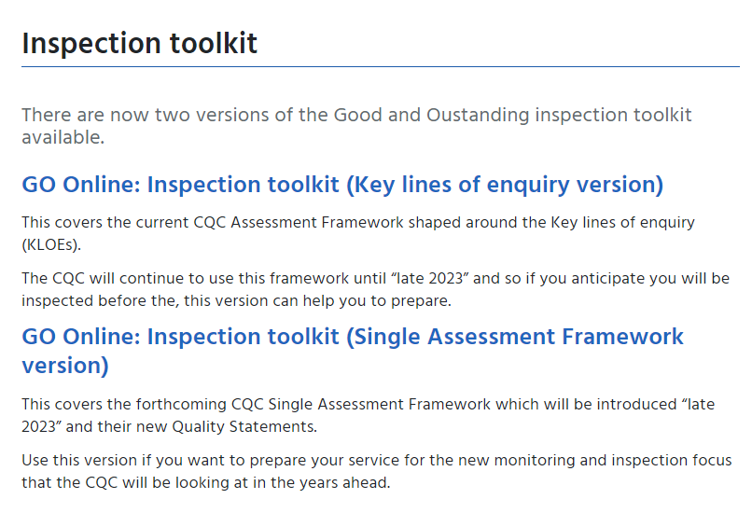
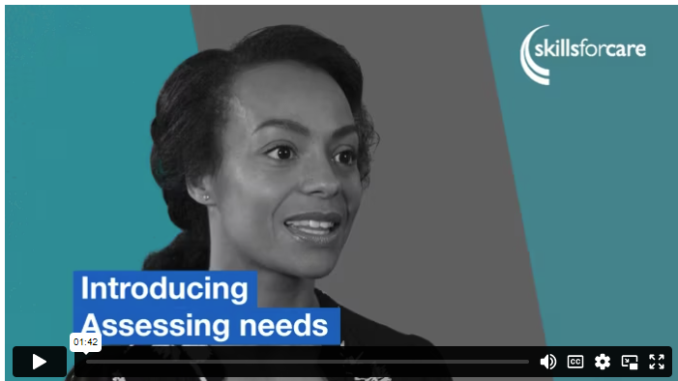
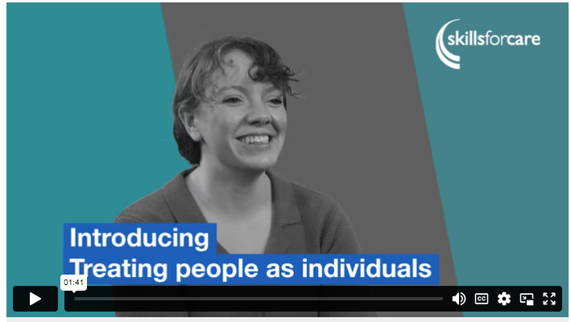
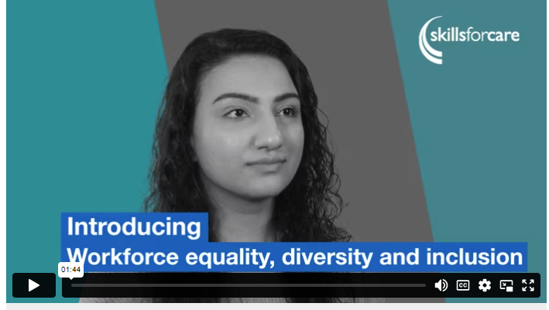
GO Inspection toolkit
Supporting you through the transitions to the new Single Assessment Framework
Notes:
Inspection toolkit (skillsforcare.org.uk) – link to live site
Currently we are in a transition phase with the CQC preparing to introduce their new Single Assessment Framework. During this period, both versions of the GO Online: Inspection toolkit are available to access.
If you anticipate you may be inspected before “late 2023”, you can use the Key lines of enquiry version to prepare for monitoring and inspection.
However, if you want to prepare for the future inspection process, choose the Single Assessment Framework version.
The new Single Assessment Framework version covers all 34 Quality Statements, providing easy access to further information about what the CQC will be looking at and how this relates to their Regulations.
Demo:
***If time permits, you can demo the toolkit***
We are going to take quick look at our website now to show you where you can find our Good and Outstanding care related resources, including a tour around the Inspection toolkit….
https://www.skillsforcare.org.uk/Support-for-leaders-and-managers/Good-and-outstanding-care/Good-and-Outstanding-Care-GO.aspx

Slide 5
New Product – CQC Delivering Outstanding Care
Describe what outstanding care looks like using practical real-life examples.​
Develop strategies to strengthen each Key Question and Quality Statement.​
Identify the evidence needed to exceed CQC expectations in inspections.​​
Assess the terminology used within the CQC inspections.​
Utilise the handouts and delegate pack to prepare to demonstrate outstanding care.​
Price per delegate £120 + VAT
“Excellent day, very informative and engaging. It was a really good mix and the facilitators kept everyone engaged. The environment was relaxed and the session made it real. Getting real life examples from other providers helped me think of other evidence ideas to record.” Lee-Ann Adriaanzen, Registered Manager, Solihull Homecare Ltd
Notes:
Delivering outstanding care seminar feedback…
“This covered the new single assessment framework and the quality statements, so it was really helpful. The facilitators interacted really well and kept it interesting. They knew their stuff. It will be a massive help to our next inspection. I will use everything I gained from it.”
Ben Miller, Registered Manager, Milkwood Care
“Outstanding is achievable, it's how we sell ourselves and the amazing we work we do that is going to get us that rating. The seminar was light hearted, witty and engaging. It isn't too wordy or complicated. The discussions were good and links to resources are really helpful. I've been writing things down during the session about what my service has achieved that will be a great way of evidencing our outstanding support.”
Joanne Crosby, Registered Manager, Alternative Futures Group
“Excellent day, very informative and engaging. It was a really good mix and the facilitators kept everyone engaged. The environment was relaxed and the session made it real. Getting real life examples from other providers helped me think of other evidence ideas to record.”
Lee-Ann Adriaanzen, Registered Manager, Solihull Homecare Ltd
“Very interactive. It was well delivered and we could contribute with ease. I took lots if examples away. Really enjoyed the day.”
Collette Tipton, Registered Manager, Total Case Management
“This course was very interesting and the trainers kept it specific and upbeat. I felt talking to other people on the course was helpful.”
Lindsey Pickering, Registered Care Manager, Broadfield House

Slide 6
Other info/useful links
To book on individually to any of the CQC seminars visit or talk to your SfC Locality Manager:
Workshops and seminars (skillsforcare.org.uk)
To commission CQC seminars for your organisation visit: https://www.skillsforcare.org.uk/About-us/Commission-our-work.aspx
Or e-mail our Business Development inbox:
business.development@skillsforcare.org.uk

Slide 7
Don’t miss out on funded essential training
Three funded training programmes, set up in response to the COVID-19 pandemic, are due to be discontinued at the end of March 2024.
This is the last year that this funded training is expected to be available - if you are interested in providing access to this for your staff, please ensure you sign up now as all training must be completed by 31 March 2024.
Rapid induction programme: new workers will receive training in eight topics and the main knowledge elements of the care certificate.
Refresher training: aimed at staff who urgently need refresher training which has expired or will expire soon, for them to continue to work safely.
Volunteer programme: Introduction to adult social care.
www.skillsforcare.org.uk/essentialtraining​
Notes:
AMENDED: JAN 2024
www.skillsforcare.org.uk/essentialtraining​
Details of the six endorsed learning providers who offer this training, and how they deliver it, as well as FAQs in response to any questions you may have about this training, can be found on the website.

Slide 8
Funded leadership programmes
Upskilling registered and frontline managers is key to providing good quality care and effectively supporting the workforce.
In recognition of this, some of our endorsed learning providers have been awarded funding to deliver the following leadership programmes:
Lead to Succeed
Well-led
Leading Change Improving Care
Understanding self-management skills
Understanding performance management
Understanding workplace culture
Find out more about the opportunity
Notes:
https://www.skillsforcare.org.uk/Funding/Funded-leadership-programmes.aspx
Eligibility Criteria
This opportunity is open to organisations that provide an adult social care service and directly employ paid care staff in England.
Participating employers must:
update their Adult Social Care Workforce Data Set (ASC-WDS) account(s) in line with the advertised requirements for the Workforce Development Fund (WDF)
https://www.skillsforcare.org.uk/resources/documents/Funding/Workforce-Development-Fund/23-24/ASC-WDS-requirements/ASC-WDS-and-WDF-requirements-23-24.pdf
ensure learners complete all elements of the programme by the end of March 2024.

Slide 9
Get ready for the CQC Single Assessment Framework
The CQC are now in the process of rolling out the Single Assessment Framework for adult social care providers.
Ensure your service is prepared by exploring recommendations, practical examples and resources covering the 34 new Quality Statements in our inspection toolkit.
Being prepared for CQC inspection seminar
Thursday 9 May 2024 | 10:00 – 15:30 | Zoom
An interactive seminar for services who want to understand the practical ways prepare for CQC inspection and evidence the quality care your service is providing.
Previous seminars have sold out so book your place now!
Notes:
AMENDED: FEB 2024
Inspection toolkit
https://www.skillsforcare.org.uk/Support-for-leaders-and-managers/Good-and-outstanding-care/Inspection-toolkit.aspx
Being prepared for CQC inspection seminar
https://events.skillsforcare.org.uk/skillsforcare/1843/home

Slide 10
Moving Up bookings open now
Our Moving Up programme supports Black and Asian minority groups who are managers or aspiring managers and have the desire and drive to progress in their career but are facing blockages and resistance preventing them from doing so.
Taking part in the programme gives participants an increased understanding of who they are, their strengths and weaknesses and a variety of techniques to help overcome any personal challenges. It will focus on increasing confidence and self-belief, to allow growth and progression to where they want to be in their career.
The Moving Up programme will be delivered through blended learning – a combination of self-learning modules and three live online sessions. If you, or someone you know, is interested, secure your place now.
If you, or someone you know, is interested, register by Friday 15 March.
www.skillsforcare.org.uk/Moving-up
Notes:
NEW: FEB 2024
https://www.skillsforcare.org.uk/Support-for-leaders-and-managers/Developing-leaders-and-managers/Moving-Up.aspx
Cost of the programme
The programme costs £750+VAT.
The next programme dates (which are three live online sessions) are:
Tuesday 30 April, 09:30 - 16:00
Tuesday 28 May, 09:30 - 16:00
Wednesday 26 June, 09:30 - 16:00

Slide 11

New guidance: Developing nursing placement opportunities
Social care nursing placements offer a wealth of opportunities for employers who can help students reach their full potential in developing their knowledge and skills within the learning environment.
With an ongoing demand for nurses and nursing associates within the sector there is a need to increase placement capacity.
This guidance is aimed at employers and those considering hosting students to help them navigate the process of linking in with higher education institutions and highlights the benefits that there are for employers in hosting students.
View the guidance
Notes:
NEW: JAN 2024
Download the free resource https://bit.ly/47TAbaO

Slide 12

New registered managers webinar…
Leading effective teams – Practical ways to lead effectively and collaboratively with your team
Thursday 21 March 2024 I 10:00 – 11:00 | Zoom
This webinar is delivered by Affina Organisation Development (AOD) and will explore how AOD apply the inspirational research of Professor Michael West to shape day-to-day practice in leading effective teams in many settings.
Gather advice, tips and practical ways to lead effectively and collaboratively with your teams which you can apply back in the workplace including:
Meeting the ABC (autonomy, belonging and contribution) of core needs in the workplace.
Developing a sense of belonging in a 'real' team.
The impact of focusing on team identity.
Register now
Notes:
NEW: FEB 2024
https://events.skillsforcare.org.uk/skillsforcare/1850/home

Slide 13
Our latest blogs and articles
The benefits of learning and development for managers
We hear from managers about the learning and development they’ve undertaken and why they’ve found this beneficial
Why managers shouldn’t be afraid to develop their staff
Victoria Collier, Deputy Head of National Workforce Development, Capability and Skills at Skills for Care discusses why managers shouldn’t fear developing their team members.
Resources to support learning and development in 2024
A round up of all the resources Skills for Care offers to support your learning and development needs both for yourself and your workforce.
What data tells us about how learning and development support retention
We round-up what our latest data tells us about how learning and development supports retention.
Notes:
https://www.skillsforcare.org.uk/news-and-events/blogs/the-benefits-of-learning-and-development-for-managers
https://www.skillsforcare.org.uk/news-and-events/blogs/why-managers-shouldnt-be-afraid-to-develop-their-staff
https://www.skillsforcare.org.uk/news-and-events/blogs/resources-to-support-learning-and-development-in-2024
https://www.skillsforcare.org.uk/news-and-events/blogs/what-data-tells-us-about-how-learning-and-development-supports-retention

Slide 14
Registered manager membership
Skills for Care is the membership organisation for registered managers.
Through membership, we support managers to develop best practice and knowledge, keep up-to-date with sector developments and share ideas with like-minded peers.
Membership benefits include:
A printed copy of our ‘Social care manager’s handbook’
Monthly newsletters including practical information and guidance
Access to Good and Outstanding care guide: Single Assessment Framework version and 34 Quality Statement Recommendation checklists
An exclusive annual resource when you renew your membership
Become a member for £35 a year.
www.skillsforcare.org.uk/membership
Notes:
www.skillsforcare.org.uk/membership

Slide 15

Registered manager membership – renewal resource
As part of our registered manager membership, all members that renew their membership receive an exclusive resource.
For those renewing from 1 April 2023 – 31 March 2024, they will receive a hard copy of Compassionate Leadership by Professor Michael West CBE.
This book explores how attending to, understanding, empathising with and helping those you lead can support them to respond effectively to the challenges they face in their work.
The four elements of compassionate leadership play a crucial part in all aspects of your role as manager, including staff wellbeing, retention, and creating safe, supported cultures
within your services.
www.skillsforcare.org.uk/membership
Notes:
www.skillsforcare.org.uk/membership

Slide 16

Good and outstanding care guide – Single Assessment Framework edition
Our updated Good and Outstanding care guide has been co-produced with The Outstanding Society and covers the new CQC inspection model.
Aimed at frontline managers and those supporting regulated services, it helps regulated providers to prepare to evidence to meet the CQC’s 34 new Quality Statements.
This latest edition is an exclusive free resource for all our registered manager members.
Become a member for £35 a year
www.skillsforcare.org.uk/membership
Notes:
www.skillsforcare.org.uk/membership

Slide 17
Deputy manager networks
These networks are specifically for deputy managers, team leaders and assistant managers
The next Deputy manager network for our area is the 14th of March in the morning and DMs can book onto the event via the link below. This is an online forum
Find your local deputy manager network:
www.skillsforcare.org.uk/deputymanagers
Notes:
Skills for Care currently supports over 140 registered manager networks, which are recognised as being invaluable by many managers.
We know the benefits these networks provide to managers, so we are setting up a new network specifically for your deputies.
Each network meeting will be virtual and facilitated by a Skills for Care Locality Manager. It will focus on themes including wellbeing and resilience, self-confidence and personal effectiveness, delegation with confidence and dignity, communicating inside and out and making sense of information.
Please note that not every part of the country will be covered by a Deputy Manager Network this year but we will be looking at the success of the first networks to consider wider expansion at a later point. If there is not a network in your area, and you would be interested in joining one in future please email RM.networks@skillsforcare.org.uk.

Slide 18
International recruitment support
Recruiting internationally is a great way to find skilled and diverse workers, but employers often tell us they have trouble navigating the legalities of recruiting internationally
Our international recruitment webpage has a range of resources including:
Webinar recordings
Guidance and checklist for gathering and assessing criminal record information including displaced people
Links to other useful sources of information including
  Overseas recruitment bite-size guide
  Code of practice for international recruitment
  Ethical recruiters list
  Government guidance
  Pastoral care guide for international recruitment
www.skillsforcare.org.uk/Internationalrecruitment
Notes:
https://www.skillsforcare.org.uk/Recruitment-support/Attracting-people/International-recruitment.aspx
New international recruitment support
Recruiting internationally is a great way to find skilled and diverse workers, but employers often tell us they have trouble navigating the legalities of recruiting internationally. Our international recruitment webpage has a range of resources including new guidance on gathering and assessing criminal record information for UK and non-UK nationals, including displaced people, written in partnership with employment experts.

Slide 19

State of the adult social care sector and workforce in England report
Our annual ‘State of the adult social care sector and workforce in England’ has been launched.
Some specific registered manager insights are:
In 2022/23 there were around 25,000 registered managers in post.
The registered manager vacancy rate was 10.6%, equivalent to an average of 2,900 in 2022/23. This is high compared to more senior managers and other managerial roles
Registered managers had a turnover rate of 23.2%, equivalent to around 5,700 leavers during 2022/23. This rate was much higher than other managerial roles, but it has decreased from last year when it was 26.3%.
Take a look at our website to see more info on registered managers and data visualisations
Notes:
NEW: OCT 2023
https://www.skillsforcare.org.uk/Adult-Social-Care-Workforce-Data/Workforce-intelligence/publications/national-information/The-state-of-the-adult-social-care-sector-and-workforce-in-England.aspx
https://www.skillsforcare.org.uk/Adult-Social-Care-Workforce-Data/Workforce-intelligence/publications/Topics/Registered-managers.aspx
In 2022/23 there were around 25,000 registered managers in post. The registered manager vacancy rate was 10.6%, equivalent to an average of 2,900 in 2022/23. This is high compared to more senior managers and other managerial roles.
Registered managers had a turnover rate of 23.2%, equivalent to around 5,700 leavers during 2022/23. This rate was much higher than other managerial roles, but it has decreased from last year when it was 26.3%.
Confirming what we have learnt from previous reports, our latest intelligence tells us that the more time across the previous year an establishment spent with the registered manager in post, the higher the CQC score was on average.
The average age of a registered manager was 48.5 (compared to 44.6 for whole sector). 32% of them are 55 and over (compared to 29% for whole sector). There are also set to be 7,900 registered managers (32%) reaching retirement age in the next 15 years, placing an emphasis on succession planning to ensure that services continue to provide well-led, consistent quality care.

Slide 20
Developing the care workforce
The Department of Health and Social Care (DHSC) has outlined plans to improve the career prospects of the domestic care workforce through training, qualifications and a clearer, care career path.
Launch of the first part of the Care Workforce Pathway
Introduction of the Care Certificate qualification
A new digital leadership qualification
£20 million for apprenticeships
An uplift to the Workforce Development Fund
Notes:
This announcement from DHSC about their plans for a workforce reform package is welcome as it includes the first version of the Care Workforce Pathway and the introduction of the Care Certificate Qualification, which are both projects which Skills for Care has consulted and supported on with the sector.
Launch of the first part of the Care Workforce Pathway –Skills for Care has worked in partnership with DHSC and consulted with the sector to develop a national career structure for the adult social care workforce The initial phase of this work focusses on articulating the knowledge, skills and behaviours associated with roles providing direct care.
Introduction of the Care Certificate Qualification – £50 million to support up to 37,000 in direct care roles enrol on the new Level 2 Adult Social Care Certificate qualification between June 2024 and March 2025. Again, Skills for Care consulted and supported the Care Certificate’s development with the sector. This reform will transform the existing standards into a recognised qualification aiming to improve portability. It reflects the existing Care Certificate standards with updates on emerging themes such as personal wellbeing, digital skills and equality and diversity.
A new digital leadership qualification –Skills for Care, in partnership with NHS-TD has developed a specification for a digital leadership qualification. This qualification aims to help equip social care leaders and managers with the confidence and capability to lead the implementation and use of technology in the delivery of care. Timescales for the development and launch of the qualification are yet to be finalised.
£20 million for apprenticeships - Local authorities and adult social care providers will be able to use the money towards training and supervising new social work and nurse apprentices.
An uplift to the Workforce Development Fund -This is for the 2023-24 financial year and will expand access to funding for learning and development.

Slide 21
Care Workforce Pathway
This first part focuses on direct care and support roles at four levels
Role category A: new to care
Role category B: care or support worker
Role category C: supervisor or leader
Role category D: practice leader
Each category has a set of behaviours, knowledge and skills expected of someone to work at that level
Notes:
The first phase of the Care Workforce Pathway:
The role categories - This first part of the pathway focuses on direct care and support roles at four levels with each level relating to a role category, they are:
role category A: new to care
role category B: care or support worker
role category C: supervisor or leader
role category D: practice leader
Contained within each role category is a defined set of behaviours, knowledge and skills expected of someone to work at that level. The care workforce pathway also demonstrates how someone can develop within each category, building on their knowledge and skills to provide the best possible care to the people who receive their support.
Roles within each category may have different job titles but the roles will have a high degree of similarity across the sector. The pathway includes a number of suggested learning opportunities to help members of the workforce develop knowledge and skills within a role or within a specific area of practice.
Role category descriptions
Each of the four role categories outline the following:
What people do in their work
A brief persona for each role category to help contextualise the information included
The behaviours people must show (must do)
Knowledge and skills people need to have (should do)
Specific areas of practice (can do) and current suggested learning opportunities
Links to wider adult social care workforce reform
To support the implementation of the pathway, a training offer will include funding for:
A new Care Certificate Level 2 qualification – and over time DHSC want this new qualification to become the baseline standard for all new care and support workers to work towards when they join the profession
Learning and development, including training courses on:
healthcare interventions to support delegation
learning disabilities including autism
dementia care
leadership
digital skills training and development of a new digital leadership qualification

Slide 22
The Pathway values
Think Local Act Personal developed values which underpin expected behaviours and feature throughout the pathway
Kind, compassionate and empathetic
Honest, trustworthy and reliable
Respect
Courageous and principled
See the whole person
Flexible, open and learning
Proud and positive
Notes:
TLAP worked with people who draw on care and support to develop a universal set of values for the sector.
The values that have been defined apply across all role categories outlined in first phase of the pathway. The intention is for these values to apply across the whole of the adult social care workforce.
Some employers and sector organisations will already have values that meet the needs of their organisation, workforce and people who draw on care, which may already align or partially align with the values set out within the pathway. We do not expect the pathway values to replace existing organisational values where these are working well. However, we would suggest that all organisations consider how the pathway values might be useful to them.

Slide 23
Next steps
DHSC and Skills for Care will start development of phase 2 of the Pathway
We recommend employers consider the Pathway and how they can apply it.
Find out more:
https://www.gov.uk/government/publications/care-workforce-pathway-for-adult-social-care
Notes:
Following release of Part 1 of the Care Workforce Pathway, DHSC and Skills for Care will commence development on Phase 2 of the pathway.
This will include a further four role categories to add to the existing four published within Part 1. These four role categories will be Deputy Manager, Registered Manager, Enhanced/Complex care roles and Personal Assistants. As part of the development of the next part of the pathway Skills for Care, on behalf of DHSC, will be engaging further with the sector for insight and feedback on what knowledge, skills and behaviours each of the above role categories require. We will also work with DHSC to scope further parts of the pathway and plan for implementation and adoption.
We recommend that all employers in the sector should consider the Pathway and think about how they can apply it.
This could involve looking at how existing organisational structures and job roles map onto the Pathway and using the Pathway to guide conversations about careers, development and progression.
https://www.skillsforcare.org.uk/Developing-your-workforce/Care-workforce-pathway-for-adult-social-care.aspx

Slide 24
Care Certificate qualification
The Level 2 Adult Social Care Certificate qualification will be accredited
The qualification aims to launch in June 24 and is embedded into the Care Workforce Pathway.
DHSC will be providing funding.
Whilst this work is underway the Care Certificate standards should continue to be used.
Further details and information will be shared by DHSC in the coming months.
www.skillsforcare.org.uk/CareCertificateQual
Notes:
The Level 2 Adult Social Care Certificate qualification will be accredited ensuring its quality and recognition by employers as care workers come to work for them. This will also reduce the costs and burden of repeat training on employers.
The Level 2 Adult Social Care Certificate qualification aims to launch to the sector in June 24 and is embedded into the Care Workforce Pathway. Awarding Organisations are currently developing the qualification.
The DHSC will be providing funding. The DHSC have announced that funding that will be made available to support people to undertake the Care Certificate Qualification, but we don’t yet have detail on how this funding will be disbursed or claimed.
Whilst this work is underway the Care Certificate standards should continue to be accessed and used by the adult social care sector.
Further details and information on the rollout of the qualification and interaction with the current Care Certificate standards will be shared by the Department of Health and Social Care throughout the coming months.
Keep up to date via:
https://www.skillsforcare.org.uk/Developing-your-workforce/Care-Certificate/Level-2-Adult-Social-Care-Certificate-qualification.aspx

Slide 25
Keep in Touch www.skillsforcare.org.uk
Alison.Porteous@skillsforcare.org.uk
Join our whatsapp groups for the area sign up for enews via our website
☏ 0113 241 1260 ✉ RMAdvice@skillsforcare.org.uk

