Slide 1
WELCOME TO JMW SOLICITORS FOR YOU
AND YOUR BUSINESS
International Recruitment within Adult Social Care - Compliance and Best Practice

Slide 2
Dipesh Shah
Partner & Head of Corporate Immigration
D: 0203 675 7597 M: 07732 065 402 F: 0203 675 7576 E: Dipesh.Shah@jmw.co.uk
Hateem Ali
Partner
D: 0203 987 7092 M: 0785 836 4821 F: 0203 675 7576 E: Hateem.ali@jmw.co.uk
Yasmeen Hamza
Senior Associate
D: 0203 987 7115 M: 07936 035 885 F: 0203 675 7576 E: Yasmeen.hamza@jmw.co.uk

Slide 3
Recruiting Overseas Workers within the Adult Social Care Sector
Our Session today will cover the following:
Effective Sponsor Licence Management & Compliance.
What happens in a Home Office Compliance Audit.
On-boarding & Right to Work Checks.
Q&A.

Slide 4
Recruiting Overseas Workers within the Adult Social Care Sector
Sponsor Licence Overview specific to the care sector
The roles we can consider within the Care Industry
Highlighting the need to assign your Certificate of Sponsorship correctly when recruiting Care Workers including the actual number of hours they will work
Responding to Home Office requests for Additional Information when applying for a Certificate of Sponsorship (CoS)
How to minimize delays when requesting for Certificates of Sponsorships and Best Practice Case Studies

Slide 5
Compliance Audits?
UKVI could undertake a compliance visit before granting a licence or at any time during the validity of your Sponsor Licence.
This is to ensure your business has the relevant HR systems in place to monitor migrants and right to work checks.
It does not happen for every application but could so be prepared!

Slide 6
Compliance Audit triggers
The Home Office have received intelligence about your organisation.
You have hit a trigger point for the number of migrants you have sponsored.
You are renewing your Sponsor Licence
Another unit within the Home Office has requested the visit as part of a joint operation
You are a B-rated Licence holder and are therefore subject to an action plan that now requires assessment
You have requested the visit
HMRC ‘Smart’ Checks reveal you may not have paid your workers in accordance with your CoS.
A history of refused visa applications or applications for Certificates of Sponsorship
Civil Penalties and not following correct Right to Work processes
Disgruntled employees

Slide 7
Compliance Audits?
The different types of Home Office Audits:
Pre-Licence Audit
Post Licence Audit
Digital Compliance Audits
In-Person Audits by UKVI Compliance Officers

Slide 8
What happens during a Compliance Audit?
Prior to the Audit:
Initial communication from Home Office setting a date for the Compliance Audit; a request for information/documents and a list of employees they would like to interview.
What takes place on the day of the Audit:
On the day of the Audit the Compliance Officers will hold interviews with your key personnel and selected employees
What happens at the end of the interview?
Your rights?
Post Audit procedures?

Slide 9
What will a Home Office Compliance Offer consider when conducting a Compliance Audit?
Your HR systems to ensure you are meeting their sponsor duties.
Whether you or your organisation’s activities pose a threat to immigration control.
Whether the original number of CoS requested on the sponsor application or annual request is still justified.
Whether your staff are complying with the conditions of their leave to stay in the UK.
Whether you continue to have a trading presence.

Slide 10
What will a Home Office Compliance Offer consider when conducting a Compliance Audit?
Candidate Visa expiry dates have been recorded and you have their up-to-date contact information.
Salary being paid in accordance with Certificate of Sponsorship
Employees day to day tasks are in line with their Certificate of Sponsorship
Online Right to Work Checks correctly completed and on HR files
Any changes in migrant circumstances
have been reported to the Home Office
This is not an exhaustive list!

Slide 11
Preparing for a Home Office Compliance Audit
Employers should ensure their immigration related records are up-to-date:
Sponsored employees’ human resources files contain all relevant documentation in accordance with the requisite government criteria;
Where a recruitment campaign has been used to support any Skilled Worker application, all documentation is available;
Right to work checks are available for all employees (including non-sponsored/European Economic Area /British nationals and Skilled Workers);
All relevant Sponsor Management System updates following changes of migrant circumstances have been reported to UKVI and
All details listed regarding the company are correct on the Sponsor Management System (i.e. address, company name, key personnel).

Slide 12
Compliance Audit Outcomes
Successful Audit- No further action required!
Written warning – followed closer monitoring by the Home Office
Licence suspended pending further investigation and representations/documents received from Sponsor Licence holder

Slide 13
What happens if your Sponsor Licence is revoked?
The UKVI can revoke a sponsor licence for various reasons, such as:
non-compliance with the sponsor duties,
poor record-keeping,
fraud or abuse of the system.
If a sponsor licence is revoked, the provider will lose the ability to sponsor new staff and to extend the visas of existing staff.
The UKVI will also curtail the visas of any staff who are currently sponsored by the provider, giving them 60 days to find another sponsor or leave the country.
– followed closer monitoring by the Home Office

Slide 14
What happens if your Sponsor Licence is revoked?
Where you as a provider are at risk of losing your sponsor licence, you should act quickly to mitigate the impact on your service delivery and service users.
You should assess your current and future staffing needs and identify any gaps or vulnerabilities.
You should also communicate with your staff and service users (and/or their family members) about the situation and provide support and guidance where possible.
You should explore alternative sources of recruitment, such as local or EU workers (EU Settlement Scheme) or other types of visas such as spouse visas, graduate visas or dependant visas
You should also review your business continuity plan and update it accordingly.
d closer monitoring by the Home Office

Slide 15
What happens if your Sponsor Licence is revoked?
A business continuity plan should clearly outline how a provider will continue to operate in the event of a disruption or crisis. It should cover aspects such as risk assessment, contingency measures, roles and responsibilities, communication channels, recovery strategies and evaluation methods.
A business continuity plan can help a provider to cope with unexpected situations, such as losing your sponsor licence, and minimise the negative effects on service delivery, staff and service users.
In conclusion, losing a UKVI Sponsor licence can be a serious threat for adult care providers who rely on international staff. However, by understanding the legal and process implications, planning ahead and having a robust business continuity plan, you can reduce your risk and prepare for the worst-case scenario.
monitoring by the Home Office

Slide 16
Sponsor’s duties: Co-operation
The sponsor must co-operate with the Home Office by:
Allowing the Home Office personnel access to any of its premises on demand
Visits can be unannounced
Adhering to any action plans set by the Home Office
Complying with any good practice guidance to minimise immigration abuse
Not be abusive to Home Office officials

Slide 17
Sponsor’s duties: Record keeping
Keep a list of records
Be kept for the duration of the sponsor licence
Sponsored migrant’s documents: Be kept for the duration of the sponsored migrant’s employment and two year after the employment has ended

Slide 18
Sponsor’s duties: Record keeping – What Docs?
All documents submitted as part of the licence application
For any sponsored migrant:
Record worker details – full name, position, gender, DOB, nationality, NI number, bank details
Copy of their passport, other ID, visa, Current BRP Card
Up to date contact details including address, email address and mobile number, emergency contact number and next of kin.
History of detailed record of any absences
Signed Employment Contract

Slide 19
Sponsor’s duties: Record keeping – What Docs?
Evidence of Staff Rotas and number of hours worked
Employee change of circumstances form to update contact details
Evidence of system of monitoring the above
Payslips
Job Description for their role
CV and any applicable Qualifications/References
Evidence of any on-going training or in-house training provided
Pension opt-out if applicable

Slide 20
Sponsor’s duties: Reporting Requirements
The sponsor must report the following to the Home Office within 10 days, where sponsored migrant(s):
Not turn up for their first day of work without your knowledge.
Absent for 10 ‘working’ days or more without authorisation
Employment is terminated
In breach of the conditions of their leave
Significant change in circumstances i.e. change in terms and conditions of employment – job role, pay etc.
Details of any third party (agency) – during the recruitment
Significant change in Sponsor’s circumstances – insolvency
If the worker is absent from work without pay, or on a reduced salary for more than 4 weeks in total in any calendar year.

Slide 21
Supplementary Employment
This seems to be a particular issue when employing Domiciliary care workers, home care workers and care workers, especially where the salary and hours prescribed on the Certificate of Sponsorship are at the ‘minimum levels’ permitted by the Home Office; i.e. £20,960 based on a 37.5 hour working week.
For any prospective employer considering employing a candidate seeking supplementary employment to work an additional 20 hours a week and where you are presented with the above scenario you would need to consider the following:
Sponsored migrants can do additional paid work on a Health & Care Worker visa AS LONG AS they are doing the main job they are being sponsored for. Any supplementary work MUST take place outside their core working hours.
If their extra job is also eligible for a Health & Care Worker visa or the job is in a shortage occupation, they can work for up to 20 hours a week for an additional employer without the need to be sponsored for that role.
If the worker undertakes additional employment that does not meet the supplementary employment criteria the worker will be in breach of their conditions of stay.
Their current employer could face the possibility of a Compliance Audit by the Home Office and the possibility of their Sponsor Licence being revoked for not abiding by the hours/salary they had confirmed when assigning a Certificate of Sponsorship to the potential employee.
The potential employee also faces the possibility of their visa being curtailed to 60 days within which time they will need to apply for a new Skilled Worker visa in order to work in the UK.

Slide 22
Supplementary Employment
In light of the above where you are presented with the above scenario from a prospective candidate you should certainly exercise caution if you employ them for 20 hours a week.
Instead, it would be better to consider employing them on a full-time basis under your Sponsor Licence rather than run the risk of employing them without the necessary permission or authority to work in the UK.
You would however need to ensure their new Skilled Worker visa to work for you is successfully approved before they commence working for you.

Slide 23
RIGHT TO WORK CHECKS Question:
“I have conducted a Home Office Right to Work check on the employee. It confirms that the prospective candidate has a valid Skilled Worker Visa and is permitted to work an additional 20 hours a week.
Surely, I would be covered if I have followed the correct Right to Work processes to employ them?”

Slide 24
RIGHT TO WORK CHECKS
Whilst conducting a Right to Work Check correctly provides you with a statutory excuse from any civil liability; the definition of illegal working is ‘knowingly employing an illegal worker or having reasonable cause to believe the employee has no right to work’.
Where you are ‘aware’ that a prospective candidate may be in breach of the conditions of their Skilled Worker visa you could potentially be employing them illegally.
It could also open the risk of a fine for illegal working, which is increasing to £60,000 per employee from January 2024 (£45,000 for first time offenders).
Whilst in practice it may be difficult for the Home Office to prove you were aware they may not be working in compliance with their Skilled Worker Visa it is important to ensure you protect you and your organisation from any risk of a fine. This could include obtaining a copy of their Certificate of Sponsorship and Work Rotas with their current employer and having a strict Right to Work clause in your employment contracts.
There is also a risk that the prospective candidate’s Skilled Worker visa could be curtailed by the Home Office, which could affect their continued ability to remain employed with you.

Slide 25
Reductions in Salary & Working Hours
QUESTION:
We are a small organisation providing home care services.
We recently lost a patient where we had provided 24-hour care.
This was a large contract for the company and as a result until I find another patient contract I cannot give as many hours to the staff who were previously working with this patient.
A number of the staff working on this contract are under a Skilled Worker Visa to work for our organisation, for which we have paid a large amount in Home Office fees.
What should we do?

Slide 26
Reductions in Salary & Working Hours
When an employer assigns a Certificate of Sponsorship to a candidate applying for a Skilled Worker Visa, they would have confirmed within this document that they will be providing the candidate with a minimum guaranteed salary based on the candidate working a minimum number of hours per week.
In accordance with their Sponsor Licence duties, an employer is duty bound to pay their employees at the salary and hours stipulated in the Certificate of Sponsorship, even where you may have lost a large contract as per the above scenario.
The only exception permitted by the Sponsor Licence guidance is where there has been a temporary reduction in the worker’s hours, or a phased return to work, for individual health reasons.
For employer considering a reduction in salary:
You must notify the Home Office via your SMS system if a worker’s salary is reduced for a reason not related to a permitted absence after you have assigned a CoS.
If as a result of the deduction in salary and hours, the worker would continue to be eligible for points for salary (£20,960/£26,200 p.a.) you can continue to employ the worker under a Skilled Worker Visa. No further action is required.

Slide 27
Reductions in Salary & Working Hours
HOWEVER:
If their revised salary no longer meets any salary, hourly or going rate requirement for the job or the route on which they are being sponsored, or the change is otherwise not permitted by the Immigration Rules or sponsor guidance you must stop sponsoring them.
You must tell notify the Home Office you have stopped sponsoring the worker via your SMS account. At this point you will have no further responsibility for the candidate and will have discharged your duties towards them in compliance of your Sponsor Licence duties.
Depending on how long the employee has worked for your organisation you will then be entitled to a refund of any portion of the Immigration Skills Surcharge that is outstanding.
The employee will then receive correspondence from the Home Office curtailing their visa to 60 days within which time they must either leave the UK or submit a fresh application to work with another organisation.
The Home Office have recently introduced smart checks with HM Revenue & Customs which will automatically alert them should an employer not be paying their employee in accordance with the salary/hours stipulated within their Certificate of Sponsorship.
Failure to abide by your Sponsor Licence duties could subsequently result in a compliance audit by the Home Office and possible suspension of your Sponsor Licence.

Slide 28
Working on a Contract Basis
QUESTION:
We are a small organisation providing home care services. We recently lost a patient where we had provided 24-hour care.
This was a large contract for the company and as a result until I find another patient contract I cannot afford to give as many hours to the staff who were previously working with this patient.
A number of the staff working on this contract are under a Skilled Worker Visa to work for our organisation, for which we have paid a large amount in Home Office fees. Whilst I do not want to lose these staff, I also cannot afford to pay them their salary until we secure a new patient contract.
I am however aware of another organisation that desperately needs staff for their organisation.
Can I lend them these members of staff to this organisation until I find another patient contract?

Slide 29
Working on a Contract Basis
Where an employee is employed under a Skilled Worker Visa, they must remain employed with the organisation that has sponsored their Skilled worker visa application. It is NOT possible to supply ‘labour’ from one organisation to another and employers will need to consider the following:
You cannot sponsor a worker if you will ‘NOT’ have full responsibility for all the duties, functions and outcomes or outputs of the job they will be doing.
If the worker will be contracted to undertake an ‘ongoing routine role or to provide an ongoing routine service’ for a third party who is not the sponsor, regardless of the nature or length of any arrangement between you and the third party this will not be permitted.
If the job amounts to the ‘hiring out’ of the worker to another organisation (third party) who is not the sponsor to fill a position with them, whether temporary or permanent, regardless of any genuine contract between you and the third party this is also not permitted.
If the Home Office suspect you are hiring a worker to a third party as routine labour, they will revoke your licence!
Furthermore, if you accept a worker supplied to you from another organisation which falls foul of the above criteria, they would not have a Right to Work for your organisation and thus you could be liable to a civil penalty of up to £20,000 (£60,000 from January 2024)

Slide 30
Evidence of Recruitment Practices
Within the Healthcare sector the Home Office are now expecting to see:
Clear evidence of a person’s previous experience relevant to the Healthcare industry
Evidence references have been obtained from overseas
Relevant qualifications
Continued on-going attempts to recruit from within the UK
Whilst it is likely that the ‘Carer’ SOC Code 6145’ will continue to remain within the Skilled Worker criteria we are seeing more rigorous checks being conducted by the Home Office on employers as well as a new subjective test which allows the Home Office the ability to interview applicants to ensure there are genuinely able to do the job they have been sponsored for.

Slide 31
Pre-Employment Checks
Providers should apply the same process for staff recruited from abroad as they would for other staff.
Employers must do all they can to ensure that people they appoint from overseas are suitable to work with adults who use care services and/or children
DBS Checks and Overseas Criminal Record Checks
Ensuring overseas job applicants have the necessary experience, qualifications and permits to work in a UK care setting

Slide 32
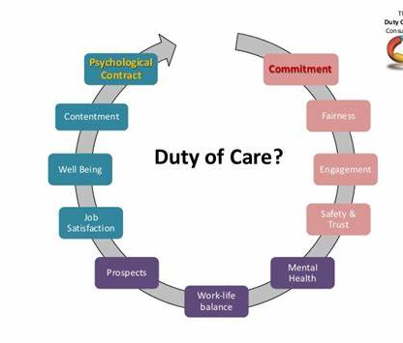
Duty of Care
The key to success is the care and effort you put in to help people settle in the UK and in their new role.
Put yourself in their shoes and think about what would help you if you went to work in a new country!
What you do will depend on your circumstances, location and the extent to which your new recruits have family and friends already here.

Slide 33
Pastoral Support and Retention
Capacity:
Having the right UK capacity in place to take responsibility for all the activity that is required to be legally compliant and manage a successful recruitment approach is essential
Preparing your UK Team:
If you are new to overseas recruitment, you may find your UK team have mixed feelings about it.
Helping your staff to understand the reasons for trying overseas recruitment and giving them a chance to hear about the experience from other organisations who have used overseas recruitment will help allay and worries

Slide 34
Advice from Social Care Providers
“This is very do-able for a small organisation”
“Be open-minded”
“Take the time to do your research, read and understand the guidance. The responsibilities that come with holding a sponsor license are on you as an individual so take them seriously”
“Plan ahead and allow time”
“If you decide to use a recruitment agency, make sure they are ethical in their practices, only use them if they are on the Government Agency list”
“Make sure you’ve got everything lined up for arrival of the recruits so that they can hit the ground running, for example, DBS and other pre-employment checks”
“Invest time in looking after your recruits when they arrive and help them settle in”
“The process is frustrating at first but gets easier as you do it more. If you decide to use a solicitor, make sure you save all of your documents that you are required to submit to the Home Office. Save everything in one place where you can easily access it in the event that you need to re-submit it at a different stage of the process”

Slide 35
RIGHT TO WORK CHECKS
An employer has a legal responsibility to prevent illegal working.
By conducting a simple, ‘Right to Work check’, when hiring new or retaining existing employees, with time- limited permission to stay in the UK you establish a statutory excuse from any civil penalties.

Slide 36
Right to Work Checks
Obtain
Check
Copy
You should conduct a right to work check BEFORE you employ a person to ensure they are legally allowed to do the work in question for you.
Employers must do one of the following before the employee commences employment which if conducted properly will provide you with a statutory excuse:
Manual right to work check
A right to work check using IDVT via the services of an IDSP
A Home Office on-line right to work check.

Slide 37
Sanctions against illegal working
If you are found to be employing someone illegally and you have failed to carry out the prescribed checks, you may face the following sanctions:
A civil penalty of up to £20,000 per illegal worker (Rising to £60,000 in January 2024 (£45,000 for first time offenders)
A prison sentence of up to 5 years and an unlimited fine
Closure of the business and disqualification as a director
Not being able to sponsor migrants
Seizure of earnings made as a result of illegal working

Slide 38
How does the online service work?
The service works on the basis of the individual first viewing their own Home Office right to work record.
They may then share this information with you, by providing you with a ‘share code’, which, when entered along with the individual’s date of birth, enables you to access the information.
The share code will be valid for 30 days.
It is vital that you access the service using the employer part of the service in order to obtain a statutory excuse.
Notes:
The service works on the basis of the individual first viewing their own Home Office right to work record. They may then share this information with you if they wish, by providing you with a ‘share code’, which, when entered along with the individual’s date of birth, enables you to access the information.
The share code will be valid for 30 days, after which a new code will be required in order to conduct an online check.
It is vital that you access the service using the employer part of the service in order to obtain a statutory excuse. It is not sufficient to view the information provided to the employee or prospective employee when they view their profile using the migrant part of the Home Office online right to work checking service.
The Home Office has an audit record of online checks conducted by employers using the service.

Slide 39
Online right to work check
The use of digital proof of immigration status forms part of the Home Office’s move towards a UK immigration system that is digital by default.
Some individuals (such as EU Citizens) would have been issued with an e-Visa and can only use the online service to prove their right to work.
Biometric Residence Card (BRC), Biometric Residence Permit (BRP) & Frontier Worker Permit (FWP) holders are also only able to evidence their right to work using the Home Office on-line service.
This means you cannot accept or check a physical BRC, BRP or FWP as proof of right to work.
https://www.gov.uk/view-right-to-work
Notes:
The link you will need to follow in order to complete an online check is listed on your handout.
It will not be possible to conduct an online right to work check in all circumstances, as not all individuals will have an immigration status that can be checked online. The online right to work checking service sets out what information you will need.
Currently the online checking services supports checks in respect of those who hold:
• a biometric residence permit;
• a biometric residence card; or
• status issued under the EU Settlement Scheme (alternatively, these individuals continue to be able to demonstrate their right to work by presenting their EU passport or ID card until the end of the EU-Exit grace period on 30 June 2021); or
• status issued under the points-based immigration system; or
• British National Overseas (BNO) visa; or
• Frontier workers permit
If an individual does not wish to demonstrate their right to work using the online service, even if their immigration status or documentation is compatible with the service, you should conduct the manual check.

Slide 40
Online right to work check:
Use the Home Office online right to work checking service on GOV.UK. Here is an example of what you will be able to see when accessing the online service.
https://www.gov.uk/legal-right-work-uk
Notes:
The link you will need to follow in order to complete an online check is listed on your handout.
It will not be possible to conduct an online right to work check in all circumstances, as not all individuals will have an immigration status that can be checked online. The online right to work checking service sets out what information you will need.
Currently the online checking services supports checks in respect of those who hold:
• a biometric residence permit;
• a biometric residence card; or
• status issued under the EU Settlement Scheme (alternatively, these individuals continue to be able to demonstrate their right to work by presenting their EU passport or ID card until the end of the EU-Exit grace period on 30 June 2021); or
• status issued under the points-based immigration system; or
• British National Overseas (BNO) visa; or
• Frontier workers permit
If an individual does not wish to demonstrate their right to work using the online service, even if their immigration status or documentation is compatible with the service, you should conduct the manual check.

Slide 41
Online right to work check report check
2. Check that any photographs on the online right to work check is of the individual presenting themselves for work.
3. Retain a clear copy of the response provided by the online right to work check.
Notes:
2. Check that any photographs on the online right to work check is of the individual presenting themselves for work. Here is an example of an online check response:
3. Retain a clear copy of the response provided by the online right to work check. This should be the ‘profile’ page confirming the individual’s right to work. This is the page that includes the individuals photo and date on which the check was conducted.
You will be given an option of printing the file or saving it as a PDF. This should be securely in either hardcopy or electronically for the duration of employment and for two years afterwards – the file must be securely destroyed.

Slide 42
Employer Checking Service
The employer is presented with an Application Registration Card stating that the holder is permitted to undertake the work in question.
Where the prospective or current employee is unable to provide any acceptable documents due to an in time outstanding application or appeal with the Home Office.
Where the employer considers that any acceptable document have not been provided, but the person presents other information indicating they are a long-term resident of the UK who arrived in the UK before 1988.

Slide 43
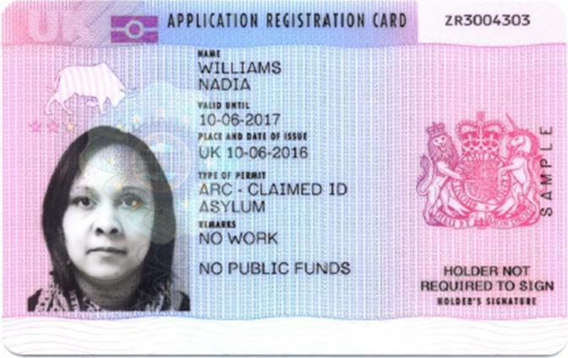
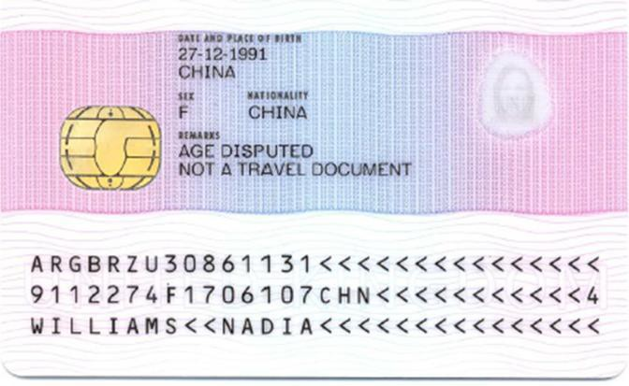
Application Registration Card
Application Registration Card: The card used to identify asylum claimants. The new ARC was introduced in June 2017.
Application Registration Cards, permitting employment, must be
verified with the Employer Checking Service.

Slide 44
Employee’s visa expires
If, on the date on which your employee visa expires you are reasonably satisfied that your employee:
has submitted an in-time application to the Home Office to extend or vary their permission to be in the UK; or
is unable to provide acceptable documentation but presents other information indicating they are a non-EEA long-term lawful resident of the UK who arrived here before 1988.
Your statutory excuse will continue from the expiry date of your employee’s permission for a further period of up to 28 days to enable you to obtain a ‘Positive Verification’ from the Employer Checking Service.
This provides you with a statutory excuse for 6 months from the date in the notice.
Notes:
If, on the date on which your employee’s visa expires (as set out in the document previously checked or the information provided by the Home Office online right to work checking service), you are reasonably satisfied that your employee:
• has submitted an in-time application to us to extend or vary their permission to be in the UK; or
• has made an appeal or an administrative review against a decision on that application which is outstanding; or
• is unable to provide acceptable documentation but presents other information indicating they are a non-EEA long-term lawful resident of the UK who arrived here before 1988
Your statutory excuse will continue from the expiry date of your employee’s permission for a further period of up to 28 days to enable you to obtain a positive verification from the Employer Checking Service. This ‘grace period’ does not apply to checks carried out before employment commences. In such circumstances, you should delay employing the individual until you have received a Positive Verification Notice from our Employer Checking Service.

Slide 45
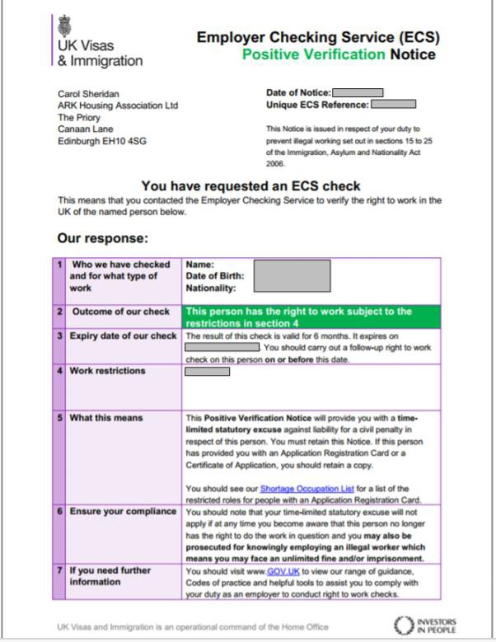

Slide 46
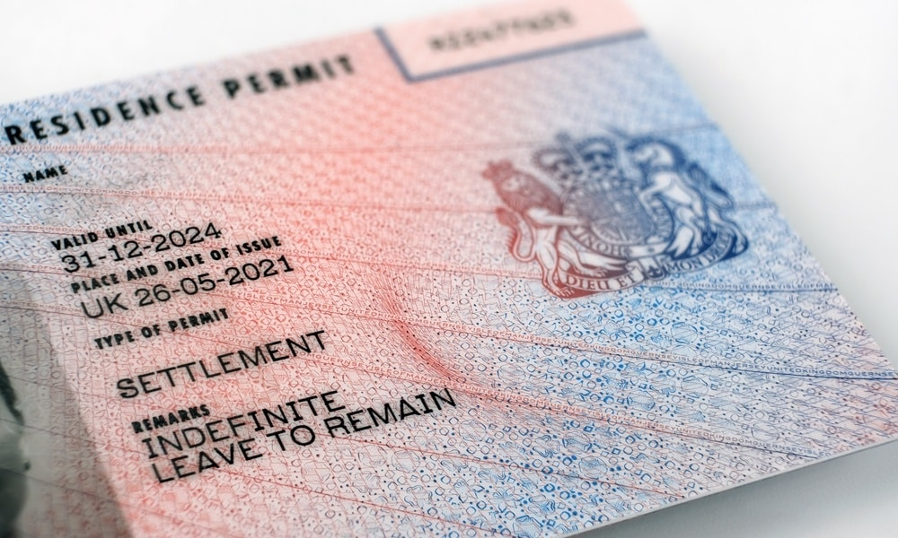
Biometric Residence Permits
You may see BRP Cards with an expiry date of 31 December 2024 even where the holder’s visa expires beyond this date. This is not an error but part of the UKVI’s move towards a digital visa process. Further announcements on the process will be made by UKVI in early 2024.
For Overseas Migrants entering the UK they are issued with a vignette (sticker) in their passport which is valid for 90 days to enable them to travel to the UK.
Following their arrival, they will have 10 calendar days or before their vignette expires to collect their BRP Card from the Post Office branch detailed in their decision letter.
You should ensure they have collected their BRP Card before they commence work as they will need the information contained on the BRP Card to generate a share code.

Slide 47
Biometric Residence Permits
If they need to start work prior to collecting their BRP Card, they will be able to evidence their right to work by producing the short validity vignette in their passport which they used to travel to the UK.
You will then need to conduct a MANUAL right to work check on the basis of this vignette which MUST be VALID at the time of the check.
HOWEVER as this will expire 90 calendar days from issue you will have to repeat the check using the online check for your statutory excuse to continue.
If you employ someone on the basis of the short validity vignette and they are unable to access their BRP information to use the online service when the vignette time expires, you are not required to immediately terminate the employment if you believe the employee continues to have the right to work.
HOWEVER, once the 90 calendar days has expired, you will not be able to establish a statutory excuse if it transpires that the employee is working illegally.

Slide 48
Questions & Answers

Slide 49
Dipesh Shah
Partner & Head of Corporate Immigration
D: 0203 675 7597 M: 07732 065 402 F: 0203 675 7576 E: Dipesh.Shah@jmw.co.uk
Hateem Ali
Partner
D: 0203 987 7092 M: 0785 836 4821 F: 0203 675 7576 E: Hateem.ali@jmw.co.uk
Yasmeen Hamza
Senior Associate
D: 0203 987 7115 M: 07936 035 885 F: 0203 675 7576 E: Yasmeen.hamza@jmw.co.uk

Slide 50
WELCOME TO JMW SOLICITORS FOR YOU
AND YOUR BUSINESS

