Slide 1
Skills for Care………….
Is committed to supporting the adult social care workforce to lead, deliver and grow.
Locality managers work with adult social care providers at a local level, as well as a wide range of other partners within the local health and care systems.
We are available to answer queries and questions on a range of topics such as:
workforce development, including funding available
workforce planning
workforce wellbeing
support and guidance for registered managers
recruitment and retention initiatives
integration and working with health.

Slide 2
Working together to improve the Culture and Values of Social Care
Hammersmith and Fulham want to transform the borough into an inclusive global economic hot spots delivering the best possible life opportunities for local people of all backgrounds. The council wants to bring people together and reform service to respond to the needs of the community.
To support the local authority in these reforms the local health and social care providers need to deliver services that are person centred, reflective and reactive to peoples changing needs, and supported to work in a co productive way other agencies
Skills for Care has numerous resources to support services to develop their all parts of their workforce and making them ready to be part of a joined up and highly trained workforce.
https://www.skillsforcare.org.uk/Home.aspx

Slide 3
How to make change happen
There are many tools that can be used to support a well-trained workforce, value based working and developing your working culture.
The first step to understanding how to develop a team is through a workforce plan.
Operational workforce planning is an essential part of ensuring that you have the right people with the right attitudes, behaviours, values, skills and experience providing the personalised care and support your organisation offers.
There are constant changes taking place within adult social care that affect the way we need to work both now and in the future. It’s therefore more important than ever for organisations of all sizes to plan ahead for their future workforce needs.

Slide 4
An employer or manager needs to understand the learning and development needs of your individual workers, teams and the service.
By carrying out an analysis and understanding your organisations skills gap analysis you can work with individuals in the team to develop a learning plan, and begin to budget for the training you need Whether it's the upfront financial cost of booking a learning provider; developing your internal training; or the time and resource costs associated with workers being away from their 'day job', learning and development will involve investment.
Good investment in training will lead to a happy, confident and competent workforce and ultimately improving the lives of those who need care and support.

Slide 5
The benefits of a well trained team are easy to see…..
There are many different ways to learn new things and it doesn’t have to be expensive.
The Care Quality Commission (CQC) key lines of enquiry, the KLOEs will assess how you make sure that staff have the skills, knowledge and experience to deliver effective care and support.
Benefits of investing in learning and development for your staff:
enable staff to deliver good and outstanding care
improve workforce competence and productivity
develop aspiring leaders
improve recruitment and retention rates.
Our guidance can help you plan, deliver and evaluate the learning and development you provide for your staff.

Slide 6
Why invest in training your staff?
The State of the Adult Social Care Sector and Workforce 2023 has some key figures
Good induction and onboarding can help keep staff for longer
A large proportion of staff turnover arose from workers leaving their posts soon after joining. Care workers with less than one year of experience had a much higher turnover rate (43%) than those with 10 years or more (15%) .
Offering learning and development can help retain staff
…employers investing more in the training and development of their staff experience lower turnover rates on average…. Care workers who received regular training and those with qualifications were less likely to leave their roles than those who didn’t.
Improve your CQC scores
‘Establishments with higher levels of staff undertaking learning and development were more likely to receive higher CQC scores (for example, take up of the care certificate, training and qualifications)’. (2021 report)

Slide 7
Two funding streams to draw from
1. Induction, refresher & volunteer training
2. The Workforce Development Fund

Slide 8
1.Induction, refresher & volunteer training
t
Funding available this year to ensure ALL workers can perform their duties safely.
Contains the main knowledge elements from the Care certificate:
assisting and moving people
basic life support
fire safety
food safety
health and safety awareness
infection prevention control
medication management and safeguarding.
Employers can select from 6 endorsed providers who can deliver the training this financial year.
www.skillsforcare.org.uk/EssentialTraining
Free to access –
you just need an ASC-WDS account with your workplace details
Notes:
Funding available for the rapid induction training
The fully funded rapid induction programme is available this financial year (23-24) to ensure all workers can perform their duties safely.
The programmes available are-
assisting and moving people
basic life support
fire safety
food safety
health and safety awareness
infection prevention and control
medication management and safeguarding (specifically around isolation).
The rapid induction also contains the main knowledge elements from the Care Certificate.
Employers can select from 6 endorsed training providers. These providers have been awarded grants to deliver the rapid induction programme. Please note, all training will be delivered virtually.
http://www.skillsforcare.org.uk/essentialtraining

Slide 9
2. The Workforce Development Fund
It's disseminated by Skills for Care on behalf of the Department of Health and Social Care (DHSC).
It supports the continuing professional development (CPD) of staff across the adult social care sector.
It’s a funding contribution towards the cost of learning and development.
The fund is paid retrospectively.
It helps towards the costs of workers completing a broad range of adult social care qualifications, learning programmes and digital learning modules.

Slide 10



The Adult Social Care Workforce Data Set
ASC-WDS is a data collection service, commissioned and funded by the Department of Health and Social Care. It is the leading source of intelligence for the adult social care workforce.
The information is used by:
Notes:
The Adult Social Care Workforce Data Set (ASC-WDS) is a data collection service that’s commissioned and funded by the Department of Health and Social Care – and it’s the leading source of intelligence for the adult social care workforce. Without the data we collect via the ASC-WDS it’d be really difficult for the government – and other bodies – to make decisions about policy and funding.
We collect the data by asking organisations such as yourselves – and also local authorities – to set-up accounts and input information about their service and also their workforce. All data is of course anonymised before it’s shared.
We know that the adult social care sector is complex and fragmented and made up of thousands of different care providers. And, we know that the people who work in the sector are absolutely vital in terms of providing high quality care and support. So, understanding that workforce is so important for planning and decision making across the sector- and that’s what we’re trying to do with ASC-WDS- to build that understanding.
There are already around 20,000 providers using the service. It provides crucial information to key decision makers such as Government, DHSC, CQC and local authorities.
We’ve recently provided evidence using out intelligence to the Health and social care select committee on workforce burnout & wellbeing and their latest enquiry on recruitment and retention. We’ve also been involved in the MAC review of impact of ending freedom of movement- and we know that’s results in care workers being added to the shortage occupation list.
So the data is really key for the sector and it is being used to support the workforce.

Slide 11
Benefits to your workplace
Funding for training your staff
Safe and free storage of staff records
Manage training records
Benchmark your workplace
Access the ASC-WDS Benefits Bundle

Slide 12
1.Workforce Development Fund
A contribution towards the costs of vocational learning
You can claim money towards the cost of course fees, employees’ salaries whilst undertaking training, training venue costs , coaching and mentoring costs
Defined list of eligible programmes
Defined time period during which programmes undertaken
Admin processes to follow
Notes:
Last year, the WDF allowed for-
Continuing professional development eLearning modules and group Learning programmes for aspiring, new and experienced leaders and managers
Level 2 and 3 awards, certificates and diplomas
Level 2, 3, 4 and 5 Apprenticeships
Leadership and management Certificate and Diploma Qualifications
Programmes include-
Dementia, autism, diabetes, EoL, falls, food, nutrition, levels 2,3,4,5 diplomas in care-standalone and as part of apprenticeships, leadership, LD, medication, MCA, MH, oral care, stroke.
Also Learning programmes which can only be delivered by endorsed providers under licence-lead to success, well led, performance management, self management, workplace culture, moving up, the 11 development modules which are for aspiring, new and experienced leaders and managers, and Learn from Events, and a learning programme for individuals who will be assessing the Care Certificate in the workplace.

Slide 13
2.Safe and free storage of your records
You can use ASC-WDS to keep your staff records securely in one place.
You can add information like their National Insurance number, date of birth and nationality, employment start date and contract information.

Slide 14
3.Manage your records
Manage training and qualification records
  Define what training courses are mandatory for each job role
  Add details of the training or qualifications each staff member has completed
  Alerts when training is about to expire, or is expired
  Download a training report to use as evidence
“The system is great for tracking my staff training. I can see at-a-glance when training is missing or expiring… the service allows me to gather information to inform policies and procedures and inductions.” Paddy Turner, Training Manager and Activities Co-ordinator, Care Matters (SE)

Slide 15
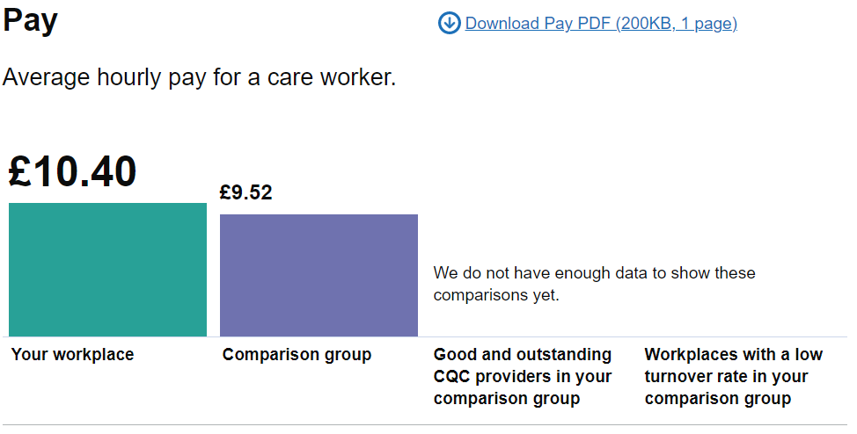
4. Benchmarking
“The benchmarking function is great for discussing aims and objectives for managers and their service such as monitoring and improving staff turnover, management of staff absence, or increasing percentage of staff with qualifications relevant to their role..”
Marisa Spice, Learning & Development Manager, Nellsar Ltd.
Notes:
You can use ASC-WDS to compare data from your workplace against similar organisations. You can find out where you rank in workforce metrics for pay, turnover, sickness and staff qualifications. We measure you against workplaces providing the same main service as you in your local authority, and can also show you the data for Good and Outstanding providers or workplaces with a low turnover rate in your area.
It’s worth noting that currently benchmarking is only available to some types of providers, but we’re working to extend this to others. [Currently: CQC regulated care homes with nursing, care only homes and domiciliary care providers]

Slide 16
5. ASC-WDS Benefits Bundle
The ASC-WDS Benefits Bundle is available to all new and existing users of the service, and it offers access to special offers and discounts across our products: seminars, eLearning and bookshop.
To find out more about the Benefits Bundle, learn more about the ASC-WDS service or create an account, visit our dedicated webpage
www.skillsforcare.org.uk/ASCWDS
Notes:
10% off values-based interviewing and valuable conversations bespoke seminars
10% off eLearning modules from Skills for Care.

Slide 17
Contact details
Ali Porteous
Skills for Care Locality Manager – SW London
07970 937362
alison.porteous@skillsforcare.org.uk
www.skillsforcare.org.uk/workforceintelligence

