Slide 1
Summary Information for Assured Digital Social Care Record Solutions
October 2023
Compiled by the North West London (NWL) Social Care Digital Programme Team

Slide 2
3​ | Context
4​ | NHSE Assured DSCR Solutions List​
5 - 8​ | NHSE Assured DSCR Solutions List: Core Capabilities ​
9​ - 29 | Assured DSCR Solution Profiles ​
30 - 33​ | Appendix:​ Features at a glance DSCR supplier contacts and information
Contents

Slide 3
Context
The purpose of this pack is to provide adult social care providers interested in implementing Digital Social Care Records (DSCRs) a summary overview of the DSCR solutions assured by NHSE Digitising Social Care (DiSC) Programme to support care providers considering which solution(s) to demo and take forward.
You can also utilise the DSCR Assured Solutions Tool here on the DiSC website to filter DSCR solutions by your specific requirements.
What is the Assured Solutions List?
The DiSC Programme at the NHS Transformation Directorate created the Assured Solutions List to support adult social care providers in England to purchase a DSCR.
What is a DSCR?
A DSCR is a technology solution that allows the digital recording of care information and care received by an individual, within a social care setting, replacing traditional paper records. DSCRs are person-centred and enable information to be shared securely and in real-time with authorised individuals across the health and care sector.
The information in this pack has been compiled from the Assured Solutions List as well as directly from DSCR suppliers via their websites and their answers to a supplemental questionnaire.
Please note that the information detailed in this pack may change over time. For full details of the DSCR solutions and for bespoke pricing and packages, please contact the suppliers directly. Further information on how to approach purchasing a DSCR can be found here.

Slide 4
Assured Solutions List
The following DSCR solutions have been assessed by the NHS Transformation Directorate in England to be included on the Assured Solutions List as of October 2023:
Access Care and Clinical
& Access Care Planning
birdie
Carebeans Care Software
Careberry
Care Control
Care Vision
CareLineLive
Cura Systems
Dom Portal
Fusion eCare Solutions
iPlanit by Aspirico
Log My Care
KareInn
Nourish Care
OneTouch
PASS by everyLIFE
Person Centred Software
Qwikify Digital Care Records Solution
Sekoia

Slide 5
Core Capability Requirements
The Assured Solutions List guarantees that listed DSCR solutions offer the minimum required features to meet the basic needs of social care providers, called the core capabilities.
All DSCR solutions on the Assured Solutions List have also passed basic financial and security checks, comply with national standards and can help social care providers to meet CQC regulations on good governance.
DSCR Core Capabilities
1.
The solution must support inclusive care planning and needs assessment
2.
The system must capture real-time, auditable records, notes, and observations that can be accessed at the point of care
3.
The system must support task planning, allocation, management and completion
4.
The system must provide controlled access to data
6.
The system must support the operation and management of a care setting
5.
The system must be able to share data with other systems and care settings

Slide 6
Core Capability Requirements
Each core capability includes the following criteria offered as standard features for all assured DSCR solutions:
1. The solution must support inclusive care planning and needs assessment and include the capability:
To capture a person-centred care plan To undertake and capture care needs assessments using templates / pre-built criteria To create care plans using templates / pre-built care plans For a social care provider to add to care plan templates / pre-built care plans To involve an individual in the process of planning their own care To set a target outcome/goal for the individual receiving care and an associated list of tasks/action
2. The system must capture real-time, auditable records, notes, and observations that can be accessed at the point of care and include the capability to:
To capture structured data for routine tasks, for example when tasks have been completed, that is linked to the care plan, including for plans a carer did not create To capture unstructured data, for example, information about activities, patient comments etc., that is linked to the care plan, including for plans a carer did not create For data to be captured and displayed consistently throughout the system so that it is easy to absorb To provide a longitudinal picture of the care provided to an individual over time To capture written notes To capture verbal notes that are converted to unstructured text To upload existing third party documents and images

Slide 7
Core Capability Requirements
Each core capability includes the following criteria offered as standard features for all assured DSCR solutions:
3. The system must support task planning, allocation, management and completion and include the capability:
To allocate tasks to the most appropriate staff members To provide information about the status of tasks in real-time To provide a list of tasks assigned to an individual care worker showing which are outstanding and which have been completed To manually identify priority tasks that require action To automatically flag overdue tasks To actively calculate an individual’s risk and flag the need for a care plan/activity to be reviewed as a result of rising risk To generate handover information for shift changes etc. to ensure continuity of care To provide an aggregated dashboard view of the status of tasks for a care manager to view
4. The system must provide controlled access to data and include the capability:
For an individual to view their own care plan and record For an authorised care worker to view care plans, assessments and records, including ones they did not create For an authorised care worker to edit and update care plans, assessments and records, including ones they did not create For authorised health professionals to view care plans, assessments and records, including ones they did not create For authorised health professionals to edit care plans, assessments and records, including ones they did not create For a version of the care record and plan to be viewable on third party devices For a social care provider to set appropriate access controls for who can create, view and edit care plans and records To maintain an audit log of all changes to a care record including who accessed the record, the date and what changes were made

Slide 8
Core Capability Requirements
Each core capability includes the following criteria offered as standard features for all assured DSCR solutions:
5. The system must be able to share data with other systems and care settings and include the capability:
To export data, including data from locally generated reports, in a flat-file format (e.g. PDF) To export data, including data from locally generated reports, in an interrogatable and importable file format (e.g. CSV) For documents to be uploaded into an individual’s care record To produce key information for emergency hospital admissions in a format that is compliant with standards
6. The system must support the operation and management of a care setting and include the capability:
For social care providers to generate, save and amend prebuilt summary reports for individual recipients of care. Please demonstrate your five most frequently used reports in your video For social care providers to generate, save and amend prebuilt summary reports at a site and service level. Please demonstrate your five most frequently used reports in your video To see a chronology of interactions and activities for auditing/inspection purposes and to manage incidents To provide reports that support a care provider to meet the Key Lines of Enquiry of the CQC inspection regime

Slide 9
The following profiles outline the additional features and details of the assured DSCR solutions that are suitable for care homes, in addition to the core capabilities already listed.
For more information on an individual DSCR solution, we would encourage you to reach out to the supplier directly.
You can find a full list of the contact details, website links, and DiSC profiles of each assured solution at the end of this pack.
Assured DSCR Solutions
Suitable for Care Homes

Slide 10
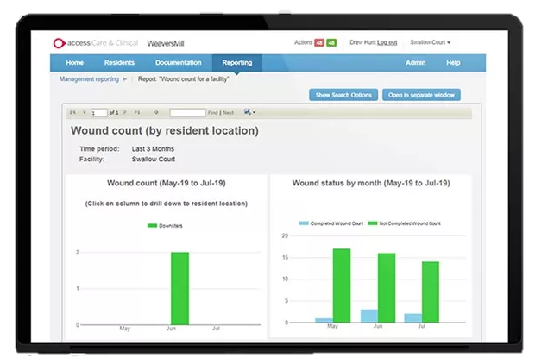
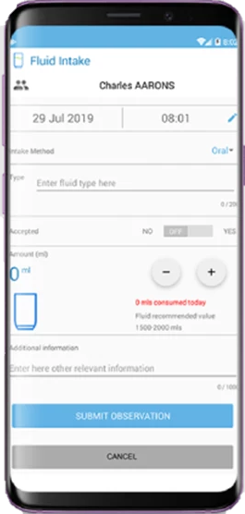
Access Care and Clinical
Video demonstration
Full demo available
Information taken from the Digitising Social Care Assured Solutions List and answers to a NWL questionnaire from Access on 2 June 2023
Setting Suitability
Care Homes | ✓
Domiciliary Care | ✕
Features
Full integration with Access Medication Management Mobile first intuitive user interface Configurable care actions & audits Proactive care alerts Dynamic care planning Configurable assessments & risk plans Configurable care plan templates Built in resilience with offline working Detailed reporting tools Secure portals & export tools
Interoperability
London Care Record | ✕
NHS Mail | ✕
London Urgent Care Plan | ✕
eMAR / pharmacy | ✓
Monitoring systems | ✓
EMIS | ✕
Health Information Exchange | ✕
GP Connect | *
Mobilisation & Installation | Training Offer | Data Migration
Offers remote-first ‘FlightPaths’, which vary based on the training offer. The recommendation for a 40 bed home spans one month and four project days. Kick-off (scoping, initial change management activities) Preparation (requirements gathering) Learning (deployment of change management plan, training) Validation (validation of configuration against requirements) Launch (go live) Review (confirmation of fully-embedded solution) | Recommended training options: Small settings (<30 beds): 1.5 hour documentation Q&A with onboarding consultants Medium settings (30-70 beds): 2 days remote super user training Large settings (>70 beds): 3 days remote super user training and 3 end user carer trainings Additional training costs roughly £750/day eLearning available | Implementation costs include access to a data import tool that allows resident and care detail (paper or electronic) to be imported into the Access application
Technology
Mobile application | ✓
Desktop application | ✕
Browser application | ✓
Works offline | ✓
Tech support available | ✓
Devices can be supplied | ✓
Own devices can be used | ✓
Illustrative Pricing (excl. VAT)
Pricing will not fluctuate for the duration of the initial agreement and additional modules (e.g. eMar or rostering) are priced independently Remote only FlightPaths: £1120 - £7075 Onsite optional FlightPaths: £2600 – 8300 Additional training available to purchase
Licensing Bands
Registered bed bands ​ | Price per year ​ | Registered bed bands ​ | Price per year ​
1-30​ | £54 +VAT​ per bed | 251-500 | £43.20 +VAT per bed
31-100 | £48 +VAT per bed ​ | 500+ | £40.30 +VAT per bed
101-250​ | £45.60 +VAT​ per bed
*HTML view integration in progress

Slide 11
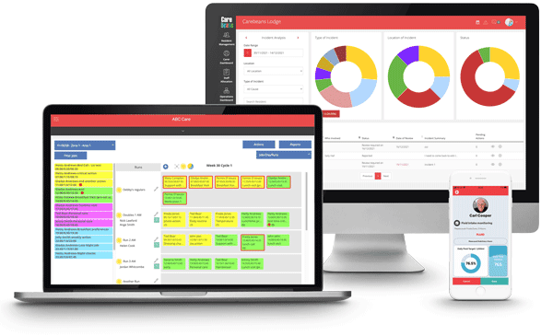
Carebeans
Full demo available
Information taken from the Digitising Social Care Assured Solutions List and answers to a NWL questionnaire from Carebeans on 24 March 2023
Setting Suitability
Care Homes | ✓
Domiciliary Care | ✓
Features
Resident Management Care planning Risk Assessments Mental Capacity and Consent Incident and Accident Management Staff Allocation Hospital Transfer Recording Operations Management Customisable Alerts Observation Management Medication Management Rostering | Time and Attendance HR Management Training Management eMAR Body Mapping On and Offline Carer App Family Portal Full Management reporting & Audit Suite Messaging Free System upgrades Free Support All in one System
Interoperability
London Care Record
NHS Mail | ✕
London Urgent Care Plan | ✕
eMAR / pharmacy | ✓
Monitoring systems | ✓
EMIS | ✕
Health Information Exchange | ✕
GP Connect | *
Mobilisation & Installation | Training Offer | Data Migration
Offers fully managed onboarding, including data migration and training services as standard The Carebeans system is highly configurable, allowing custimisation Commitment support line and named contact from Carebeans Software system is fully available on day one of the contract. Onboarding and training team support available from initial stages onward | Provides management and carer training before go live Provides ongoing support while using the system Offers online training and video user guides Specialist training teams (1:1 or group) Dedicated nurse advisor on staff | Maintains a general plan for migration, which is then built around each customer’s requirement and their data’s maturity
Technology
Mobile application | ✓
Desktop application | ✕
Browser application | ✓
Works offline | ✓
Tech support available | ✓
Devices can be supplied | ✓
Own devices can be used | ✓
Illustrative Pricing (excl. VAT)
Priced on a sliding scale per service user, with some minimum charges and volume price reductions that may take place at contract negotiation. Onboarding and training as well as family/payroll modifications are priced separately according to number of users.
Licensing Bands
Service user bands ​ | Price per month ​ | Initial set up & training ​
0-30​ | Fixed £220 +VAT​ | £1000 +VAT​
31-50​ | £7.50 +VAT per user ​ | £1500 +VAT​
101+​ | £6.50 +VAT​ per user | POA​
*HTML view integration in progress

Slide 12
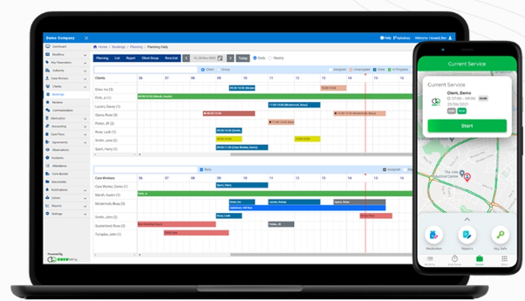
Careberry
Video Demonstration
Full demo available
Information taken from the Digitising Social Care Assured Solutions List and answers to a NWL questionnaire from Careberry on 23 May 2023
Setting Suitability
Care Homes | ✓
Domiciliary Care | ✓
Features
Generate full care plans Integrate / build your own risk assessments Third party access for assured safety Comprehensive rostering system Integrated body maps Accident reporting Automated compliance checks Notes and comprehensive reports Create your own reports Electronic logs Integrated client agreements E-MAR chart, with real time updates | Application API and staff application forms Integrated referencing Integrated carer agreements Interviews/records and competency sign off Plan and record shadowing Keeping all staff meeting notes in the platform Automated training matrix Custom form builder Observations and supervision Recruitment tracker Real time alerts and notifications SMS and push Notifications
Interoperability
London Care Record
NHS Mail | ✓
London Urgent Care Plan | ✓
eMAR / pharmacy | ✓
Monitoring systems | ✕
EMIS | ✕
Health Information Exchange
GP Connect | *
Mobilisation & Installation | Training Offer | Data Migration
Each implementation is supported by a dedicated case manager who providers training and onboarding The implementation process will be guided by Careberry with full support The timeline for implementation will vary depending on the resources dedicated to the process and the current client caseload, ranging from one week to several months Case Managers will make a plan and ensure that the customer is live for their desired data, fully explaining what needs to be done to meet deadlines | Dedicated account manager will provide training Train the trainer support available Offers in-person training with a number of sessions determined with the provider | Does not currently offer data migration support or cut over support
Technology
Mobile application | ✓
Desktop application | ✕
Browser application | ✓
Works offline | ✕
Tech support available | ✓
Devices can be supplied | ✕
Own devices can be used | ✓
Illustrative Pricing (excl. VAT)
The care provider can choose from two pricing models based on their needs: pricing per service user or pricing on a fixed term. Both are billed monthly. Alternative pricing models can be explored on request. In person training is billed at an extra cost depending on travel and sessions booked
Per service user Roughly estimated at between £15 -£40+VAT/month, dependent on service and hours provided. Varies monthly based on active service users | Fixed term Based on the number of service users at the time of agreement, usually fixed for 12 months. Can switch between terms
*HTML view integration in progress

Slide 13
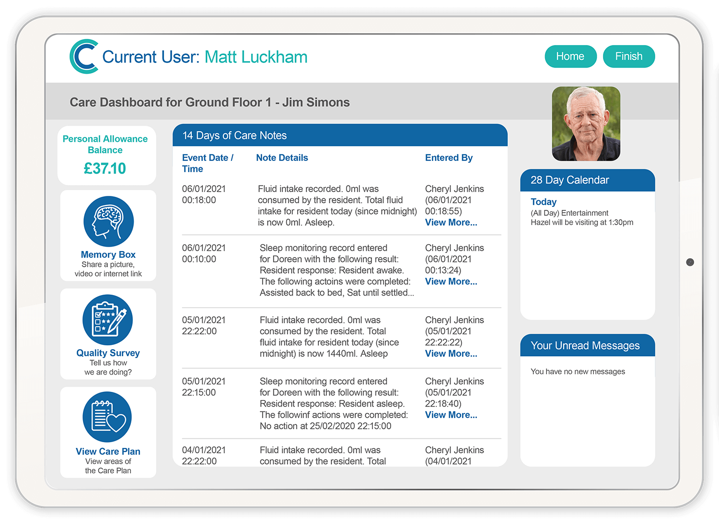
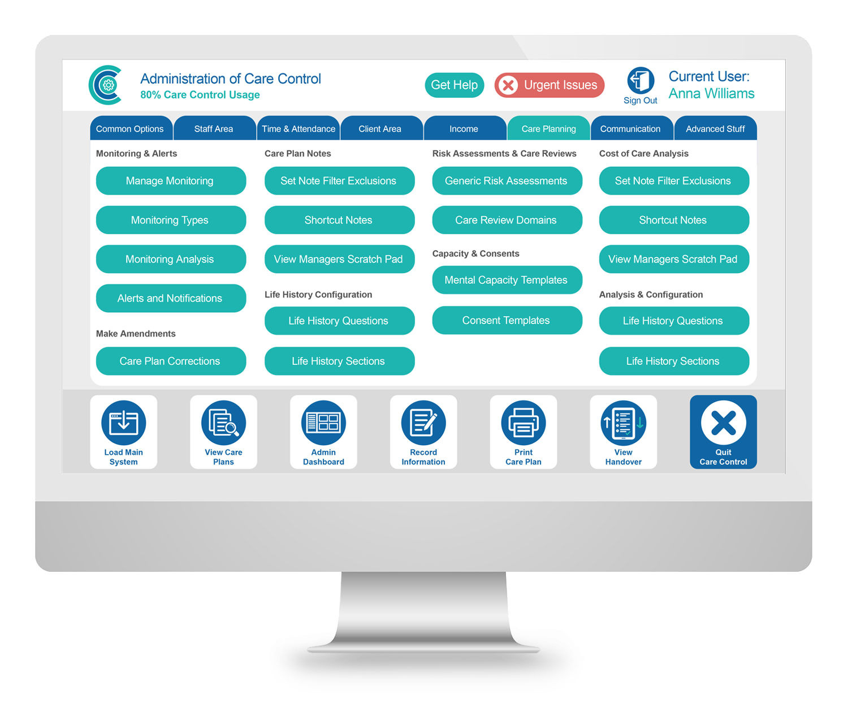
Care Control Systems
Video Demonstration
Full demo available
Information taken from the Digitising Social Care Assured Solutions List and answers to a NWL questionnaire from Care Control Systems on 29 March 2023
Setting Suitability
Care Homes | ✓
Domiciliary Care | ✕
Features
Care planning Medication management Rostering HR Income management | Payroll Compliance Friends and family support Custom tasks
Interoperability
London Care Record
NHS Mail | ✓
London Urgent Care Plan | ✓
eMAR / pharmacy | ✓
Monitoring systems | ✓
EMIS | ✓
Health Information Exchange | ✓
GP Connect | ✓
Mobilisation & Installation | Training Offer | Data Migration
Initial 4 week implementation plan with the option to purchase additional training packages if required. We will work with the provider to create a bespoke training package​ The typical implementation process involves: Configuring the solution Installing the solution without interrupting existing ways of working, without downtime (option to make the switch overnight) A bespoke plan for easy implementation Dedicated staff training over a set period Option to utilise as few or as many elements of the system as desired | Maintains an e-learning platform with competency based modules to support training for all members of staff. ​ Upon implementing and before go-live provides bespoke training plan with regular ‘check ins’, as well as ongoing support during system use Four training sessions provided during implementation (before go-live) Offers ongoing support | Can support with migration – further information upon request. ​
Technology
Mobile application | ✓
Desktop application | ✓
Browser application | ✓
Works offline | ✓
Tech support available | ✓
Devices can be supplied | ✓
Own devices can be used | ✓
Illustrative Pricing (excl. VAT)
All on-going support is included within the package, no additional costs​ One-off set-up fee of £399 per site includes an initial 4 week implementation and training​ Additional training offers: Pro Pack- £169 +VAT; Premium Pack - £329 + VAT; Enterprise Pack - £419 + VAT​ Costings are based on a per service user/month basis (based on 1 year agreement)
Care Homes (more service user bands available) ​
Service user bands ​ | Price
Up to 15 | flat rate £1700 per annum
16-35 | £10.00 per service user/per month
36-54 | £9.50 per service user/per month ​
55-74 | £9.00 per service user/per month ​
75-100 | £8.50 per service user/per month ​

Slide 14
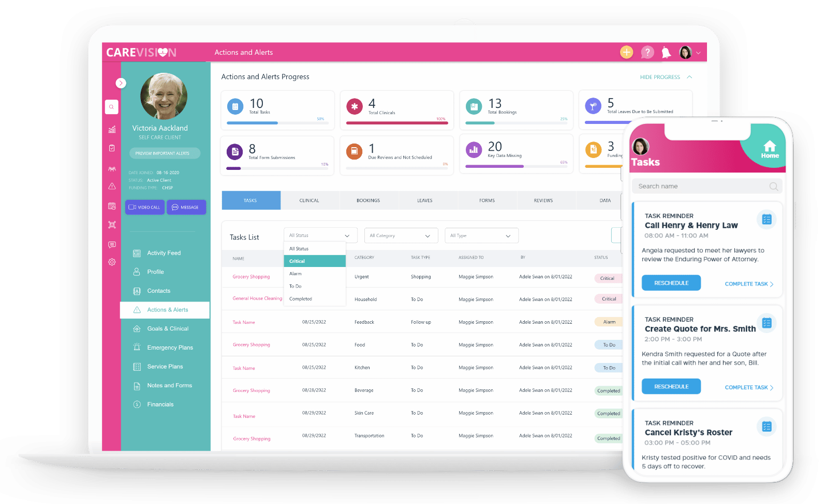
Care Vision
Video Demonstration
Full demo available
Information taken from the Digitising Social Care Assured Solutions List and answers to a NWL questionnaire from Care Vision on 24 March 2023
Setting Suitability
Care Homes | ✓
Domiciliary Care | ✓
Features
Care planning Body map Professional notes QR code scanning Group activities Rota HR module Nurse call integration | Pre-admission Accidents and incidents trend analysis Service user and staff filing cabinets Training and supervision Event reporting Visitor book | Chef & housekeeping Handover Message centre Icon driven Reporting and analysis Accounts/billing Audit management Directors Dashboard
Interoperability
London Care Record
NHS Mail | ✕
London Urgent Care Plan | ✓
eMAR / pharmacy | ✓
Monitoring systems | ✕
EMIS | ✕
Health Information Exchange | ✕
GP Connect | *
Mobilisation & Installation | Training Offer | Data Migration
Approximately 30 day implementation period, tailored to needs and availability The following steps are included in mobilisation plan following contract signing: Migration files to be completed and sent back; Hardware ordered and invoice sent; Cloud built; Onboarded date agreed, hardware shipped; Onsite training carried out​ Plan of action outlined with key activities for go live and set up with assigned roles and responsibilities at implementation outset | Offers both onsite and online training (at additional cost for onsite training), individually or as a blend of face-to-face, group, and self-service training Online training and tutorial videos available on website Ongoing support at no extra cost​ One day training for all staff provided during typical implementation | One-off data transfer per home available, with or without care plan options
Technology
Mobile application | ✓
Desktop application | ✕
Browser application | ✓
Works offline | ✓
Tech support available | ✓
Devices can be supplied | ✓
Own devices can be used | ✓
Illustrative Pricing (excl. VAT)
Additional modules have an additional cost (Medication, chef, house keeping, rota, clocking in, accounts/billing, HR, nurse call integration, visitor book. ​ £600 - data transfer per home (£900 with care plans)​ £400 online training, £700 on-site training ​ Minimum charge per location is £150 for both care homes and domiciliary care
Care Homes (more service user bands available) ​
Service user bands ​ | Price per month ​
39-50​ | £239​
0-12​ | £72​
*HTML view integration in progress

Slide 15
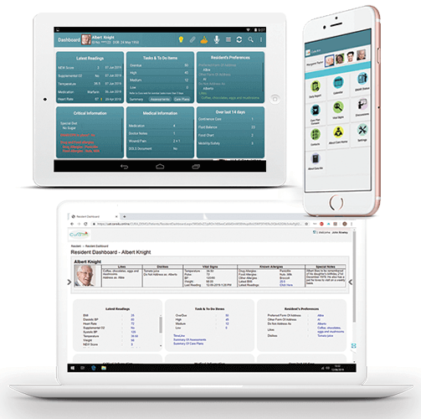
Cura Systems
Video Demonstration
Full demo available
Information taken from the Digitising Social Care Assured Solutions List and answers to a NWL questionnaire from Cura Systems on 25 October 2023
Setting Suitability
Care Homes | ✓
Domiciliary Care | ✕
Features
Person-centred, configurable care plans, assessments and monitoring tools Advanced Incident Reporting forms Saves time and allows carers to focus on care Recording of information about staff induction, skills, experience and training Complete medication administration with safeguards and connectivity to our pharmacy system Mobile apps for care givers and next of kin | Task allocation to the most appropriate staff or team, with update status and reminders Bespoke management dashboard reporting enabling views by locations and drill down functions Proactive support for the digital journey, change expertise & a dedicated team with domain knowledge Fully compliant with GDPR, Cyber Essentials Plus certification.
Interoperability
London Care Record | ✕
NHS Mail | *
London Urgent Care Plan | *
eMAR / pharmacy | *
Monitoring systems | ✕
EMIS | *
Health Information Exchange | *
GP Connect | *
Mobilisation & Installation | Training Offer | Data Migration
Timescales of a minimum of four days, an average of six days, and a maximum of 10 days (factors such as data migration and complexity can affect timescales) Provides a dedicated account manager Guidance through the digital transition and change management process: a kick-off meeting to outline the process, change management, gap analysis and tailored training plan Online or onsite training – providing follow-up training for staff changes and video tutorials Quarterly business review meetings | Offers online or onsite training Train the trainer approach: Cura trains a group of staff champions chosen by the provider, who then train other staff Includes ongoing consultation to help train all end users | Data migration is typically completed as part of implementation
Technology
Mobile application | ✓
Desktop application | ✕
Browser application | ✓
Works offline
Tech support available | ✓
Devices can be supplied | ✓
Own devices can be used | ✓
Illustrative Pricing (excl. VAT)
An active license, charged at £1 per week, is required for each active service user and each staff user. For example, a care home with 30 service users and 40 staff users will cost £70 per week for licensing the software Implementation costs will depend on the modules selected by the provider and staff requirements for training and support. Implementation is priced in a package, and a typical 40 bed care home typically requires a 6 day package, priced at £2500
*Integration in progress

Slide 16
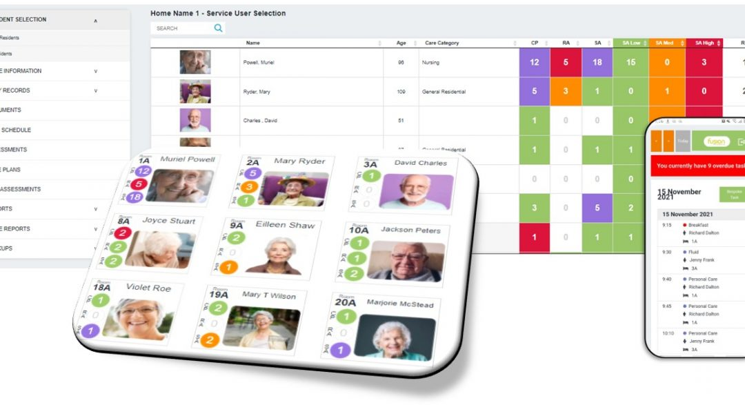
Fusion eCare Solutions
(Video Link TBD)
Full demo available
Information taken from the Digitising Social Care Assured Solutions List and answers to a NWL questionnaire from Fusion eCare Solutions on 26 May 2023
Setting Suitability
Care Homes | ✓
Domiciliary Care | ✕
Features
Resident dashboard Home analysis dashboard Daily notes, quick notes Body maps Risk assessments Standard/Supporting assessments Scheduled Tasks | Weight/Blood Sugar/BMI/Assessment Graphs Document management Handover report Resident flexible report writer Resident and user audit reports Configuration assessment writer Care plan and risk assessment template/guidance tool Inbuilt messaging system Family user access
Interoperability
London Care Record
NHS Mail | ✓
London Urgent Care Plan | ✓
eMAR / pharmacy | ✓
Monitoring systems | ✕
EMIS
Health Information Exchange
GP Connect | *
Mobilisation & Installation | Training Offer | Data Migration
Time to install the software to varies per client, no set duration​ The average time from confirmation to setting the database through system configuration and importing data takes a 3-5 working days. ​ Includes a pre-installation meeting to discuss setup, configuration, and rollout​ Further pre-rollout meetings available before training. ​ Flexible rollout options (phased or all-at-once) to provider preference Stable Wifi required during mobilisation and installation | Dedicated account manager​ Face-to-face and online​ training available to preference Future Training and New Starter Training can be done on request | Basic data can be imported via csv, pdf, jpeg, docx formats. ​ Database configuration included in set up meetings
Technology
Mobile application | ✓
Desktop application | ✓
Browser application | ✓
Works offline | ✓
Tech support available | ✓
Devices can be supplied | ✓
Own devices can be used | ✓
Illustrative Pricing (excl. VAT)
Packages are licensed per site and calculated based on the provider’s number of beds, with banding outlined below.​ One-off costs include​ Training - £485 (additional training is invoiced for time taken)​ Installation/Hosting set up - £265/£400/£450 ​ Additional modules:​ Resident Invoicing​ Workforce Management/Rota/Staff App/Payroll/HR​ Costs will include an annual RPI increase
Care Homes Care Plan / Tasks Costings
Beds ​ | Price per month ​
1-35 | £154​
36-65 | £179
66+ | £203
*HTML view integration in progress

Slide 17
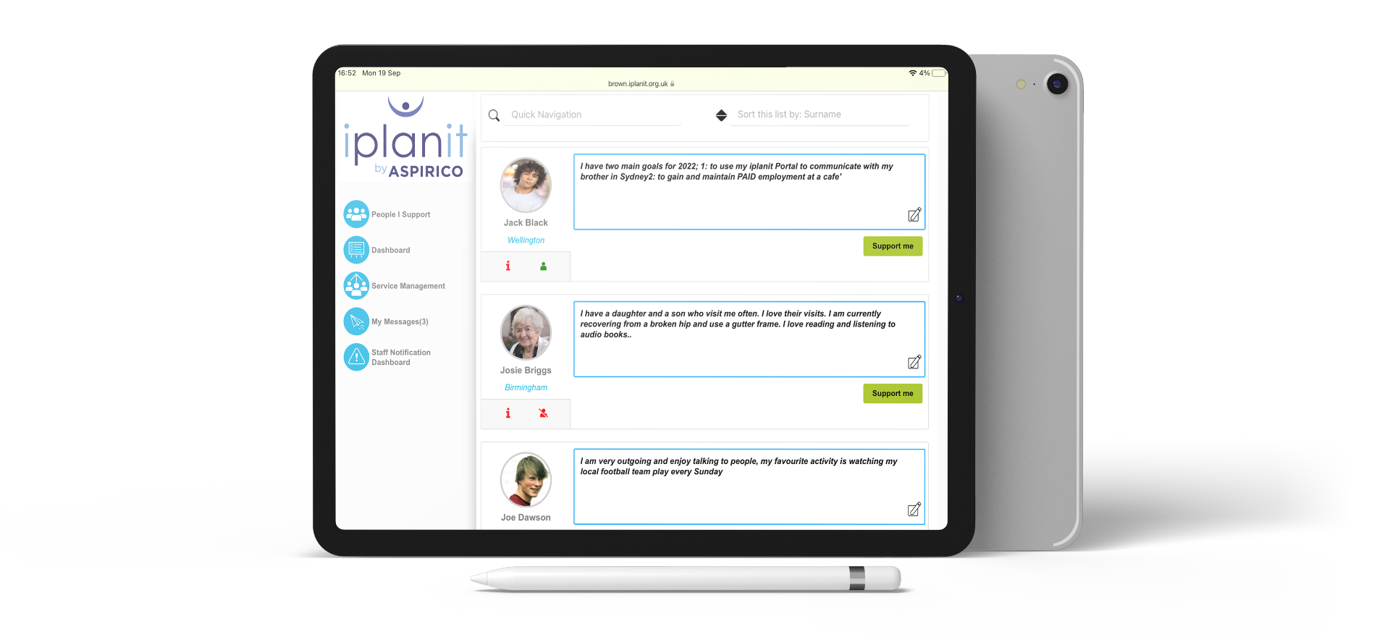
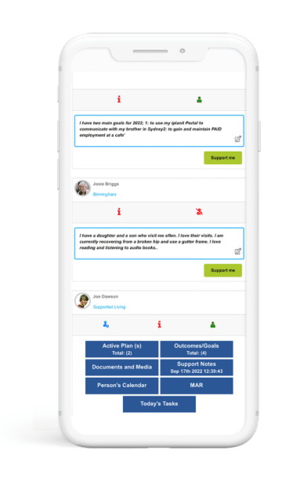
iPlanit by Aspirico
Video Demonstration
Full demo available
Information taken from the Digitising Social Care Assured Solutions List and answers to a NWL questionnaire from Aspirico on 31 March 2023
Setting Suitability
Care Homes | ✓
Domiciliary Care | ✓
Features
specialist care plans a range of optional modules so you can tailor the solution to your specialist services incorporates familiar terminology and workflows from intake to service delivery to reporting and monitoring
Interoperability
London Care Record
NHS Mail | ✓
London Urgent Care Plan | ✓
eMAR / pharmacy | ✓
Monitoring systems | ✓
EMIS | ✓
Health Information Exchange | ✓
GP Connect | ✓
Mobilisation & Installation | Training Offer | Data Migration
Modular framework comprised of a core product (which all providers use) and a range of optional modules​ Offers configurability and flexibility - providers can add in different components/modules on an ongoing basis Dedicated Client Manager to guide providers through implementation and training through an incremental approach.​ Implementation includes a project kick-off meeting to set out a project plan based on the level of configuration required and optional modules chosen. Then support is given for testing, sign-off and planning the training and implementation approach | Online iplanit Learning Centre, suite of training videos monthly Best Practice Clinics webinars​ Works with provider to plan a training and implementation approach that suits specific needs and resources, whether a module-by-module rollout approach or a full rollout at a pilot site.​ Regular rollout support reviews​ Onsite training and workshops also available​ | Data migration support available, subject to analysis. ​
Technology
Mobile application | ✓
Desktop application | ✕
Browser application | ✓
Works offline | ✓
Tech support available | ✓
Devices can be supplied | ✕
Own devices can be used | ✓
Illustrative Pricing (excl. VAT)
Licenses charged per user and based on an Annual Subscription Charge model. No additional charges for family and friend “invited guest” access, nor are there any limits on the number of provider staff or managers. Separate one-off implementation costs​ No limit on the number of staff, management or Service User “invited guests”​ Modular framework comprised of a core product (which all providers use) and a range of optional modules​
Rough Pricing for Core iPlanit Modules
Service users ​ | Price per annum ​
<25 | £3,000
30 | £3,750
40 | £4,880
100 | £10,000

Slide 18
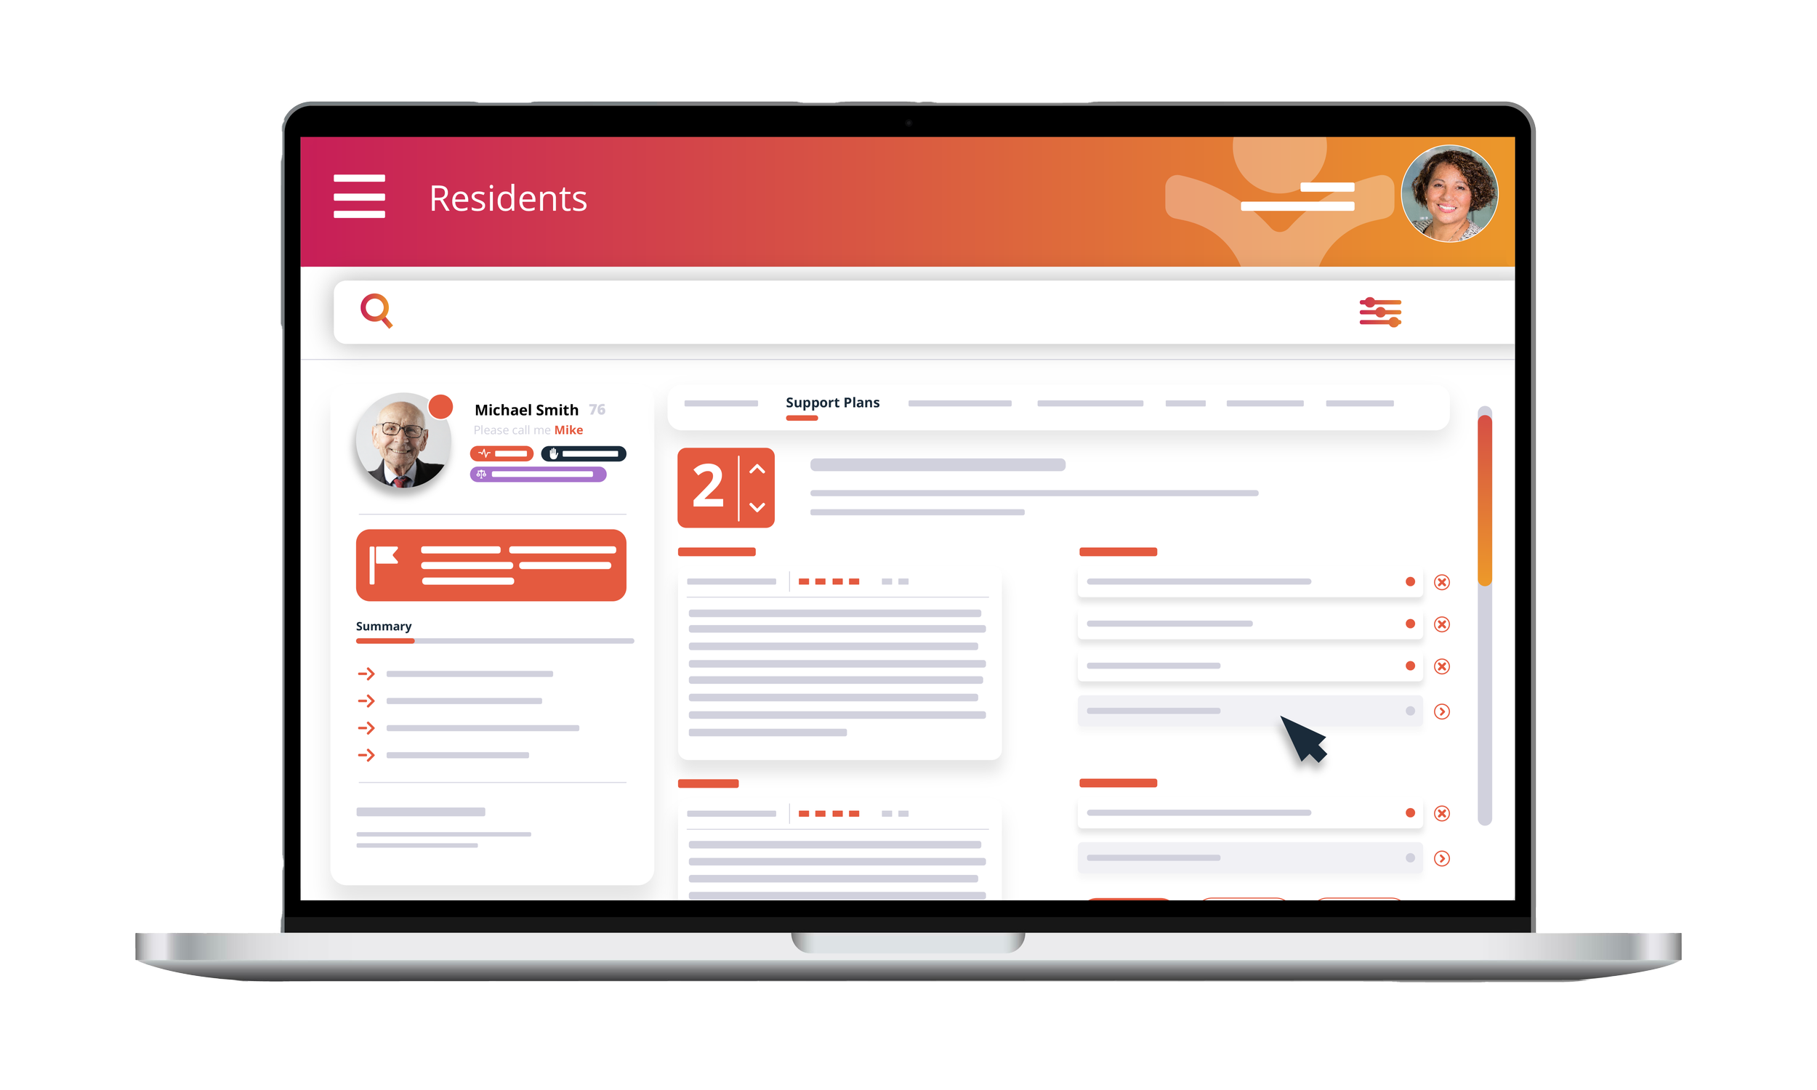
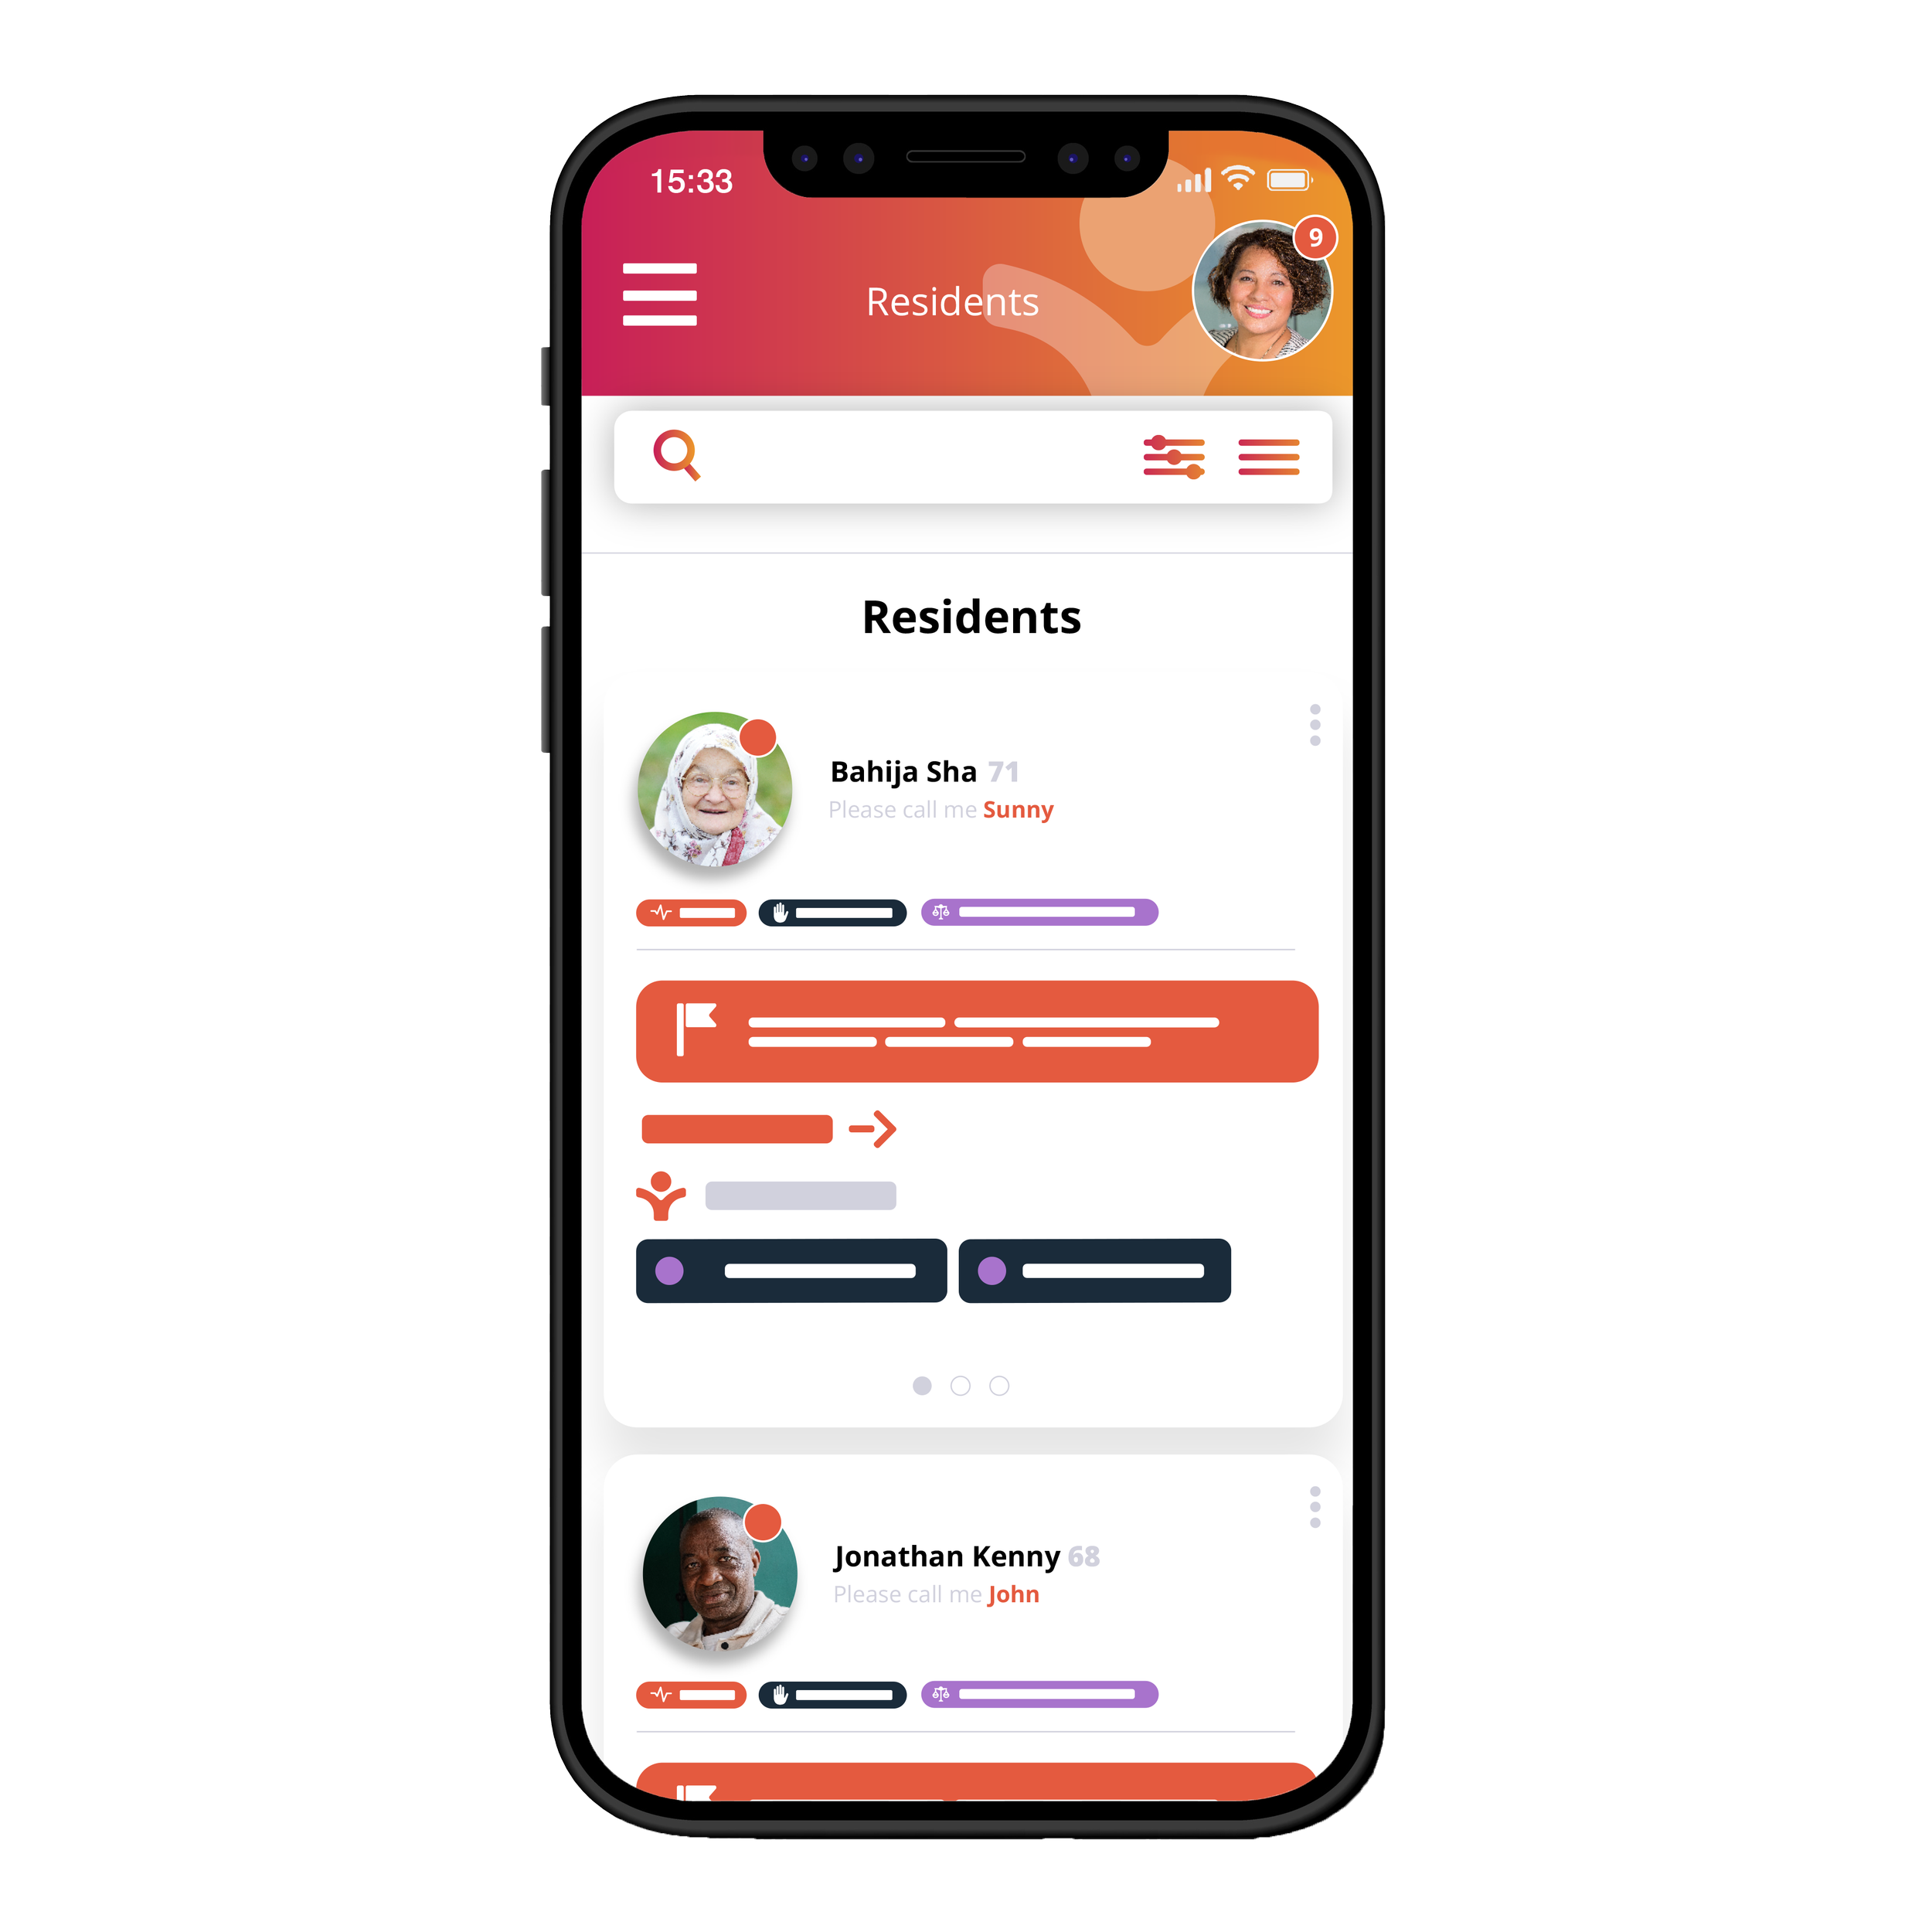
KareInn
Video Demonstration
Full demo available
Information taken from the Digitising Social Care Assured Solutions List and answers to a NWL questionnaire from KareInn on 17 April 2023
Setting Suitability
Care Homes | ✓
Domiciliary Care | ✕
Features
Digital care planning suite: person centred care plans, risk assessments, bespoke risk assessments Interactive body map: wound management, reporting, creams Flexible audit reports across KareInn as PDF or .CSV file Dedicated handover feature Wellbeing portal to share videos, photos and access relevant posts with loved ones
Interoperability
London Care Record
NHS Mail | ✕
London Urgent Care Plan | ✕
eMAR / pharmacy | ✓
Monitoring systems | ✕
EMIS | ✕
Health Information Exchange | ✕
GP Connect | *
Mobilisation & Installation | Training Offer | Data Migration
Aim for your home to be ready to use the software independently within 12 weeks​ Preparation and data migration (4 to 6 weeks) Training (1 to 3 days) Go-live (1 day) Post go-live coaching and support​ (6 weeks) In-house change management experts ​ Welcome pack with comms for staff/residents/families ​ Dedicated Account Manager, 24/7 Customer Service Success Manager, and project manager for large roll-outs Full implementation plan​ | Face to face training as standard Online training provided on a 1-hr sessional basis, free of charge​ A step-by-step process available on a shared project management dashboard​ Training & support team​ Online tutorials, guides and video library Able to support procedures modifications so that staff know how to access help and customer service​ Provides training on handling BAU enquiries in-house (user set up, password management, access levels)​ | £62 per resident Records never leave care setting ​ Provides, as needed, a transcription service to convert resident care plans as an alternative to using frontline team
Technology
Mobile application | ✓
Desktop application | ✕
Browser application | ✓
Works offline | ✕
Tech support available | ✓
Devices can be supplied | ✕
Own devices can be used | ✓
Illustrative Pricing (excl. VAT)
£8 per resident per month software license fees for the first 2 years​ £62 per resident for data migration. ​ Face to face training (1 day) is £500 + VAT (based on a 40-bed home)​ Where occupancy is significantly below registered numbers an agreed resident number will be made between the two parties​ A discount of up to 15%(£6.80 per resident/month) is available for customers who pay annually rather than via monthly direct debit
*HTML view integration in progress

Slide 19
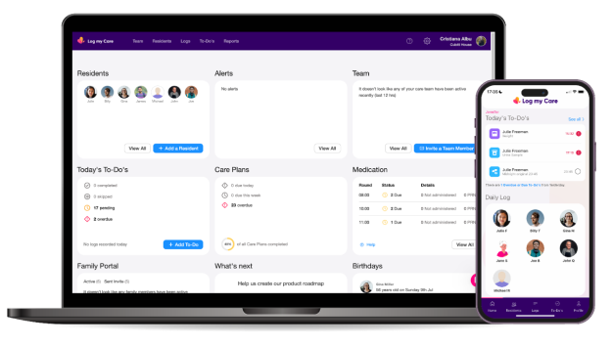
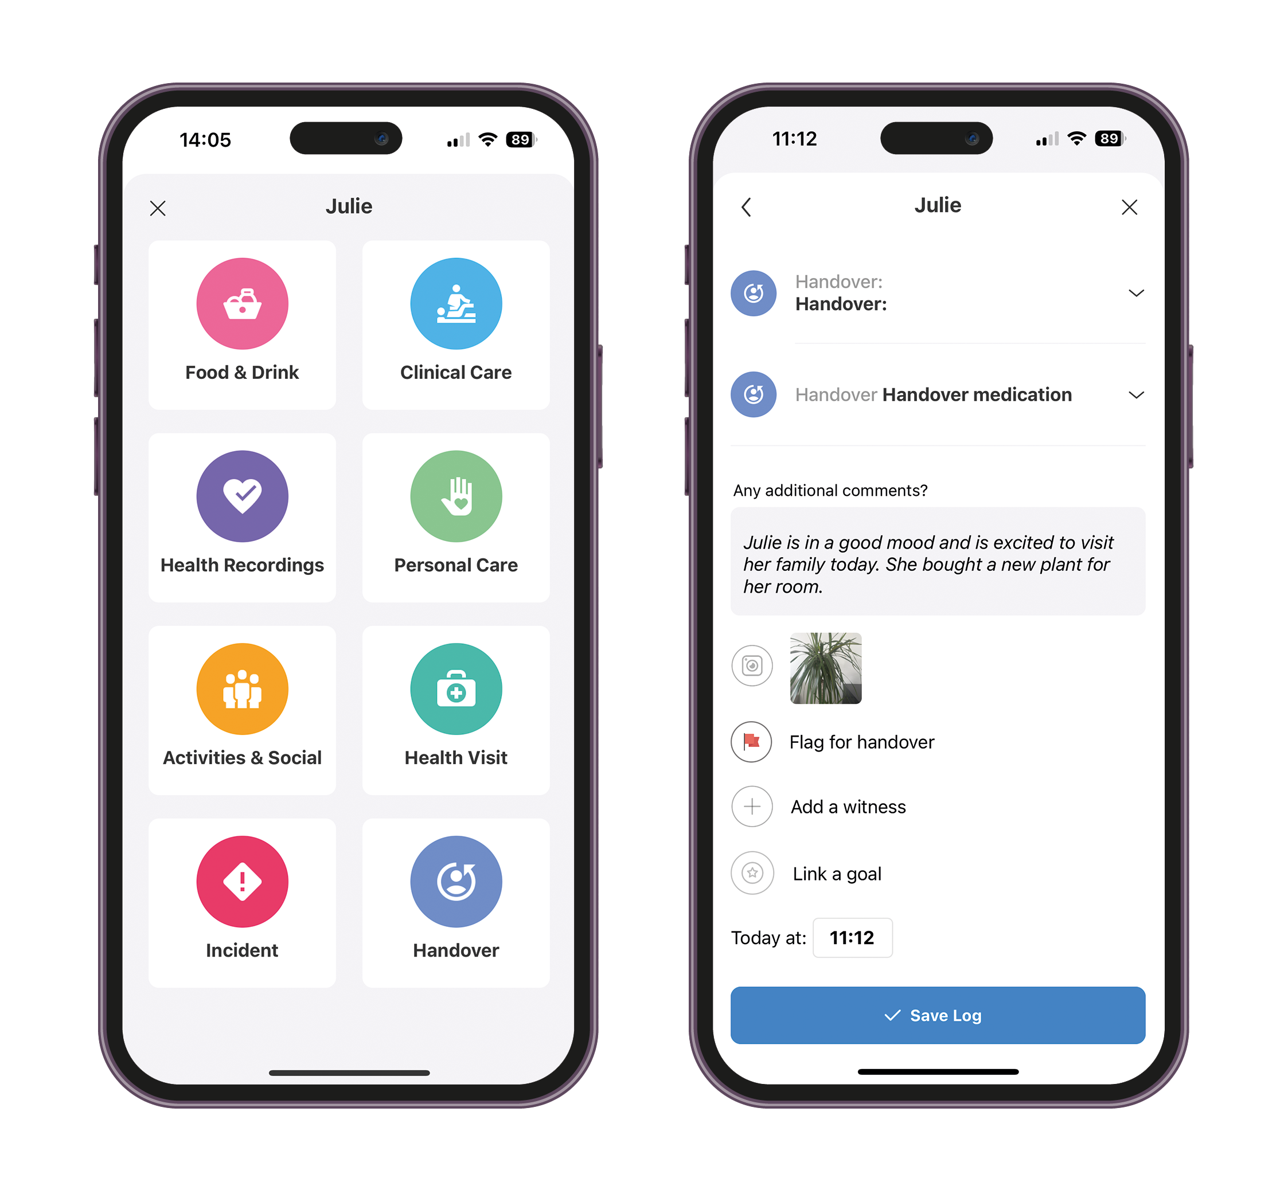
Log my Care
Video Demonstration
Full demo available
Information taken from the Digitising Social Care Assured Solutions List
Setting Suitability
Care Homes | ✓
Domiciliary Care | ✕
Features
care plans & risk assessments – 55+ customisable templates and the ability to create your own electronic daily logging and intuitive task scheduling reporting & self-auditing body maps, photos and videos – offering visual logs training & skills matrix handovers
Interoperability
London Care Record
NHS Mail
London Urgent Care Plan
eMAR / pharmacy | ✓
Monitoring systems
EMIS
Health Information Exchange
GP Connect | *
Mobilisation & Installation | Training Offer | Data Migration
Flexible - can use system in most basic form and add to system as needed. ​ Aim for your home to be ready to use the software independently within 4-6 weeks whether transitioning from a paper-based or digital system Introduction calls with Customer Success Executive System configuration (1-7 days) Data input (1-7 days) One-to-one training session (1-2 hours) Testing (1-7 days) Question and answer session with supplier (1 hour) | One-to-one training sessions Provides step-by-step tools & guides, videos and frequently asked questions via online portal Throughout implementation, provider can book calls with the assigned Customer Success Executive, access support guides and training videos and contact the support team 24/7 | Data input covered during implementation process
Technology
Mobile application | ✓
Desktop application | ✕
Browser application | ✓
Works offline | ✓
Tech support available | ✓
Devices can be supplied | ✓
Own devices can be used | ✓
Illustrative Pricing (excl. VAT)
No set up fee and free trial available ​ No limit on number of services users/staff​ Packages:​ Starter – free​ (basic functionality) Pro – sliding scale pricing annual & monthly: 1 active service user = £29.17/month + VAT up to 50 active service users = £5.83/month + VAT; Monthly: 1 active service user = £35.00/month + VAT up to 50 active service users = £7.00/month + VAT​ Group – multiple sites/more than 50 service users - bespoke quote on request​ Add-ons: eMAR: £2.30/month per active service user + VAT; Family portal: £1.80/month per active service user + VAT ​
*HTML view integration in progress

Slide 20
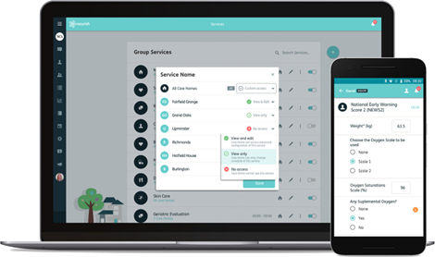
Nourish
Video Demonstration
Full demo available
Information taken from the Digitising Social Care Assured Solutions List
Setting Suitability
Care Homes | ✓
Domiciliary Care | ✓
Features
personalised & contextual care plans adapted to every individual link to public health systems like GP Connect and other industry-leading technology providers securer infrastructure, iso27001 & cyber essentials plus certification and cloud-based hosting role-based access 24/7 UK-based support, dedicated customer success manager and professional implementation team
Interoperability
London Care Record
NHS Mail
London Urgent Care Plan
eMAR / pharmacy | ✓
Monitoring systems | ✓
EMIS
Health Information Exchange
GP Connect | ✓
Mobilisation & Installation | Training Offer | Data Migration
Services are supported by personal onboarding support Offers three implementation options: Ready to go – out of the box best practice ideal for independent care providers. Self-serve, simple implementation, no training Standard training – ideal for independent care providers looking for some level of personalisation and customisation. This includes two days training for senior staff, and self-training for floor-staff. Legacy care plans are migrated in line with your normal monthly reviews, so you can start using Nourish from day one. Enterprise implementation including project management – ideal for medium to large groups or providers with a multitude of care types. Tailored experience for groups includes an orientation session at a higher level, redefinition of plans, and delivery of training either through Nourish or via a Train the Trainers’ route | Libraries of best practice tools flex to multiple care settings​ 1-2-1 training​ Dedicated Project Management and Customer Support teams Staff and train-the-trainers options available | Standard training implementation option includes migration of legacy care plans
Technology
Mobile application | ✓
Desktop application | ✕
Browser application | ✓
Works offline | ✓
Tech support available | ✓
Devices can be supplied | ✓
Own devices can be used | ✓
Illustrative Pricing (excl. VAT)
£2 Per licence per week​ £195 Per service per month (Alternative pricing for independent providers under 50 registered beds)​ | Implementation fee - £650.00​ Training day rate - £650.00 Lite handsets including 2 years of MDM - £200.00​ Premium handsets including 2 years of MDM- £329.00​ 25 QuickClose Tags - £50.00​

Slide 21
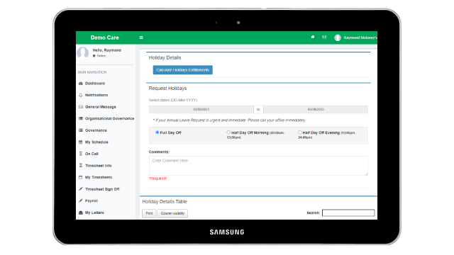
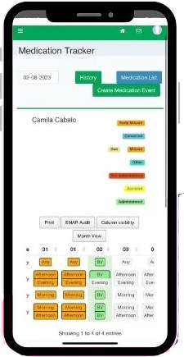
OneTouch
Video Demonstration
Full demo available
Information taken from the Digitising Social Care Assured Solutions List List and answers to a NWL questionnaire from OneTouch on 26 October 2023
Setting Suitability
Care Homes | ✓
Domiciliary Care | ✓
Features
CMS – one platform that supports the management of all care delivery needs, including staff data, client data, rostering, care plans, data capture, HR and financial management Scheduling – multiple scheduling tools available in real time for all care settings eMar – fully integrated electronic medication administration record tool Care plans – fully customisable or templated care plans/ assesments/ etc. for all care settings Reporting/auditing – full library of pre-configured reports and integrations i.e BI tools Task management – real-time task management and auditing for all aspects of care delivery Security – ISO 27001, ISO 9001, Cyber Essentials Plus Accreditations, NHS Toolkit
Interoperability**
OneTouch has an open API (Application Programming Interface) allowing integration with various CRM, ATS, Learning Management and Rostering software providers. GP Connect HTML view integration in progress
Mobilisation & Installation | Training Offer | Data Migration
Approximately two weeks accelerated implementation for core functionality, including: Gathering a detailed understanding of needs and goals, including technical and staff experiences, to match business and operational requirements (bespoke solutions available) Simple but secure data migration and mapping from legacy systems Providing appropriate support to make the transformation to digital processes as seamless as possible and keeping business-as-usual disruption to a minimum | Maintains an online knowledge centre with learning videos and modules Support team available to providers to help with any queries or support needs Additional training following implementation is available, based on the modules selected and priced accordingly. | Provides data migration support Add. info TBD
Technology
Mobile application | ✓
Desktop application | ✕
Browser application | ✓
Works offline
Tech support available | ✓
Devices can be supplied | ✓
Own devices can be used | ✓
Illustrative Pricing (excl. VAT)
Priced based on the number of active users, which is defined at any admin, management, and/or care staff member who uses OneTouch A reducing fee per user/per month is available based on scale. There is a one off implementation fee dependent on the size of the organisation, the number of branches or services, or via a phased implementation agreement Any tech development requests are scoped out and priced prior to commencement of any work.

Slide 22
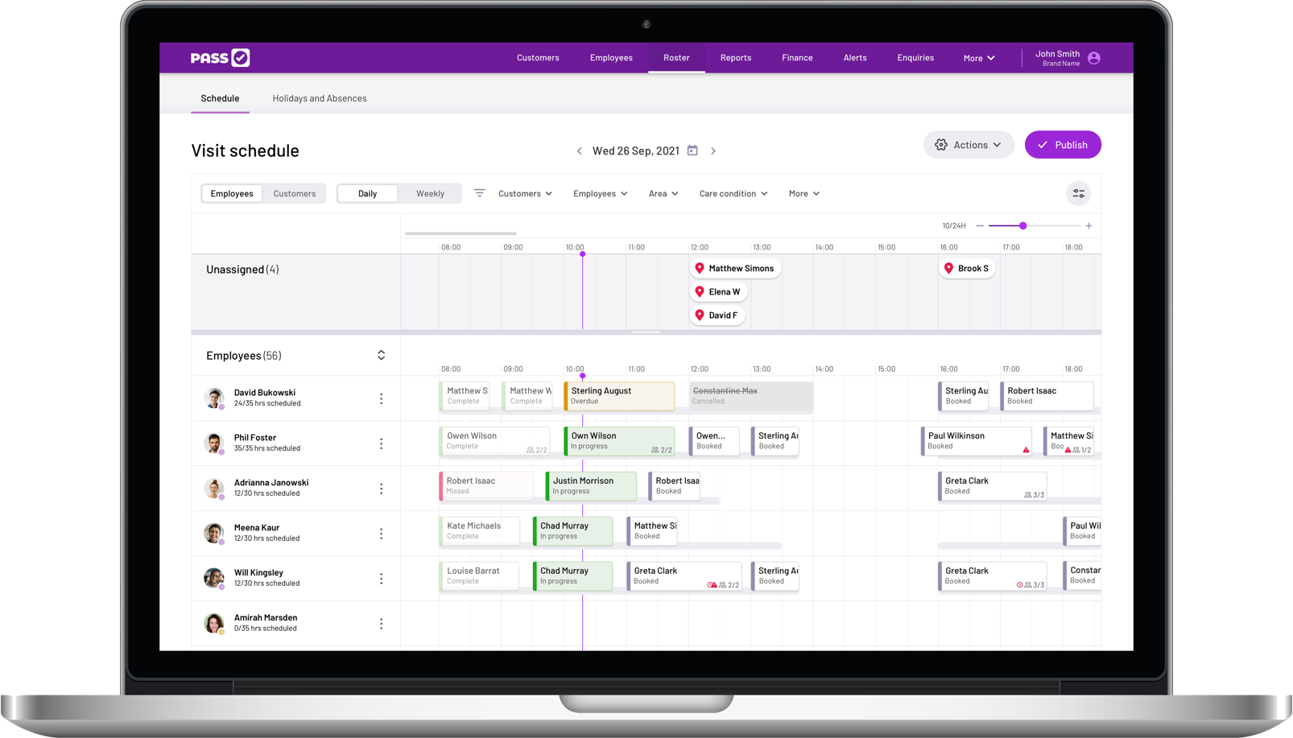
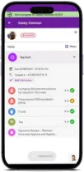
PASS by everyLIFE
Video Demonstration
Full demo available
Information taken from the Digitising Social Care Assured Solutions List and answers to a NWL questionnaire from everyLIFE on 27 March 2023
Setting Suitability
Care Homes | ✓
Domiciliary Care | ✓
Features
For carers: bodymaps, speech-to-text, photos, assessments and observation tools, incident reporting For managers: timeline of care, review dates, real time audit trail, outcome tracking A record that can be interpreted by auditors to establish that an activity has taken place Document builder to create bespoke templates and tailor the pre-built document suite Real time reporting Safer medication management
Interoperability
London Care Record
NHS Mail | ✕
London Urgent Care Plan | ✕
eMAR / pharmacy | ✕
Monitoring systems | ✕
EMIS | ✕
Health Information Exchange | ✕
GP Connect | ✓
Mobilisation & Installation | Training Offer | Data Migration
Timescales vary, but aim to implement at a single ‘office’ within 30 days of contract signature Personal onboarding support​ Flexible implementation by design Implementation starts with a Project Kick Off meeting to define scope of the roll out and sets target go-live dates managed by a project manager. Roll out can be batched for multiple sites. Regular reviews will be held throughout the onboarding period | Tools and guides online ​ ‘Train the trainer’ approach for large organisations ​ Tailored training packages Blended learning package, incorporating online & face-to-face​ training 1 to 1 training for new starters​ Offers a range of free of charge programmes including weekly webinars and master classes Assessment tests available for online training A dedicated Account Manager will be assigned after Go-Live | Can support data migration via the ‘Launch’ Project Managers for: paper based/Word/Excel/digital care management system from another software supplier. ​
Technology
Mobile application | ✓
Desktop application | ✕
Browser application | ✓
Works offline | ✓
Tech support available | ✓
Devices can be supplied | ✓
Own devices can be used | ✓
Illustrative Pricing (excl. VAT)
Sliding scale service charge based on number of users (monthly or annual payment schedule). Service charges include software licensing, software upgrades, account management and customer support.​ One-off up-front implementation charge covers project management, technical system build and training. ​ Additional offices after the first built within implementation - £195.00 per office build (DSCR only), £250.00 per office build (DSCR with rostering)
Care Homes (more service user bands available) ​
Service users ​ | Price per month (DSCR only) ​ | Price per month (+Rostering)
Up to 15 | £180.00 | £360.00
16-50 | £6.60 per service user | £13.20 per service user
51-150 | £4.20 per service user | £8.40 per service user
151+ | £3.70 per service user | £7.40 per service user

Slide 23
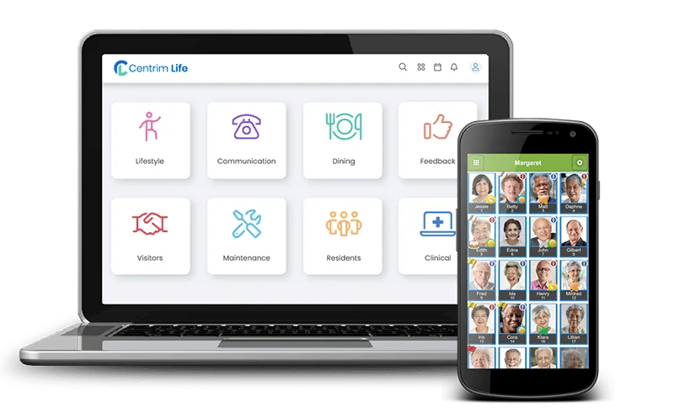
Person Centred Software
Video Demonstration
Full demo available
Information taken from the Digitising Social Care Assured Solutions List and answers to a NWL questionnaire from PCS on 22 March 2023
Setting Suitability
Care Homes | ✓
Domiciliary Care | ✓
Features
Accidents and incidents Post falls observations Interactive body map Fluid and nutrition monitoring SNOMED compliant structured care notes Organisation configuration Speech to text and text to audio Photo stream and video upload Relatives gateway Messaging and Alerts | Task allocation Group reporting Skills and capacity planning Bespoke and flexible reporting Staff training, experience, and skills reporting Accessible information Residents’ goals and outcomes Role-based access IP address whitelist Mobile Device Management
Interoperability
London Care Record | ✓
NHS Mail | ✓
London Urgent Care Plan | ✓
eMAR / pharmacy | ✓
Monitoring systems | ✓
EMIS | ✓
Health Information Exchange | ✓
GP Connect | ✓
Mobilisation & Installation | Training Offer | Data Migration
The typical implementation process takes 4-6 weeks (includes onboarding activities, training, and the transfer of data (whether from paper or an electronic system).​ Example Implementation Plan: ​ -2 weeks – arrange training with dedicated Client Success Manager, receive physical and electronic resources and posters to notify of change; ​ -1 Week – import staff & service users, set up handsets to wifi, technical check; ​ Go Live – Implementation Day. Monitor & Handset training; ​ +1 Week – Progress Review with a member of the Training Team; ​ +2 Weeks – Remote Care Planning Training +4 Weeks – Senior managers Reports training and Implementation Sign Off. ​ | Initial implementation training followed up by shorter training sessions for senior staff around the digital care planning process.​ Online tools, guides and webinars Online and/or onsite training days and remote system health checks ​ Train the trainers course Standard or bespoke training packages available, including managing users, using devices, care planning and creating reports. ​ | Offers a data migration experience. However, this is specific to the existing systems in place so is agreed on a customer specific basis.​
Technology
Mobile application | ✓
Desktop application | ✕
Browser application | ✓
Works offline | ✓
Tech support available | ✓
Devices can be supplied | ✓
Own devices can be used | ✓
Illustrative Pricing (excl. VAT)
Digital care planning starter pack: £7.20 per bed/month Hand held device for nurses and carers (inc. device, 2 batteries, charge racks and free replacement for any damages, lost or faulty) - £36 per device/month ​ Digital care planning training - free per home, one-off (online). Onsite at an additional day rate ​ System set up elearning training - £12.50 p/home p/month ​ Various training courses available at a monthly/yearly rate. ​ Integrations with other digital solutions - £18 per home, per month​ | Free add-ons: GP Connect; Relatives Gateway; eRed Bag; System set up ​ Priced add-ons:​ ATLAS eMAR - £6 per bed/month ​(+£625 training per home) ATLAS GP - £1 per bed/month ​ Care sector benchmarking - £80 per home/month ​ Digital reception - £36 per home/month ​ Nurse call messaging - £120, per home/month ​ Action plans and audits - £2 per bed/month

Slide 24
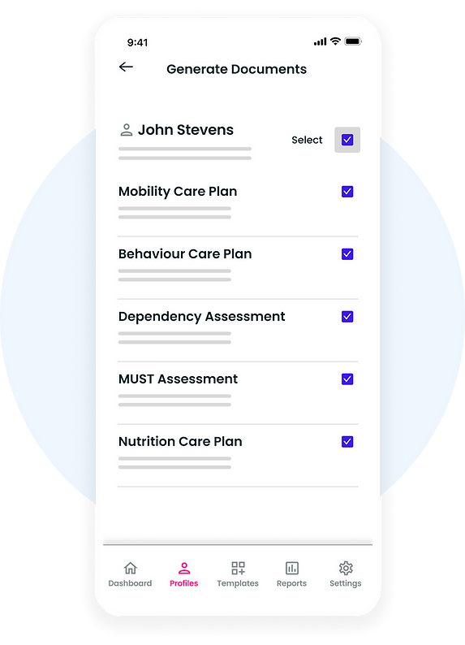
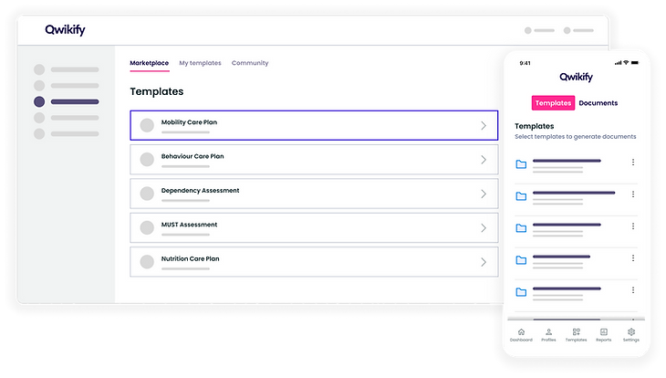
Qwikify
Video Demonstration
Try for free
Information taken from the Digitising Social Care Assured Solutions List
Setting Suitability
Care Homes | ✓
Domiciliary Care | ✕
Features
Automatically generate draft care plans in minutes and easily integrate manual changes Structured workflows and smart templates to support care plan quality Systematically update care plans and assessments from a single source of truth to improve compliance Simultaneously generate multiple care plans and assessments from a single source of truth Question prompts ensure consistency between users and across documents Edit, make manual amendments and regenerate your documents Includes care plans, assessments, forms, charts, tasks, notes and reports Review and approve documents, keep an audit trail version history of all changes
Interoperability
London Care Record
NHS Mail
London Urgent Care Plan
eMAR / pharmacy
Monitoring systems
EMIS
Health Information Exchange
GP Connect | *
Mobilisation & Installation | Training Offer | Data Migration
Providers requiring a standard configuration can self-service onboard without any training, which can be implemented within days. Tailored implementation plans available for providers who require customisation, additional training, data migration or consultancy. Timescales will depend on specific requirements. Providers can become development partners to deliver specific features and requirements. This can be an attractive option for organisations seeking to transition from either paper or an alternative digital care planning solution at a future date. Timescales will depend on the scope of the requirements and the customer target date for the transition. | Further information available from supplier | Further information available from supplier
Technology
Mobile application | ✓
Desktop application | ✕
Browser application | ✓
Works offline | ✓
Tech support available
Devices can be supplied
Own devices can be used | ✓
Illustrative Pricing (excl. VAT)
Further information available from supplier
*HTML view integration in progress

Slide 25
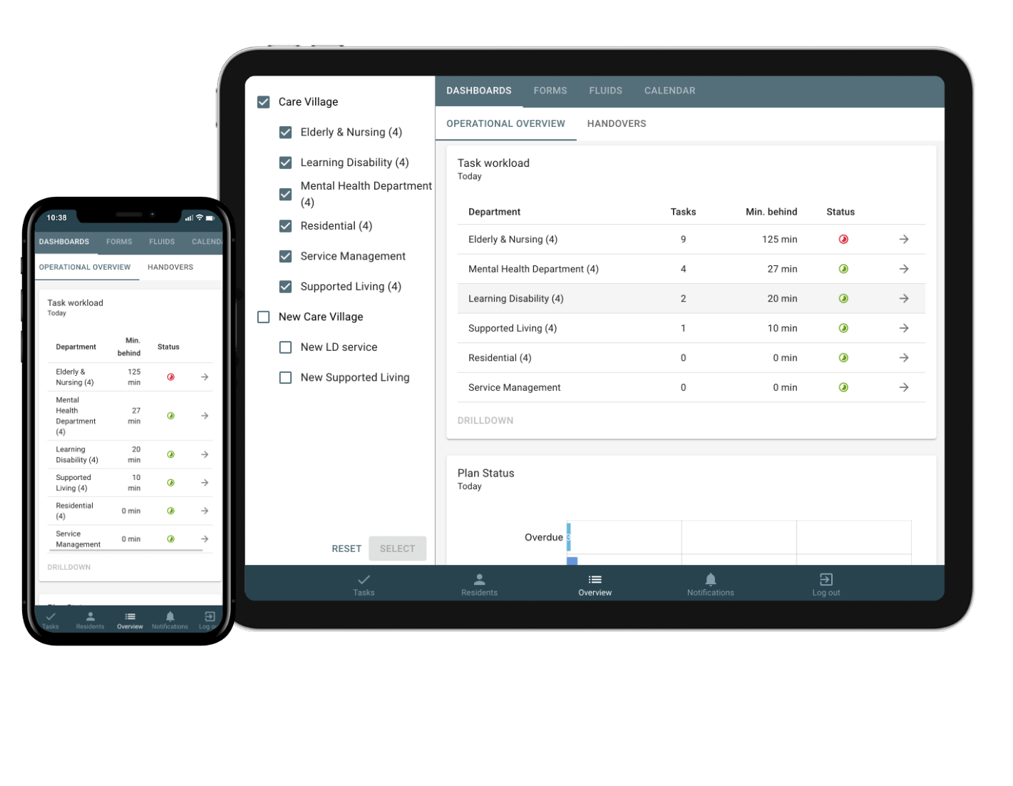
Sekoia
Video Demonstration
Full demo available
Information take from the Digitising Social Care Assured Solutions List and answers to a NWL questionnaire from Sekoia on 23 March 2023
Setting Suitability
Care Homes | ✓
Domiciliary Care | ✓
Features
Care and support plans aligned to the provider’s current framework, or using available best practice templates Care delivery routines personalised to each person being supported Care delivery notes and observations Risk assessments aligned to the provider’s current framework or available best practice templates Use photos, pictures and videos personalised to the person being supported Families can engage with Sekoia to share photos, calendars, and send messages to stay in touch The person being supported can access Sekoia to view their daily routines/plans Speech to text
Interoperability
London Care Record
NHS Mail | ✕
London Urgent Care Plan | ✕
eMAR / pharmacy | ✕
Monitoring systems | ✕
EMIS | ✕
HIE | ✕
GP Connect | *
Mobilisation & Installation | Training Offer | Data Migration
Phased implementation plan (includes technical clarification, management decisions, timetable for onboarding, kick-off)​ Approx. 6 weeks timeline for an average home, this can be quicker/longer, depending on the time the provider can dedicate to populating the system. Provides hands-on implementation and training with a dedicated onboard manager Offering support as needed at implementation and on an ongoing basis. Supplies Industry Standard Frameworks and best practices for providers to start from and build/develop their usage further. ​ | Onboarding all staff and managers​ (1 hour kick off) Offers 4 x 2 hour super user trainings followed by 1.5 hour staff sessions Unlimited training and support available Offers check-ins and networks​ Best practice guides in ‘help centre’ ​ Remote-first approach, in person on request New starters can watch recorded trainings | Sekoia does not support data migration
Technology
Mobile application | ✓
Desktop application | ✕
Browser application | ✓
Works offline | ✕
Tech support available | ✓
Devices can be supplied | ✓
Own devices can be used | ✓
Illustrative Pricing (excl. VAT)
Charge per resident or service user per month is £10 + VAT, covering all modules and all ongoing support / new releases with no hidden extras or add-ons. ​ Offers Group Licence Fee discounts for larger groups and a discount for paying annually upfront. ​ Charges a one off implementation fee, depending on the size of organisation and how much set up / training is involved, ranging £1,000 to £4,000
*HTML view integration in progress

Slide 26
Appendix

Slide 27
Features at a Glance
 | Suitable for Care Homes | Suitable for Domiciliary Care | Devices can be supplied | Software can work offline | Supplier supports data migration | On demand eLearning platform available
Access Care/Clinical | ✓ | ✕ | ✓ | ✓ | ✓ | ✓
Access Care Planning | ✕ | ✓ |  | ✓ |  | ✓
birdie | ✕ | ✓ | ✕ | ✓ | ✓ | ✓
Carebeans | ✓ | ✓ | ✓ | ✓ | ✓ | ✓
Careberry | ✓ | ✓ | ✕ | ✕ | ✕ | ✕
Care Control Systems | ✓ | ✕ | ✓ | ✓ | ✓ | ✓
Care Vision | ✓ | ✓ | ✓ | ✓ | ✓ | ✓
CareLineLive | ✕ | ✓ | ✓ | ✓ | ✓ | ✓
Cura Systems | ✓ | ✕ | ✓
Dom Portal | ✕ | ✓ |  | ✓ |  | ✓
Fusion eCare Solutions | ✓ | ✕ | ✓ | ✓ | ✓ | ✕
iPlanit | ✓ | ✓ | ✕ | ✓ | ✕ | ✓
KareInn | ✓ | ✕ | ✕ | ✕ | ✓ | ✓
Log my Care | ✓ | ✕ | ✓ | ✓ | ✓ | ✓
Nourish | ✓ | ✓ | ✓ | ✓ | ✓ | ✓
OneTouch | ✓ | ✓ |  |  | ✓ | ✓
PASS | ✓ | ✓ | ✓ | ✓ | ✓ | ✓
Person Centred Software | ✓ | ✓ | ✓ | ✓ | ✓ | ✓
Qwikify | ✓ | ✕ |  | ✓
Sekoia | ✓ | ✓ | ✓ | ✕ | ✕ | ✕

Slide 28
Assured Solutions Contacts and Information
Supplier | Contact | Website | Assured List Profile
Access Care/Clinical | lloyd.evans@theaccessgroup.com 07808 774136 | https://www.theaccessgroup.com/ | https://beta.digitisingsocialcare.co.uk/assured-solutions/access-care-clinical
Access Care Planning | victoria.myers@theaccessgroup.com kristaps.bumburs@theaccessgroup.com 0845 345 3300 | https://www.theaccessgroup.com/ | https://beta.digitisingsocialcare.co.uk/assured-solutions/access-care-planning
Birdie | enquiries.dps@birdie.care | https://www.birdie.care/ | https://beta.digitisingsocialcare.co.uk/assured-solutions/birdie
Carebeans | jeremy@carebeans.co.uk; carl@carebeans.co.uk 01925 386802 | https://www.carebeans.co.uk/ | https://beta.digitisingsocialcare.co.uk/assured-solutions/carebeans-care-software
Careberry | info@mycareberry.com 0330 880 1090 | https://mycareberry.com/ | https://beta.digitisingsocialcare.co.uk/assured-solutions/careberry-software
Care Control Systems | sales@carecontrolsystems.co.uk 01822 738100 | carecontrolsystems.co.uk | https://beta.digitisingsocialcare.co.uk/assured-solutions/care-control-systems
Care Vision | rishi@care-vision.co.uk 020 8768 9809 | care-vision.co.uk | https://beta.digitisingsocialcare.co.uk/assured-solutions/care-vision
CareLineLive | Sales: sales+dsc@carelinelive.com / 03300 885 767 SDR Team Lead: gg@carelinelive.com / 03300 885 767 | https://carelinelive.com/ | https://beta.digitisingsocialcare.co.uk/assured-solutions/carelinelive
Cura Systems | John.rowley@cura.systems 020 3621 9111 | https://cura.systems/ | https://beta.digitisingsocialcare.co.uk/assured-solutions/cura-systems
Dom Portal | A G Prashant: manager@domportal.care +44 782 201 3140 | https://www.domportal.care/ | https://beta.digitisingsocialcare.co.uk/assured-solutions/dom-portal

Slide 29
Assured Solutions Contacts and Information
Supplier | Contact | Website | Assured List Profile
Fusion eCare Solutions | info@fusionecs.co.uk 01133 979 555 | https://fusionecare.com/ | https://beta.digitisingsocialcare.co.uk/assured-solutions/fusion-ecare-solutions-ltd
iPlanit | enquiry@aspirico.com 020 3693 7500 | https://aspirico.com/iplanit/ | https://beta.digitisingsocialcare.co.uk/assured-solutions/iplanit-aspirico
KareInn | Justine Ellory: hello@kareinn.com 0800 970 5185 | https://kareinn.com/ | https://beta.digitisingsocialcare.co.uk/assured-solutions/kareinn
Log my Care | sales@logmycare.co.uk | https://www.logmycare.co.uk/ | https://beta.digitisingsocialcare.co.uk/assured-solutions/log-my-care
Nourish | getintouch@nourishcare.co.uk | nourishcare.co.uk | https://beta.digitisingsocialcare.co.uk/assured-solutions/nourish
OneTouch | Louis Coyne: louis@onetouchhealth.net / +353 87 777 9598 Cillian Kelleher: cillian@onetouchhealth.net / +353 87 777 9598 | https://www.onetouchhealth.net/ | https://beta.digitisingsocialcare.co.uk/assured-solutions/onetouch
PASS | hello@everylifetechnologies.com | everylifetechnologies.com/ | https://beta.digitisingsocialcare.co.uk/assured-solutions/pass-everylife
Person Centred Software | hello@personcentredsoftware.com 01483 357 657 | personcentredsoftware.com | https://beta.digitisingsocialcare.co.uk/assured-solutions/person-centred-software
Qwikify | info@qwikify.com 0800 689 3596 | www.qwikify.com | https://beta.digitisingsocialcare.co.uk/assured-solutions/qwikify
Sekoia | contact@sekoia.co.uk (0)20 7751 4010 | https://sekoia.co.uk/ | https://beta.digitisingsocialcare.co.uk/assured-solutions/sekoia-ltd

