Slide 1
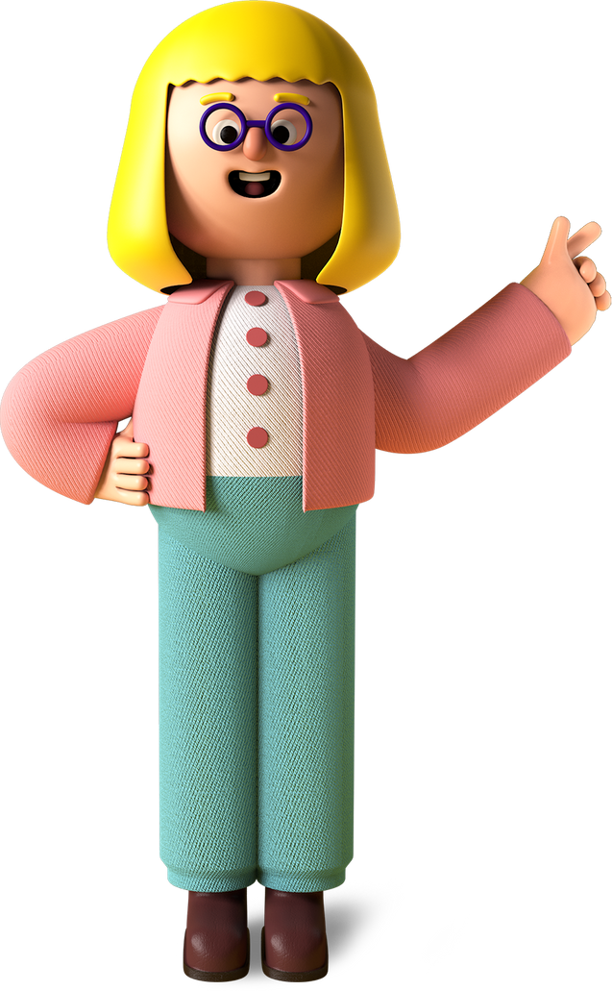
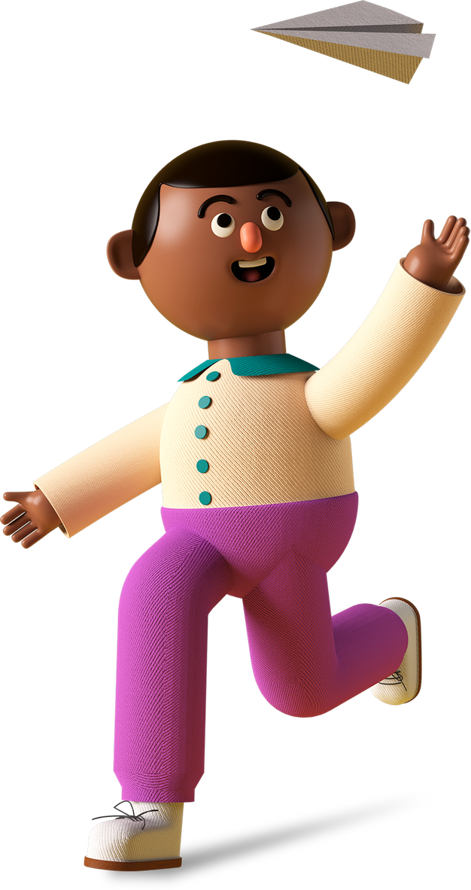
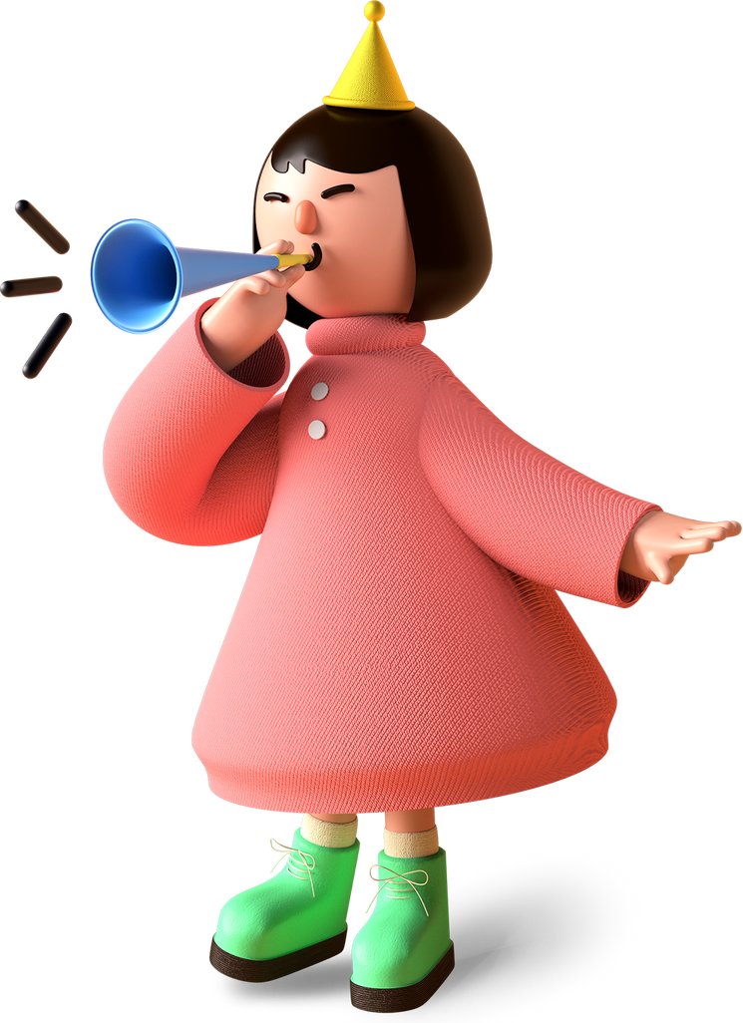
EQUITY DIVERSITY& INCLUSION
IN HEALTH AND SOCIAL CARE
Notes:
With issues around staff shortages retention and recruitment presently in the sector after almost 2 years from the start of the pandemic, the topic of inclusion couldn't be more timely
We all want a workplace which is happy,
successful, motivated, no concerns such as bullying, harassment and discrimination
Well have you ever thought how a happy and an inclusive workforce can help

Slide 2
Dudley Sawyerr
(He, Him )
https://mynameis.raceequalitymatters.com/
Notes:
– Many people may have left room after the first two steps but let’s act upon what we have learnt and put it into action. It always great to talk about it but we all can make a difference putting what we have learnt into practise.
put things like asking how you pronounce someone’s name or ask what they liked to be called is a way of making someone be made to feel inclusive

Slide 3
Health & Social Care Consultant and Business Strategist at People Care Services
Chair for the Registered Managers Groups LCaS across 14 London Boroughs to facilitate and drive change.
Working with the NHS to engage Social Care staff and community in the Keeping Well London project.
Champion of diversity and inclusion for change and is engaging in some research projects around Dementia to help with future direction for government bodies.
The Race Equity Reference Group Co-Chair (Skills For Care)

Slide 4
The Facts
People from ethnic minority communities account for one in five of the adult social care workforce in England and play a vital role in the day-to-day care of people in our communities.
In CQC’s State of Care report in October 2022, reported that inequalities pervade and persist
Data from the Office for National Statistics shows that in 2018 to 2020, highlighted people who are more likely to face inequalities in access and experience when using health and care services, including:
People from an ethnic minority group
People who have a long-term condition
Autistic people or people who have a learning disability
Children and young people.

Slide 5
There are lots of different characteristics that set individuals apart from each other, such as someone’s ethnicity or religion, their gender and sexuality, age or if they have a disability. All these characteristics could lead to varying levels of discrimination and privilege.

Slide 6
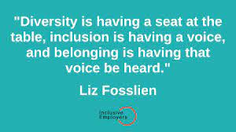

Slide 7
H&F DEMOGRAPHICS
Ethnicity:
Population showed an increase in non-white residents and a decrease in white residents.
7.3% of Hammersmith and Fulham residents identified their ethnic group as other
12.3% identified their ethnic group within the "Black, Black British, Black Welsh, Caribbean or African" category.
10.5% identified their ethnic group within the "Asian, Asian British or Asian Welsh
6.7% identified as mixed or multiple ethnic groups
Age:
Over 10% of the population are over 65
16% are between 50 – 64
Disability:
In 2021, 15.5% of Hammersmith and Fulham residents were identified as being disabled.
Religion:
There has been a decrease in Christianity and a rise in other religion’s including No- religion.

Slide 8
Culturally appropriate care
Culturally appropriate care (also called 'culturally competent care') is sensitive to people's cultural identity or heritage. It means being alert and responsive to beliefs or conventions that might be determined by cultural heritage.
Cultural identity or heritage can cover a range of things. For example, it might be based on ethnicity, nationality or religion. Or it might be to do with the person's sexuality or gender identity. Lesbian, gay, bisexual and transgender people have a particular culture. So do Deaf people who use British Sign Language.
The regulations culturally appropriate care is relevant to are:
Regulation 9: Person centred care
Regulation 10: Dignity and respect
Regulation 11: Need for consent

Slide 9
What are the legal obligations with equality in an organisation?
Since 2010, the Equality Act has provided the legal framework for protecting individuals from unfair treatment.
The employer, must ensure that their processes and policies comply with the Equality Act. Failure to do so can raise a claim of unlawful discrimination, which could result in then and the organisation being summoned to an employment tribunal.
It’s also important to be aware that, as an employer, they could be found vicariously liable for actions of your employees which breach the Equality Act – regardless of whether they were aware of them.
To fully protect your employees and business from discrimination, it is critical to understand the Equality Act as well as ensuring that their workplace culture is actively inclusive.

Slide 10
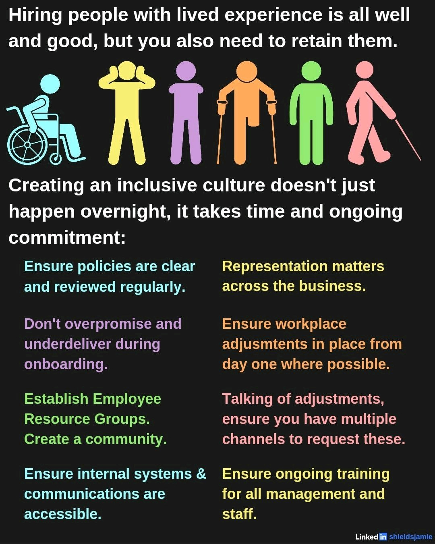

Slide 11
HOW DO SYSTEMS AND PRACTICES LEAD TO INEQUALITY?
As manager in social care resources are deployed to support both staff and clients.
ROLE AND RESPONSIBILITY OF MANAGERS IN RELATION TO EDI

Slide 12
DATA & MONITORING
Identify data that could be collated in your organisation to monitor equality, diversity, inclusion
Identify ways to monitor and report equality, diversity, inclusion outcomes to stakeholders

Slide 13
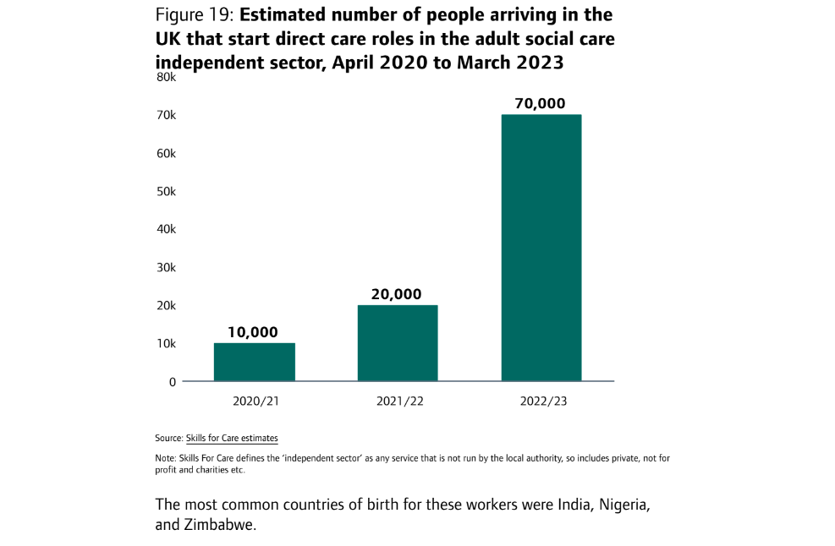

Slide 14
THINGS WE CAN DO?
Blind recruitment
Scoring
Objective interview processes
Inclusion statements in job adverts:
“As an equal opportunities employer, we are committed to the equal treatment of all current and prospective employees and does not condone discrimination on the basis of age, disability, sex, sexual orientation, pregnancy and maternity, race or ethnicity, religion or belief, gender identity, or marriage and civil partnership. We aspire to have a diverse and inclusive workplace and strongly encourage suitably qualified applicants from a wide range of backgrounds to apply and join us.”

Slide 15
complain directly to the person or organisation
1
use someone else to help you sort it out (called ‘mediation’ or ‘alternative dispute resolution’)
2
make a claim in a court or tribunal
3
Contact the Equality Advisory Support Service for help and advice.
4
Discrimination at work
Employees should talk to their employer first to try and sort out the
problem informally. You may also want to read about workplace disputes.
If things cannot be sorted out informally, talk to Acas, Citizens Advice or a trade
union representative.
What you can do if you think you’ve been unfairly discriminated against you can:

Slide 16
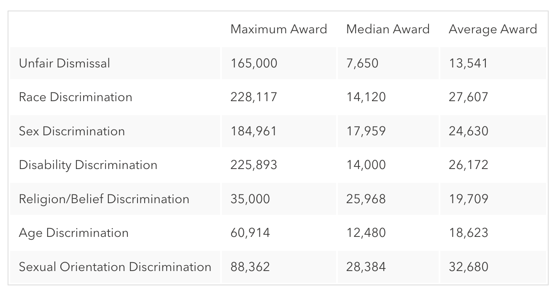
Annual award statistics for 2021/2022
What is the cost to an organisation?
The maximum award was £228,117 for a race discrimination case.
The second highest discrimination award was for a similar amount - £225,893 - in a disability discrimination case.

Slide 18
Embedding EDI in the workplace
Flexible working
unconscious bias training
Develop policies and procedures that support equality and diversity
Build into recruitment process
Training on equality and diversity

Slide 20
HENRY – VIDEO ON DEMENTIA AND MUSIC –BRINGING ABOUT AMAZING RESULTS
https://youtu.be/RcbddBfoaG4?si=jO4alw5J6xW2nH7A

Slide 21
Activity
What does Equality, Diversity and Inclusion look like in place of work?
How do you practically deliver Equality, Diversity and Inclusion?
Give examples of how you do?

Slide 22
Thank you!
PLEASE GET INTOUCH
FOR FURTHER SUPPORT
Dudley Sawyerr
dudley@peoplecareservices.com

