Slide 1
Keeping Well - Providing psychological and wellbeing support for health and social care staff in North West London
Support options for staff psychological wellbeing

Slide 2
Staff Mental Health and Wellbeing Hubs
Wellbeing hubs for healthcare staff (NHS and social care) were set up in the initial stages of the Covid-19 pandemic and operate across England. The hub offer is confidential and free of charge for all healthcare staff.
https://www.england.nhs.uk/supporting-our-nhs-people/support-now/staff-mental-health-and-wellbeing-hubs/
NHS England define the following priorities for all hubs:
1) Deliver proactive outreach and engagement
2) Provide rapid clinical assessment
3) Provide onward referral and care co-ordination to deliver rapid access to mental health services and support
Keeping Well North West London offer rapid psychological assessment, brief advice and emotional support, signposting and onward referral for NHS and Social Care staff working in this area.
We support staff working and/or living in eight boroughs - Ealing, Hammersmith and Fulham, Hounslow, Kensington & Chelsea, Harrow, Hillingdon, Westminster and Brent.

Slide 3
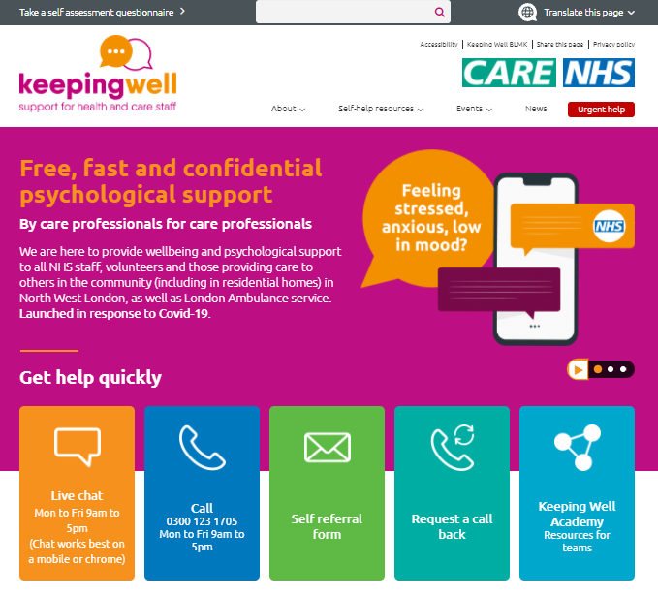
Keeping Well offer for individuals
Specialist signposting and information including self-help resources
Advice and support
Onward referrals (NHS, third sector or specialist services)
Priority access to NWL IAPT services
Care navigation to help staff into and engage with external services
Mindfulness sessions (group or 1:1)
Long Covid support (3 group offers available)
Follow up

Slide 4
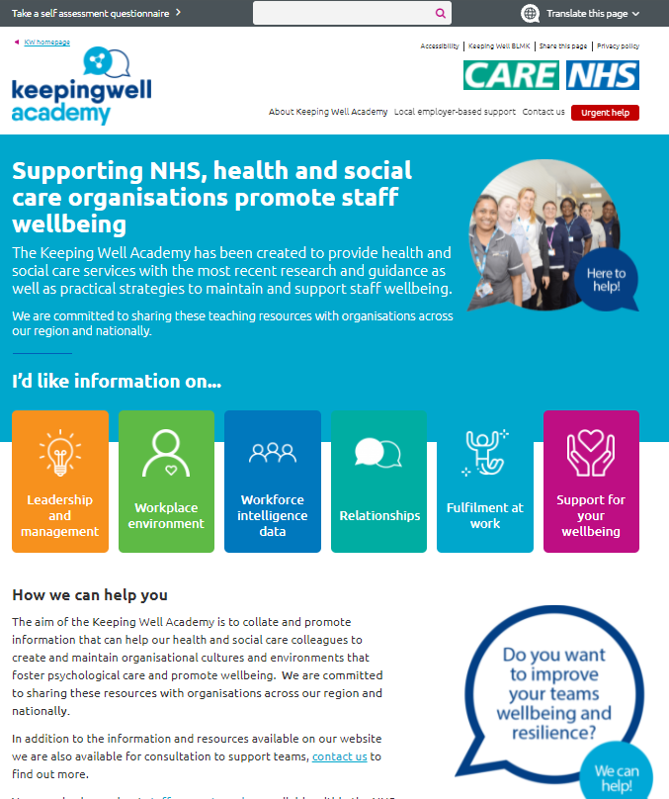
Keeping Well offer for teams and organisations
Keeping Well Academy – resources specifically for managers, teams and organisations on how to support employees’ mental wellbeing
Consultations with teams and support for managers
Presentations and wellbeing workshops for teams – previous topics included ‘stress management and preventing burnout’, ‘maintaining a work-life balance’, ‘improving posture at work’ etc.
Group/team mindfulness sessions with Peter Helmer
Future plan is to run Wellbeing Champion Training (1.5 hours) for social care – if interested, please let us know by emailing us and we will send information once it is finalised

Slide 5
National & local offers
Samaritans wellbeing support line for health and social care staff –provide confidential, non-judgmental support. Open 7am to 11pm, 7 days a week call 0800 069 6222
Wellness Action Plan - A personalised and practical tool for employees to use to identify how to address what keeps individuals mentally well at work and what can result in poor mental health. It also opens up a dialogue, helping supervisors better understand the needs and experiences of employees.
Tavistock and Portman Relationship Support – free short-term online individual or couples’ counselling for all NHS staff and social care workers.
IAPT services – health and social care staff can refer to local service or through KW NWL hub for priority mental health support.

Slide 6
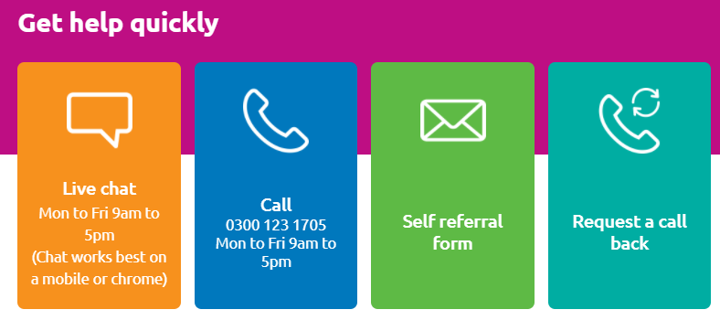
How to get help
Your organisation may already have some support mechanisms in place but sometimes you may need more personal help. You can get in touch with the Keeping Well team by:
www.keepingwellnwl.nhs.uk

Slide 7
Any questions?
Email: Keepingwell.nwl@nhs.net

